Slide 1
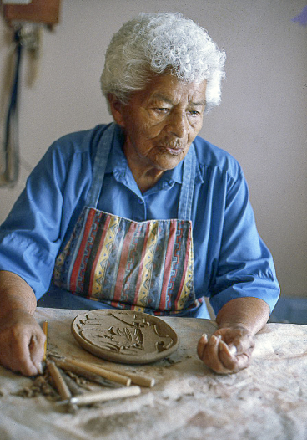
HOME: Native People in the Southwest
“From this work our life is brought forth,”
Madeline Naranjo, Santa Clara

Slide 2
Making HOME: Consultations
2000 and 2001, two general advisory meetings. One at the Heard with 22 attendees from 19 Arizona tribes, and one at IAIA in New Mexico with 20 attendees.
Identified primary themes: Family, community, land, language and assertion that “we are still here.”
With core advisors, developed a structured interview instrument.
Dr. Tessie Naranjo and Gloria Lomahaftewa interviewed and recorded 47 people in New Mexico and Arizona respectively in 2002 and 2003. Some of the recordings are in the Community section of touch screens.
A Nathan Cummings grant paid for 56 people in 2003 and 2004 to review our collection and select and comment on pieces to be exhibited. Video taped commentary for touch screens.
Visited 10 community museums.

Slide 3
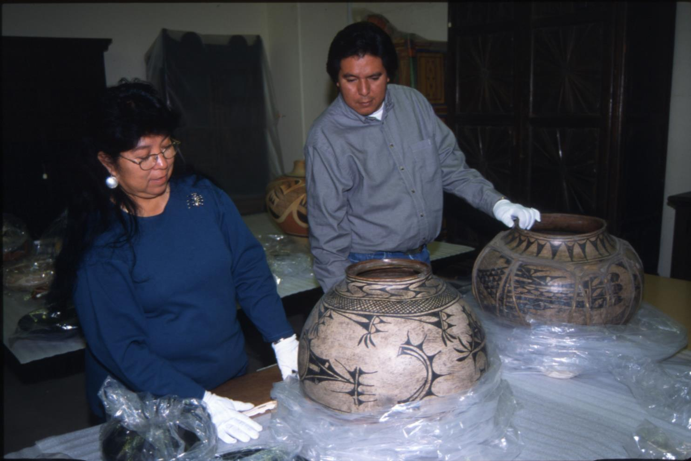

Slide 4
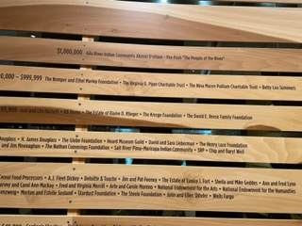

Slide 5
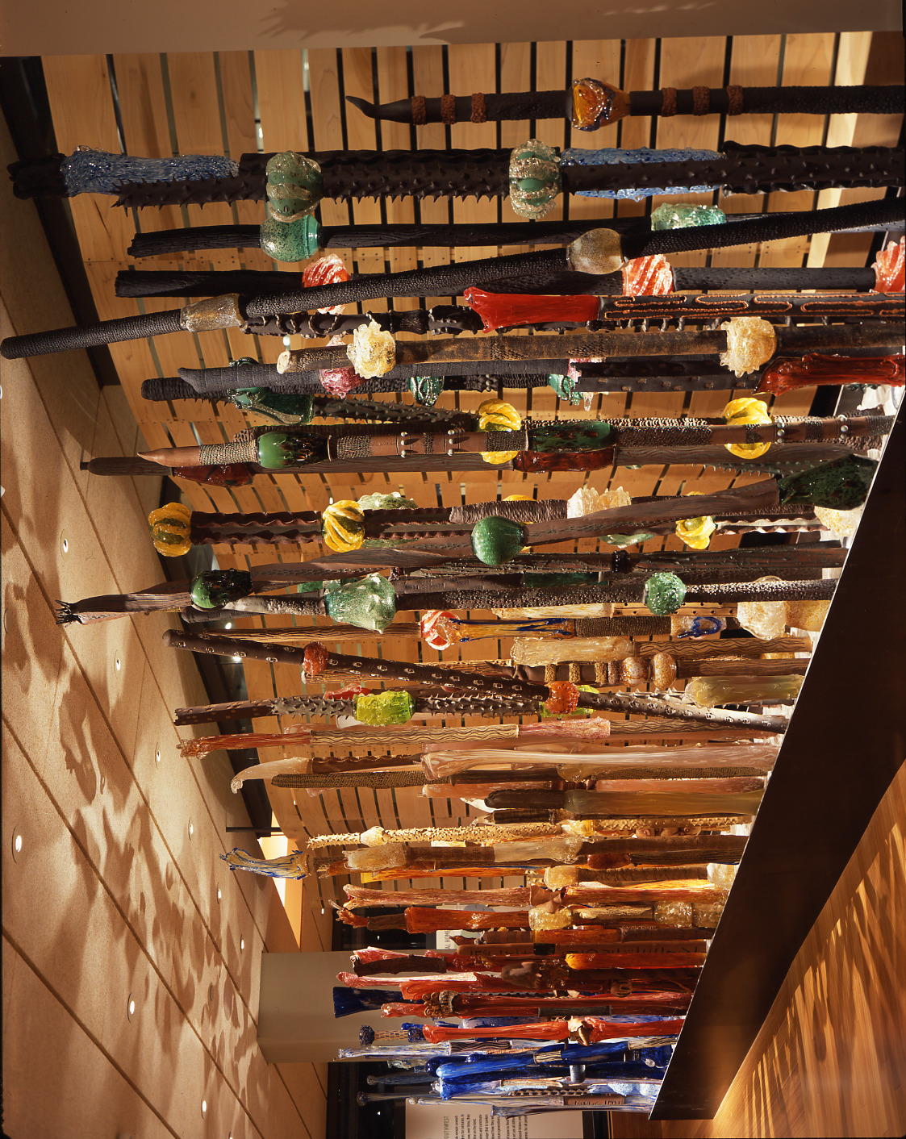

Slide 6
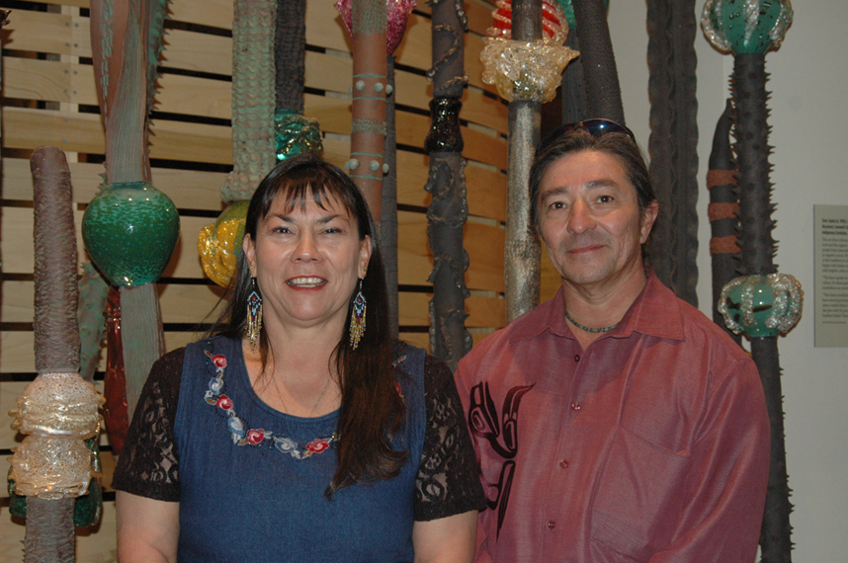

Slide 7
Tony Jojola, (1958-2022), Isleta, and Rosemary Lonewolf (b. 1953), Santa Clara Tewa. Indigenous Evolution, 2005, This art fence references the land of the Southwest, and the organic fences built by Native people from materials such as adobe and ocotillo or saguaro cactus. The fence begins with darker colors, and then continues with brighter colors representing land and sky.
“This fence speaks to the endurance of our culture. It’s about going through boundaries; it symbolizes our persistent existence.” Tony Jojola
“This linear installation reminds visitors to leave stereotyped preconceptions behind and enter a world where indigenous people blend the past with the present and firmly establish a limitless future.” Rosemary Lonewolf

Slide 8
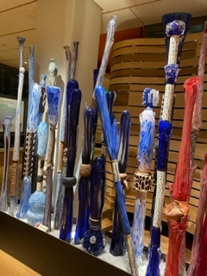
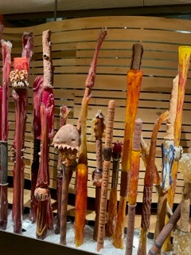
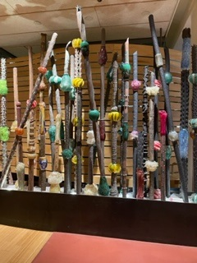

Slide 9
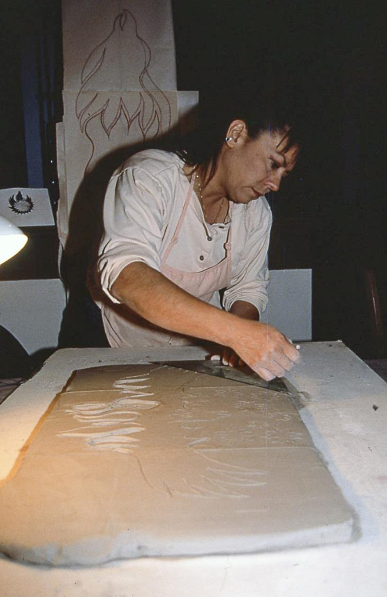

Slide 10
Points to offer visitors
One of several art works commissioned for the exhibition
We chose two artists who worked in an old material in the Southwest—clay, and a new material in the Southwest—glass.
The artists had not worked together before.
Rosemary moved into the Valley for a bit to work exclusively on her portion in 2004, sharing a sleeping loft in a remodeled garage studio “with another ceramic artist and a LOT of mice.” It was completely different from work she had done and her family’s work. You can mention that in the Pueblo section they will see work by her grandfather, father and aunt to understand what a departure this was.
Tony worked with Chihuly several times over the years including attending Pilchuck in 1978 in 1980s was an assistant to Chihuly and in the late 1990s at Chihuly’s Taos Glass Arts and Education. Tony once called glass “clay you can’t touch.”

Slide 11
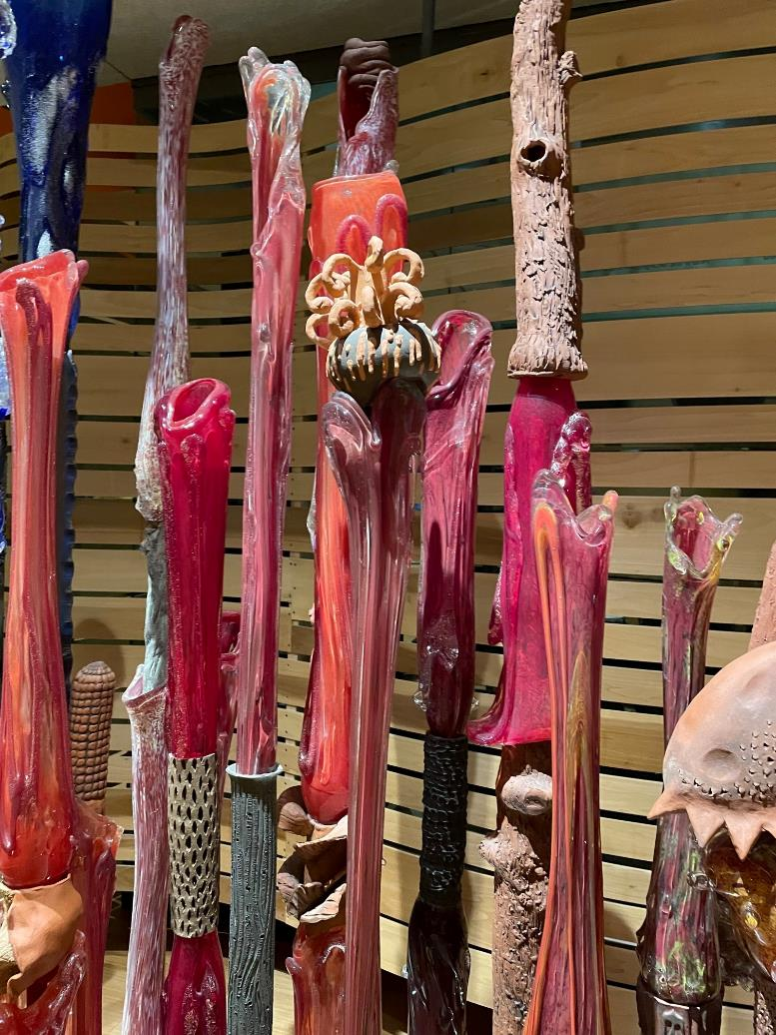
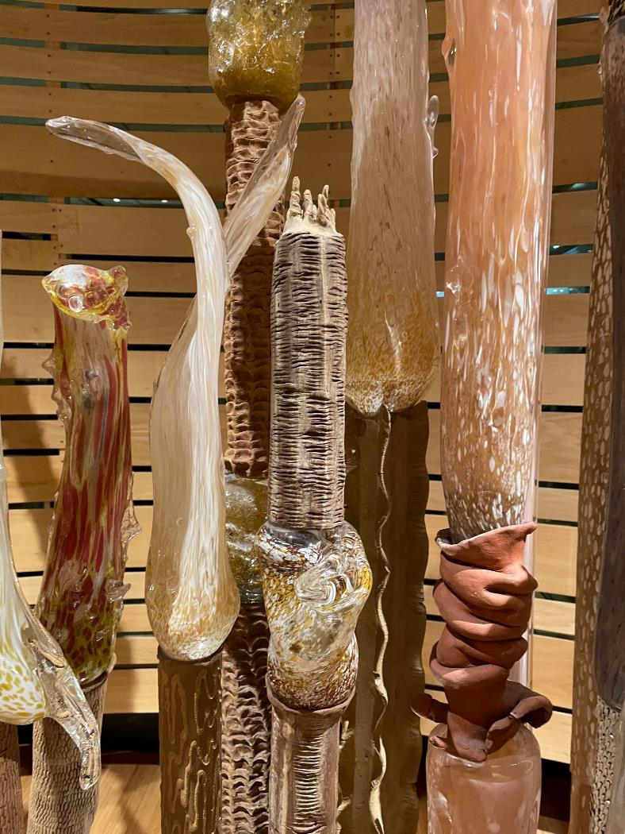

Slide 12
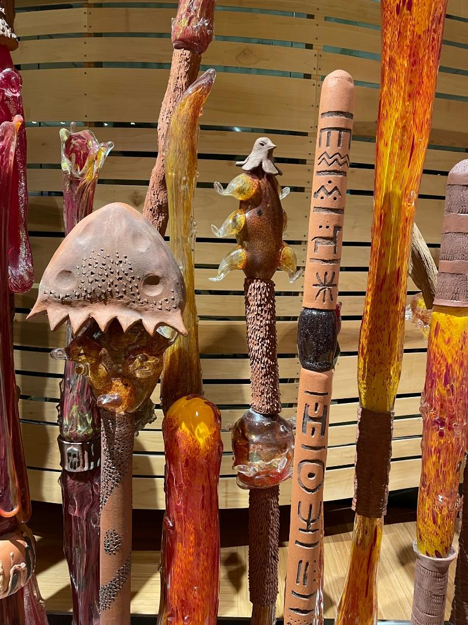
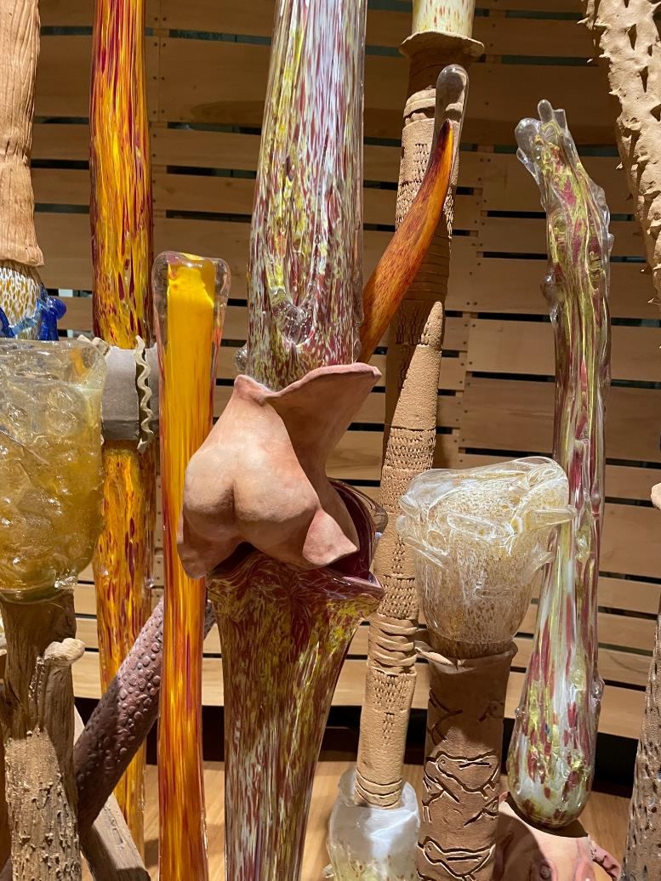

Slide 13
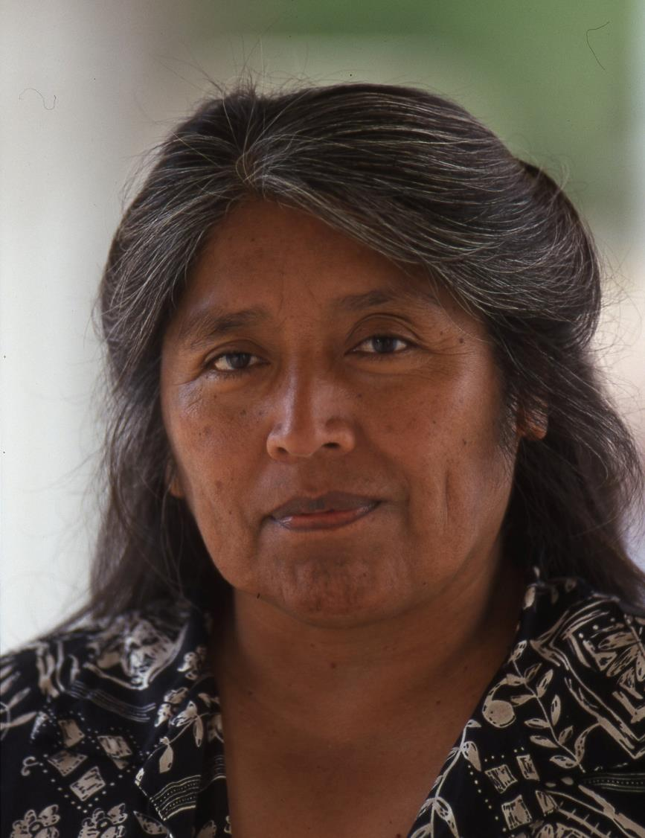
Dr. Ofelia Zepeda,
Tohono O’odham
Ofelia Zepeda, a MacArthur Fellow, created poems based upon transcripts of interviews. One poem greets visitors to the left of the Roxanne Swentzell family grouping. The poems are on banners throughout the gallery and printed as a group in the HOME publication.

Slide 14
Redefining Home
As children we grew up knowing our neighbors not as people living next door to us,
but as relatives.
Our aunt and her family lived on one side, and our cousin and his family lived on
the other. That is the way it had always been.
A home is both the space inside and outside the building.
A home is more than just the structure, the house, the ki:, the hogan, the wikieup.
Ki: in O’odham means both house and home.
It is the aroma, the textures of the buildings that help us remember.
The smell of the wet dirt walls,
the smell of dry dust.
It is the smell of the green brush on the roof, in the walls.
It is the texture.
The smooth mud walls,
the rough ribs from cactus and ocotillo,
the branches of cottonwood and posts from cedar and pine.
Home is a place that has the right feel,
the right smell,
the right sense of coolness when you touch the walls.

Slide 15
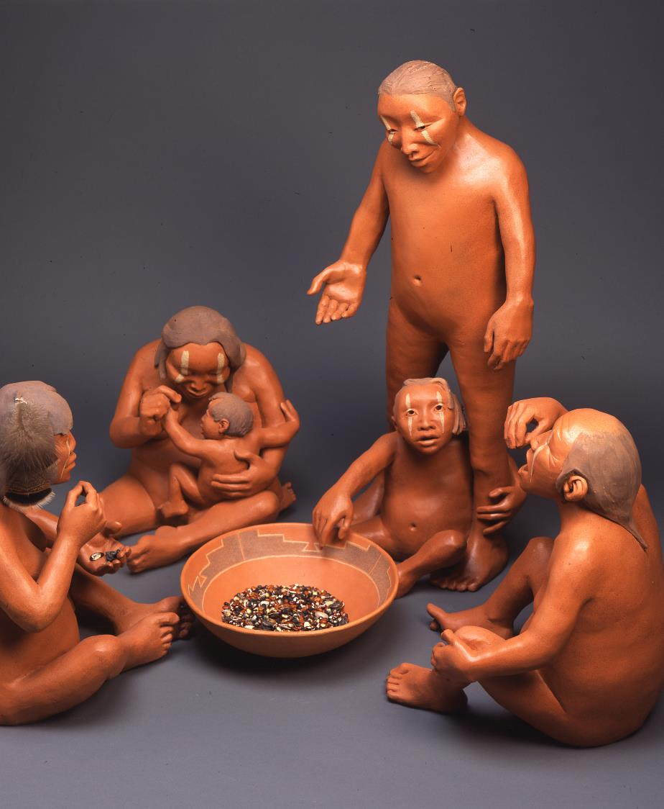
Tse-ping by Roxanne Swentzell, Santa Clara
“Tse-ping means belly button. In the Tewa world, the belly button is the center of the world. Each pueblo has a belly button in the pueblo. The belly button is in the middle of the plaza. It is a rock of where we come from. It is reminding us of where we come from, from the earth. In Tse-ping, the bowl is the center of the earth and is like the belly button. We are all centered around the earth. We all come from the earth. We are all eating out of the earth. Because of that, we all become one family.”
-Roxanne Swentzell

Slide 16
Points you can mention
The artist is very much involved with Indigenous foods and sustainable land use.
You can see she placed in the bowl seeds of the “three sisters,” corn, beans and squash.
The family is multi generational. Many advisors, especially in the Pueblo section, talked about family as community. Tessie Naranjo said in Tewa, there is no word for “family,” but there is a word for “all of us.”
In the first lines of her poem Ofelia says, “As children we grew up knowing our neighbors not as people living next door to us, but as relatives. Our aunt and her family lived on one side, and our cousin and his family lived on the other. That is the way it has always been.”

Slide 17
Home Main Label
In the American Southwest, Native people remain connected to the lands that have been their homes for centuries. In HOME, they tell of that connection and how, over time, they have faced change regarding how they live on the land. They have seen change within their families and communities. They have seen change in the language that is spoken at home, and they have made choices about how they will keep important elements of home for future generations.
Native artists express multiple facets of home in their art. The stories of the people who made the art are all different and yet, as Native people, they have a shared history and land, and their stories have common themes for all people. The permanent collection of the Heard Museum is a part of those stories.
“We are still here” is the main message Native people want us to deliver.
Introduce main themes that advisors said they wanted to see presented: land, family, community and language.
This is the museum’s permanent collection. HOME is the signature exhibition of the permanent collection. It isn’t a permanent exhibition. At the Heard there is no such thing as a permanent exhibition.
Change, the nature of change and choices about how Native people deal with change are reflected in art.
The art reflects both past and present.
Commonality of themes for all people, including visitors.
Madeline Naranjo quote isn’t on the label, but it bears repeating. “From this work our life is brought forth.”

Slide 18
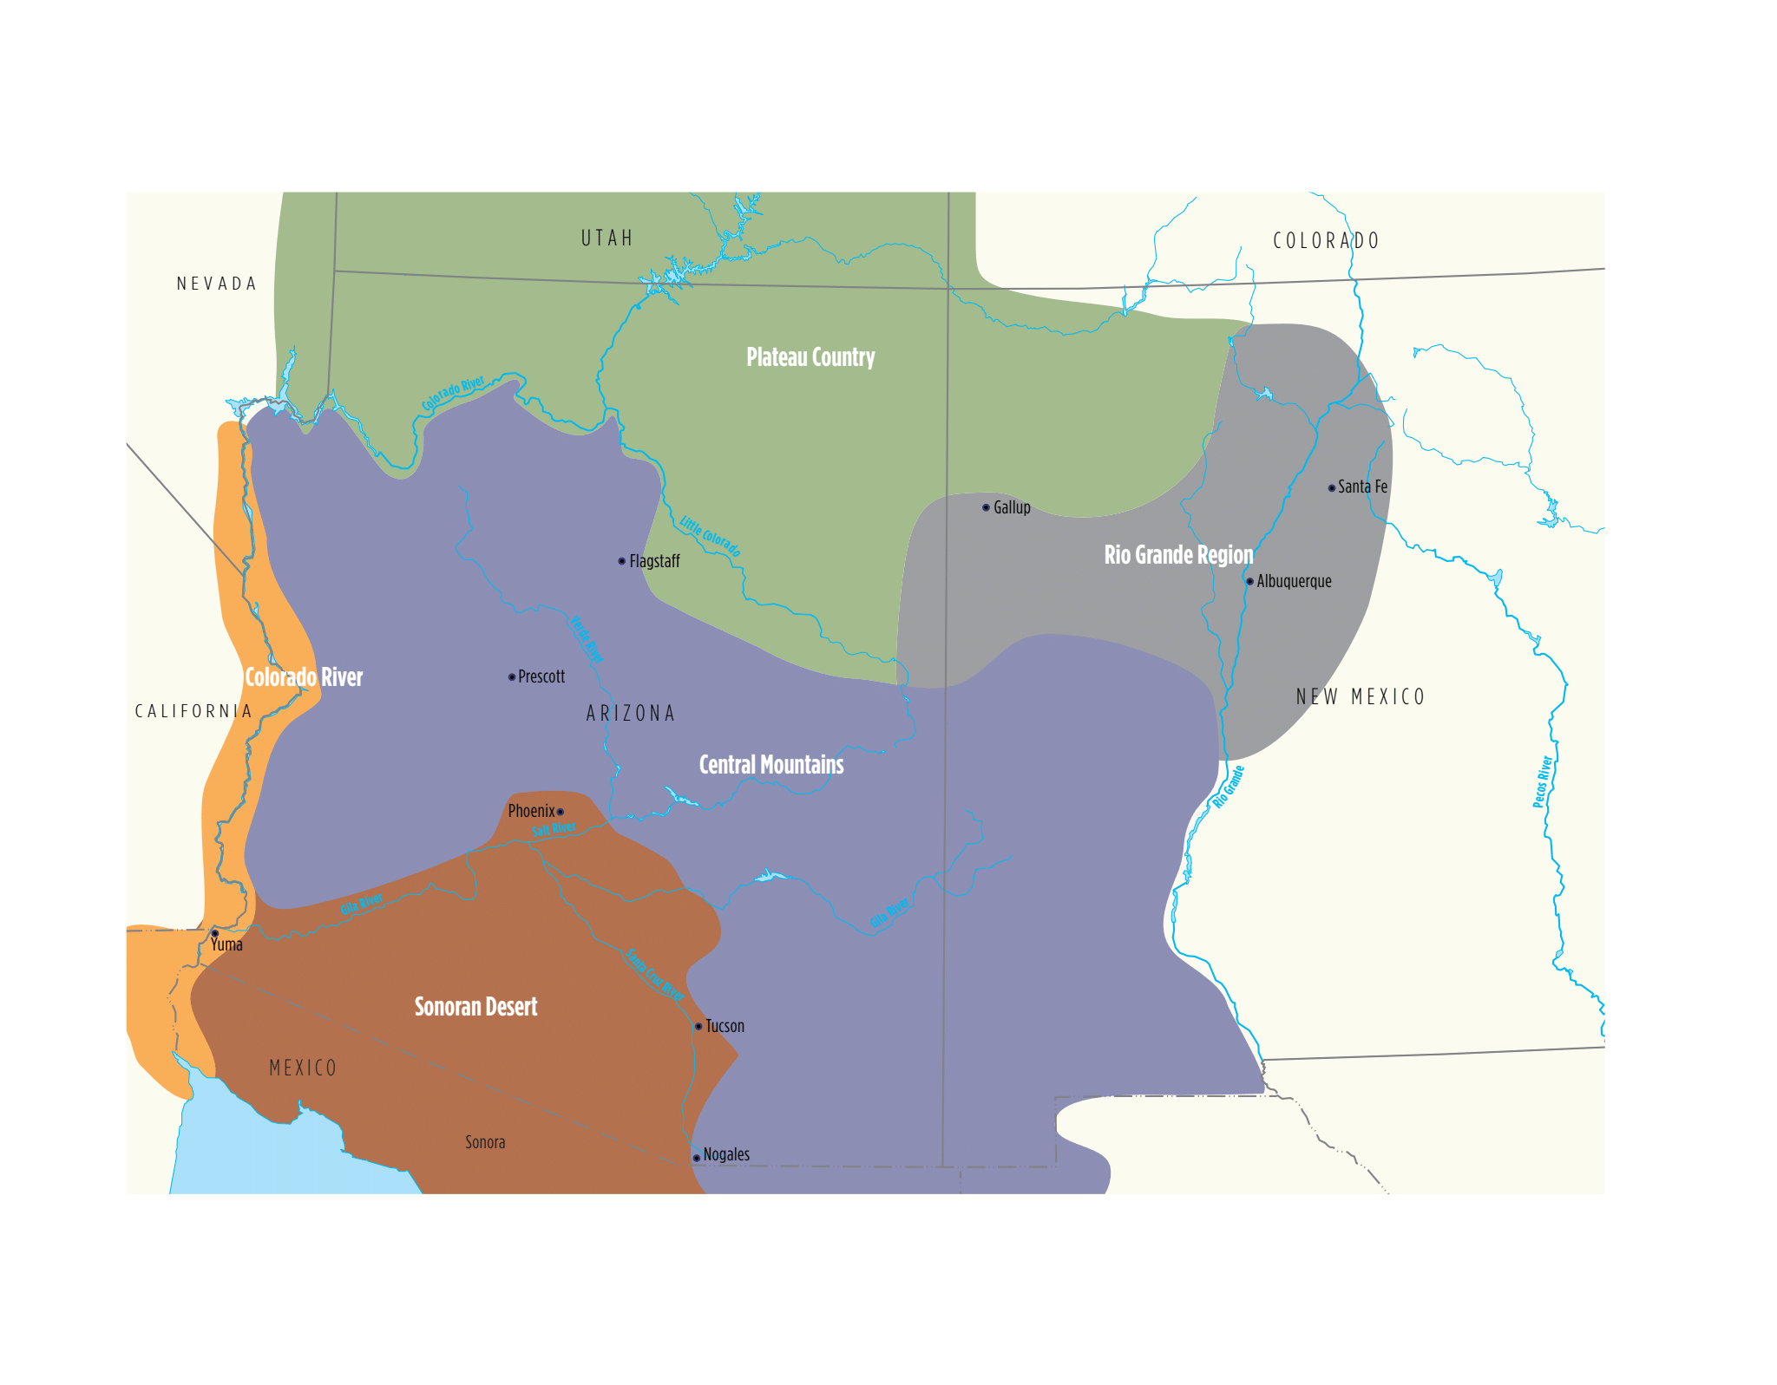

Slide 19
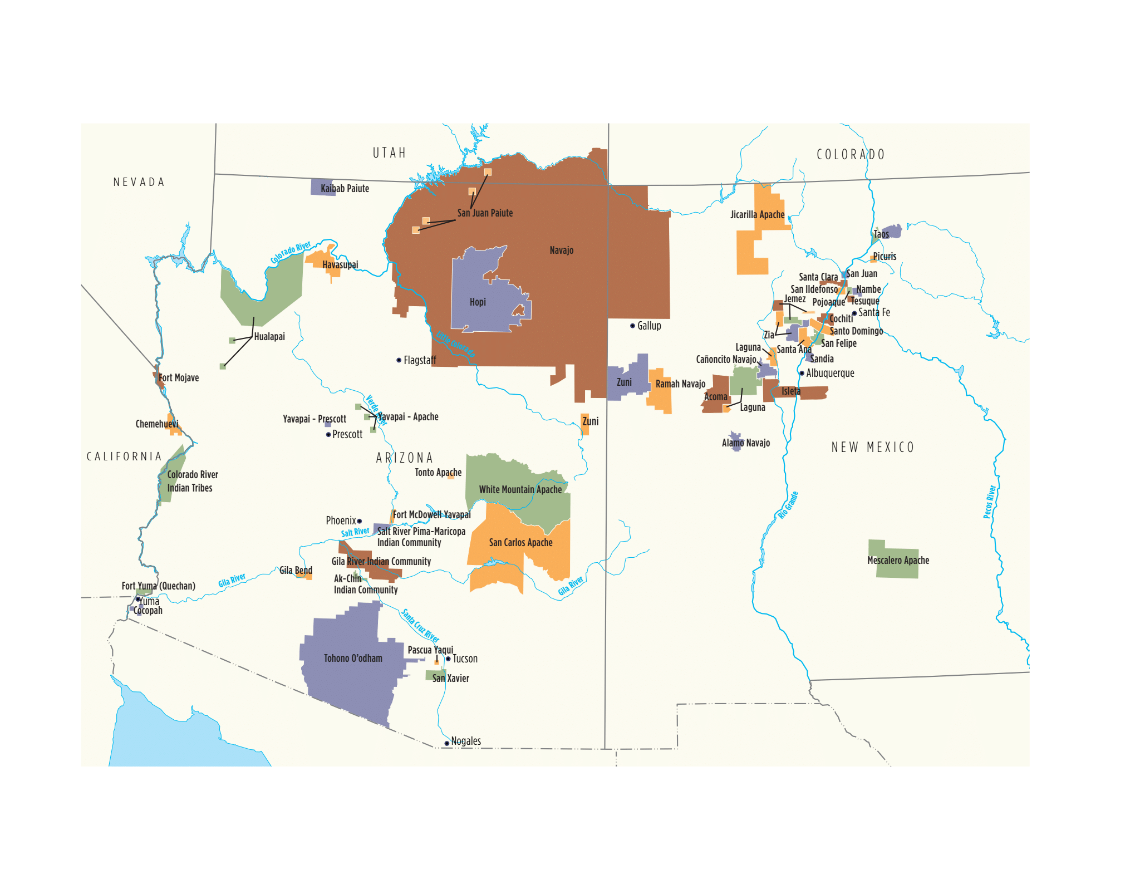

Slide 20
Basic Points
Greatly diminished land area in the mid to late 1800s as people were forced onto reservations.
22 tribal nations in Arizona, including most recently Zuni sacred lands
23 tribal nations including 19 Pueblos
The colors on the map mean nothing
If you want to you can call out the 5 major modules of HOME that people will be visiting. They are Rio Grande Pueblos, Colorado Plateau, Colorado River, Sonoran Desert, Central Mountains

Slide 21
Wide-ranging Questions
Don’t hesitate to say, “I don’t know,” in response to a question. It can be followed with possible sources of information.
Refer people to the Heard web site, where they can find links to Curatorial and the Library.
Encourage people to visit the web sites of tribal nations and learn about history and visitor attractions.
Admissions staff have information about local restaurants.

Slide 22
Myths and Stereotypes
Stoic, humorless
Homogeneous
Unchanging
Contemporary is not authentic
Romanticized past
National Museum of the American Indian. Do All Indians Live in Tipis. 2nd edition 2018. 1st edition 2007. New York, NY: Harper Collins Publishers. Contributors are Native staff members of NMAI who respond to a wide range of common myths and stereotypes based on recurring questions staff members have dealt with over the years.

