Slide 1
Ancestral Pueblo and New Mexico Pueblo Section
Our culture and our creative arts are interwoven and inseparable. Everything in our lives is all-inclusive. We must preserve what has been created and what can be created. Popovi Da, San Ildefonso Tewa
Quoted in Pueblo Nations: Eight Centuries of Pueblo Indian History by Joe S. Sando, Jemez Pueblo, 1992.

Slide 2
The Heard Museum connects Indigenous creativity to the world by presenting the voice and vision of American Indian artists
HOME’s focus is on 1,500 years of Indigenous creativity in the Southwest
Philosophical perspective: In researching and learning about the art we present, we do all that we can to overcome the anonymity that is present in many older works.
In talking with visitors where possible emphasize an artwork as the creative expression of a specific person whose work is worthy of consideration. In some instances when the individual artist was once known, you might make use of a statement that begins “the person who made this…..”.

Slide 3
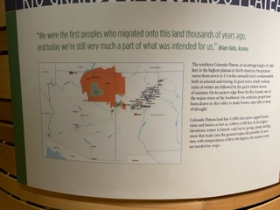
Great quote from Brian Vallo who was the founding director of Acoma’s museum and served an extra term as Acoma’s governor through Covid.
This label’s most important points include:
the reference to precipitation as being “undependable both in amount and timing,”
tremendous variability in terrain,
importance of the Rio Grande over the centuries

Slide 4
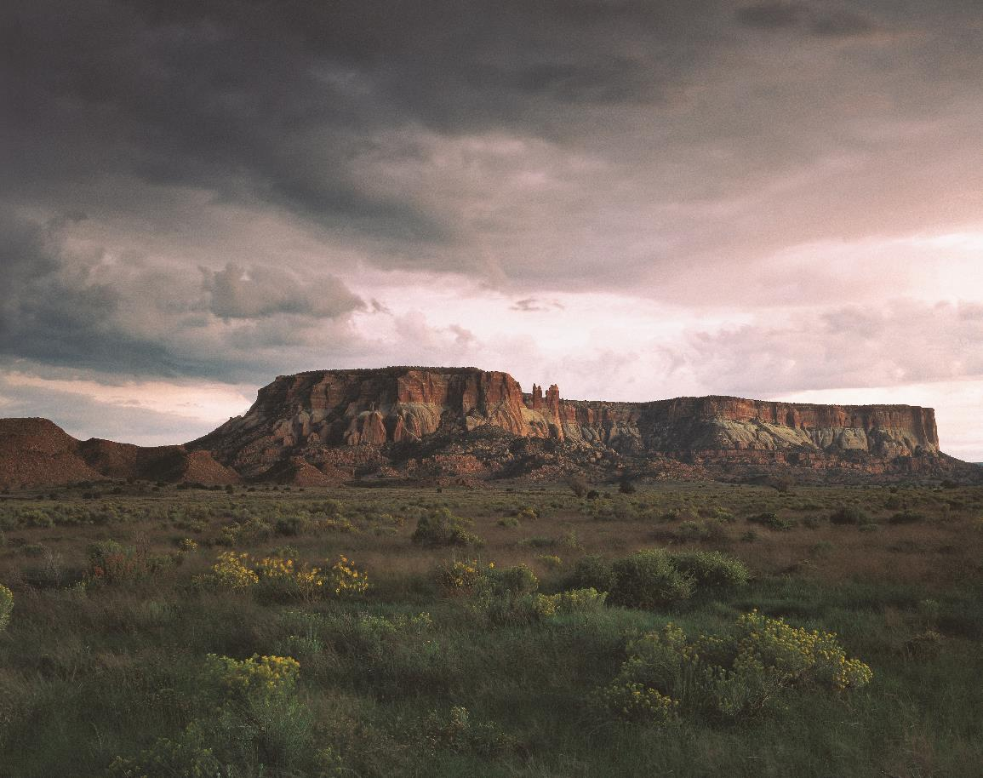
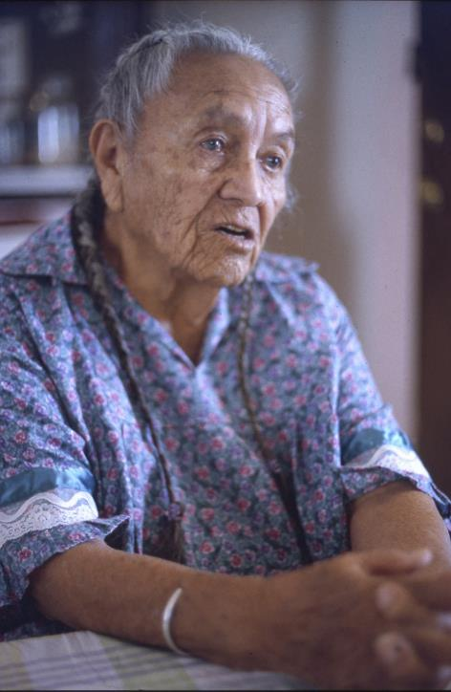
What I see is my home. I don’t own it but it’s home, the river, the trees, the birds that fly, they’re all mine. Estefanita Martinez, Ohkay Owingeh (San Juan Pueblo)

Slide 5
Points to mention in Ancestral area
We use the term Ancestral Puebloans. Some people may be familiar with the term Anasazi, which archaeologists began to use in 1927. It is a Diné term that translates to “ancient enemy.” It is not a term we use. The Indian Pueblo Cultural Center takes up the subject on its web site.
People didn’t “vanish.” THEY MOVED. Puebloan people have moved throughout their history in the Southwest. The romantic notion of “vanished” makes for a great story and has been used frequently. It just isn’t true.
One reason for moving included the extended drought of the 12th and 13th centuries.

Slide 6
Sections in Rio Grande Pueblo Module
Ancestral Pueblo
Historic
Oven area
Northern Pueblos
Southern Pueblos
Rio Grande Pueblo Jewelry
Western Pueblos
Zuni Jewelry

Slide 7
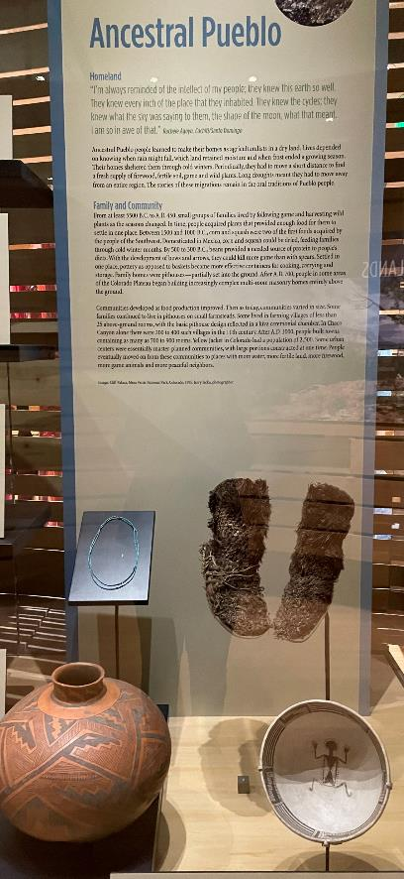
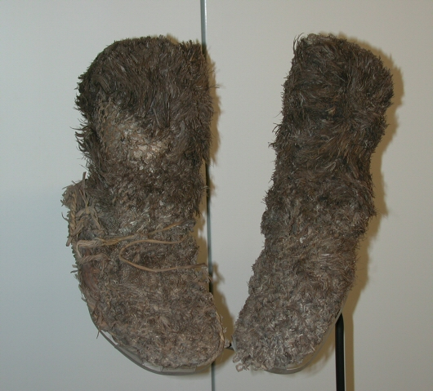
Feathered Sandal Socks 950-1300 C.E.
I’m always reminded of the intellect of my people. They knew this earth so well.
They knew every inch of the place they inhabited….I’m so in awe of them.
Rachel Agoyo, Cochiti/Kewa (Santo Domingo)
Can talk about incredible preservation in the Southwest and point to other examples of it in the case. Can link to climate just mentioned in the map label
Sandal and sock woven of yucca fiber with turkey feathers woven into the sock to make it durable, warm and dry. Some shredded juniper bark was also tucked in along the edges for insulation. Turkey feathers were more durable.
Can recall this sandal sock when showing people Ramona Sakiestewa’s reconstruction of a turkey feather blanket.

Slide 8
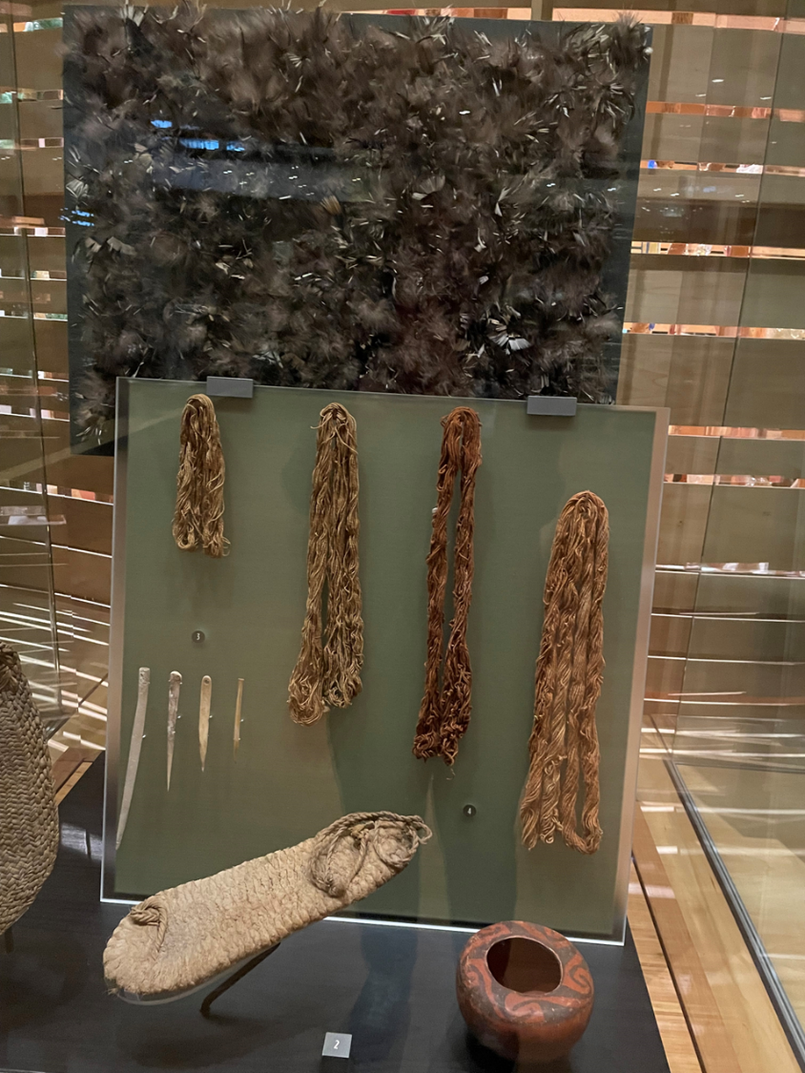
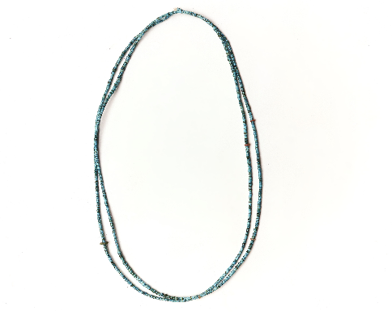
Ramona Sakiestewa made this turkey feather blanket sample. It received an award at the 1982 Guild Native American Arts Exhibit.
Made of the same yucca cordage as sock/sandals and it also uses turkey feathers.
Did larger blanket as commission for Bandelier National Monument 2.5 x 3 ft. and 3,000 feathers. She used leftover cordage to make this.
Very involved process of scraping, boiling, sun-bleaching the yucca and hand twisting with a spindle.
You might mention that this is a gift of the artist, and she has given us her archives.
Ancestral Puebloan turquoise and necklace with an estimated 2,700 beads, a few of which are either red shell or coral. Either possibility reflects the trade networks of Ancestral people that reached into Mexico and to the Pacific. C. 1000 C.E.

Slide 9
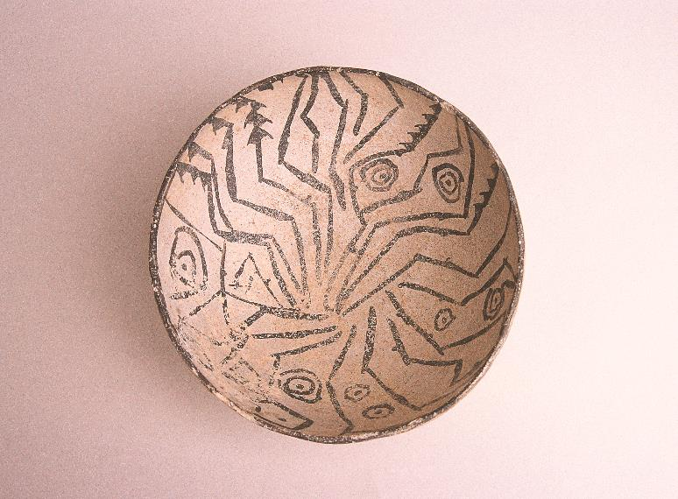
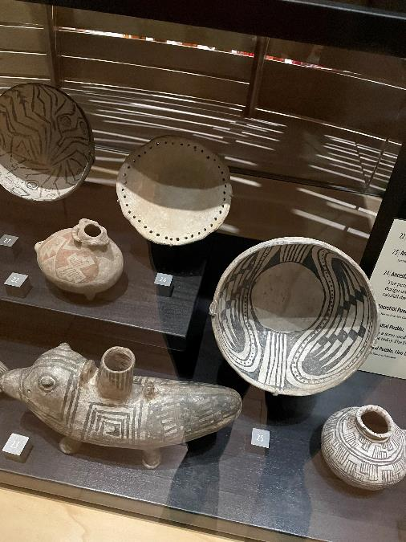
Lino Black on Gray bowl 500-600 C.E.
Puki 1050-1300 C.E.
Pottery-making base mold or turntable. The holes are for tying strings to measure for balance or evenness in form and paint design.
It was in early Heard Museum exhibits and was cataloged as a plate.

Slide 10
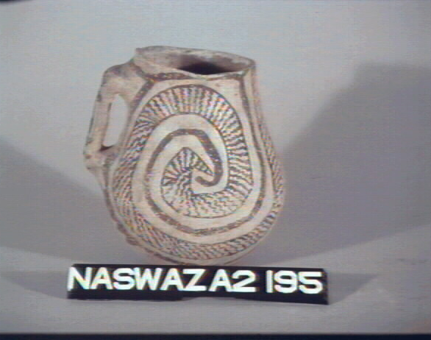
Ancestral Pueblo. Red Mesa black-on-white pitcher, A.D. 870-950. The potter who made this pitcher painted a design that resembles a coiled snake and then placed pebbles in a pocket in the base to make the pitcher rattle

Slide 11
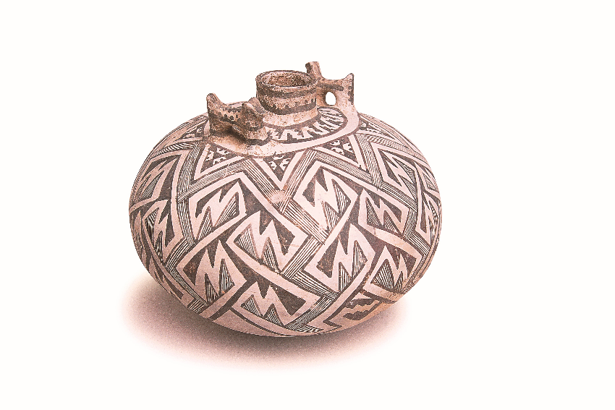
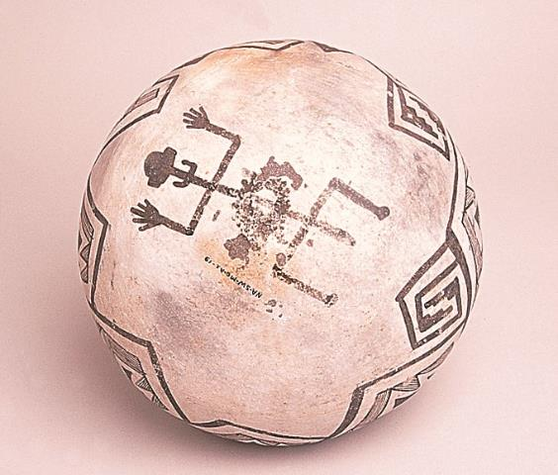
Tularosa Black on White Canteen 1100-1300 C.E., with dog effigy handles is meant to be seen from all sides when in use.

Slide 12
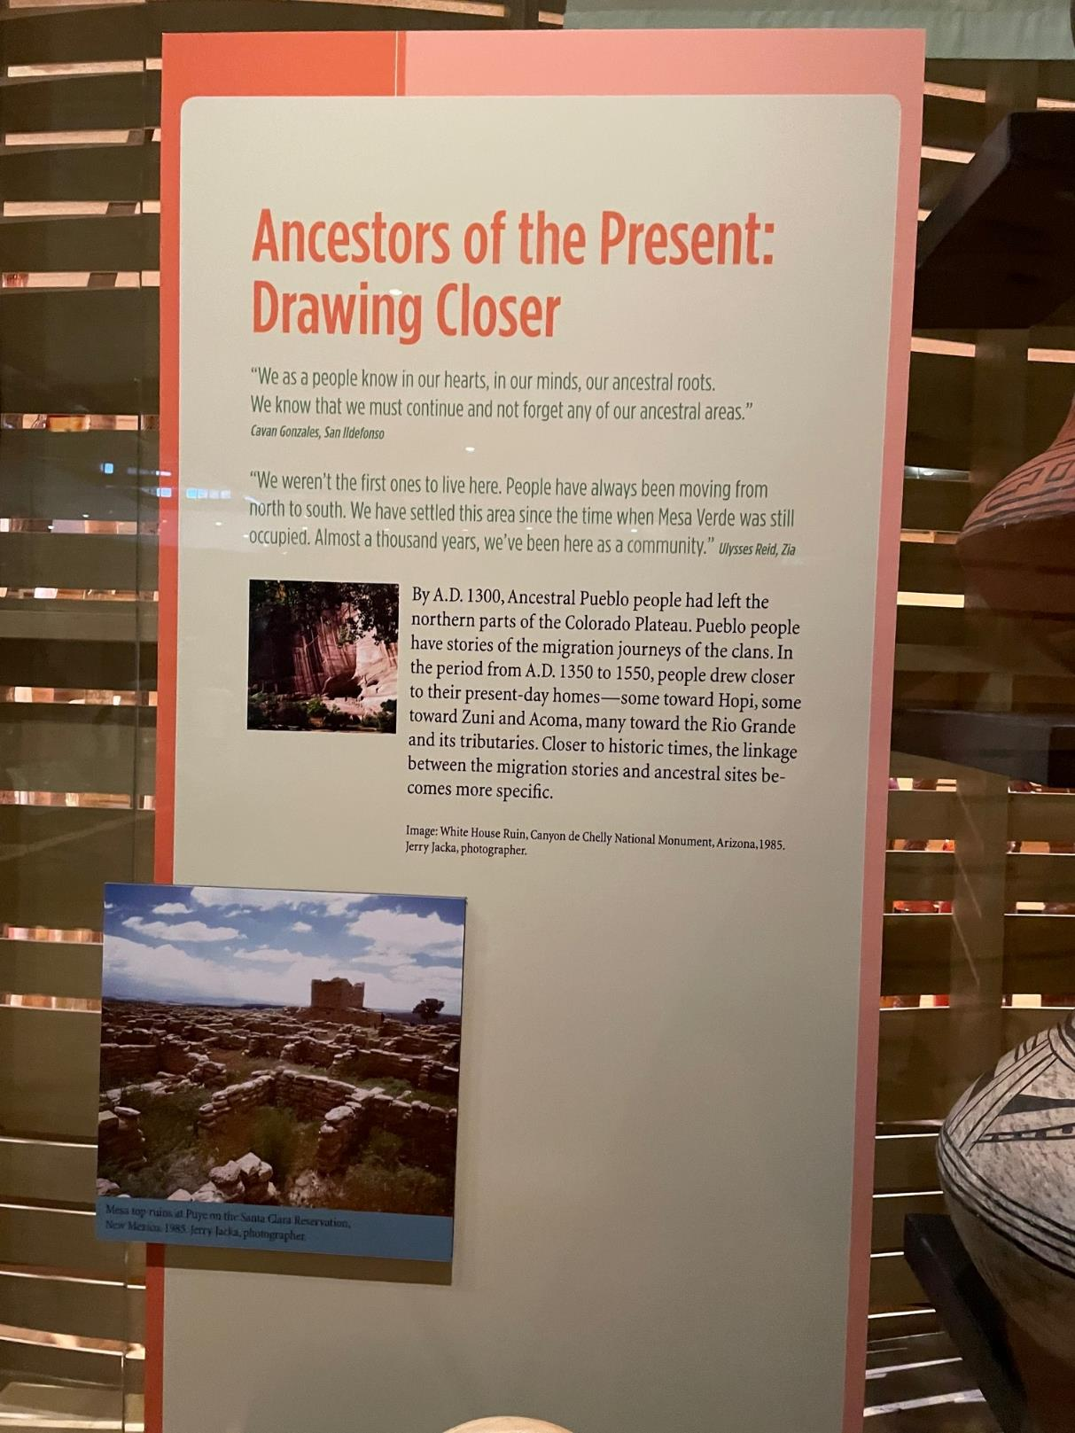
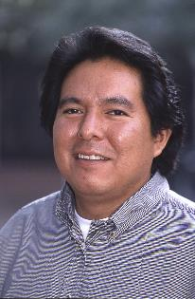
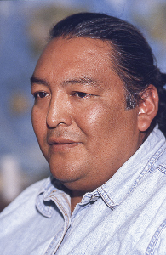

Slide 13
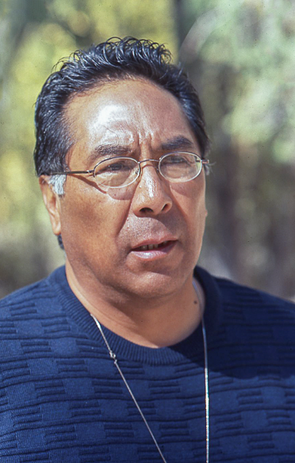
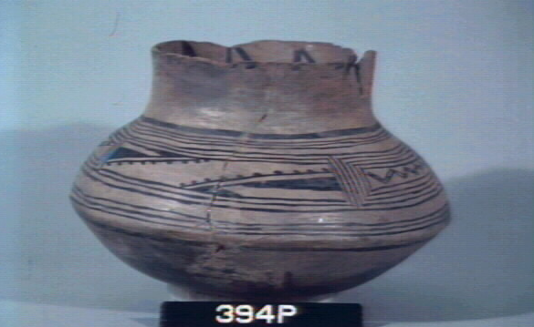
.
Gary Roybal, San Ildefonso/Tewa, in this Bandelier Black on Gray jar, c. 1500 C.E., saw
triangular elements that represent mountains and dots are trees that line a trail along a stream

Slide 14
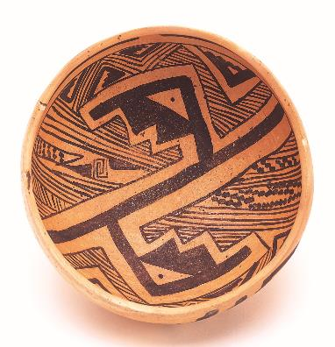
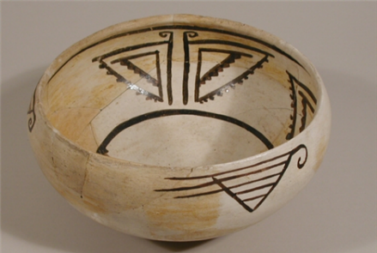
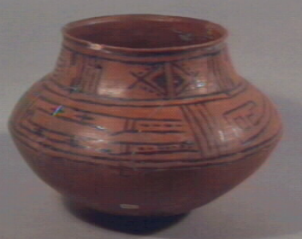
Abstraction and specialization in later ancestral ceramics
Ancestral Hopi
Jeddito Black on Yellow Bowl
1300-1450 C.E. Coal-fired,
popular trade ware.
Ancestral Zuni
Pinnawa Glaze-on-white bowl, 1350-1450 C.E. Specialist ware with only a few sources among nine villages along the Zuni River and tributaries
Otowi Pueblo
San Lazaro Glaze Polychrome jar, 1490-1550 C.E.
Popular trade ware. Specialist-made, requiring limited ore-based pigments and a complex production process.
Otowi, Puye, Tsankawi are Tewa communities that traded with each other.

Slide 15
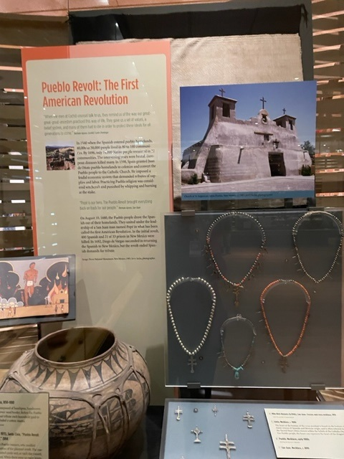
They maintained their traditions regardless of persecutions. That’s why we have those traditions today because of their strong desire to continue. Gary Roybal San Ildefonso,2002
When the men at Cochiti talk to us, they remind us how our ancestors practiced this way of life. They gave us values, a belief system and some of them had to die for that. Rachele Agoyo, Cochiti/Santo Domingo, 2002
Important numbers
1540 Spanish enter Pueblo homelands where 40,000-50,000 people lived in 80-100 villages
1696: 14,000 Native people in 22 communities
1598: Spain granted Juan de Onate Pueblo homelands to colonize and gain converts for the Catholic Church
The invaders instituted a feudal economic system requiring tribute in the form of grain and labor.
Pueblo religion was deemed witchcraft , punishable by whipping and burning at the stake.
The practice carried out by the Franciscan priests drove Pueblo religion underground but did not stop it. (Later in your tour in the Yoeme [Yaqui] section, you can contrast with the Jesuit approach.)
For information on the cross necklaces, you might want to take a look at Allison Bird-Romero’s book Heart of the Dragonfly. Here husband Michael Bird-Romero made a series of silver crosses based on the crosses on the old necklaces.

Slide 16
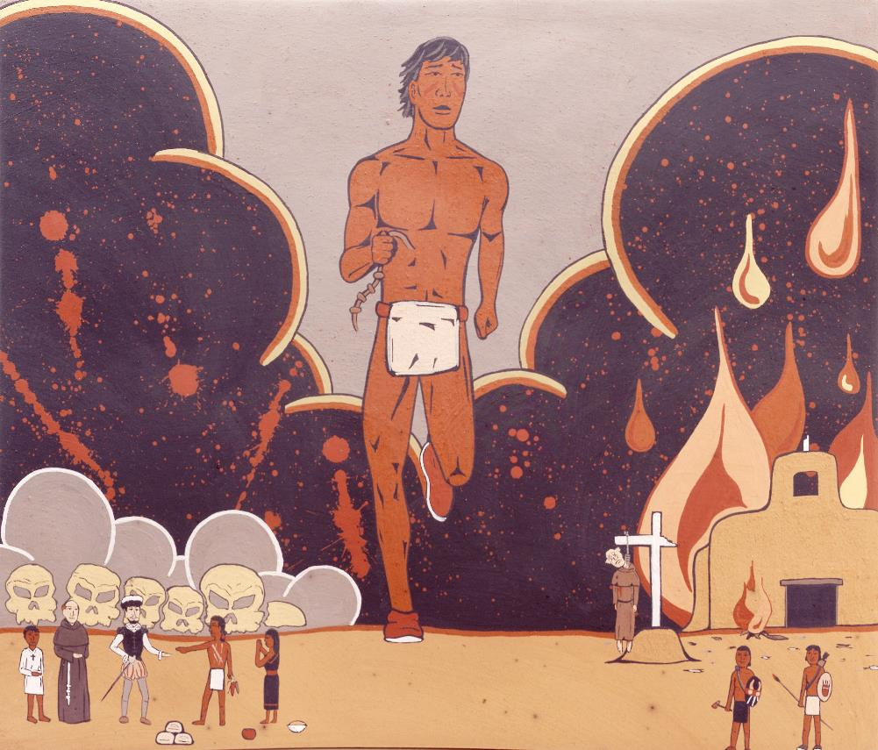
Jason Garcia, Santa Clara Tewa, Pueblo Revolt August 10, 1680, 2004.
United under Popé, of Ohkay Owingeh (San Juan) 400 Spanish and 21 of 33 priests in New Mexico were killed.
Garcia depicted one of the runners who ran to the villages with a knotted cord, untying a knot each day. When the last knot was untied it was time to rise up.
In the lower left, Garcia has depicted the payment of tribute to the conquistador under the encomienda system. The boy is payment to the church as an indentured servant. In the lower right, Garcia depicted a hanged priest as flames engulf a church.
In 2005, a statue of Popé by Cliff Fragua was installed in Statuary Hall in the U. S. Capitol, representing New Mexico.

Slide 17
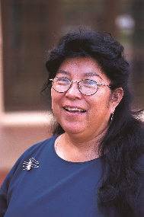
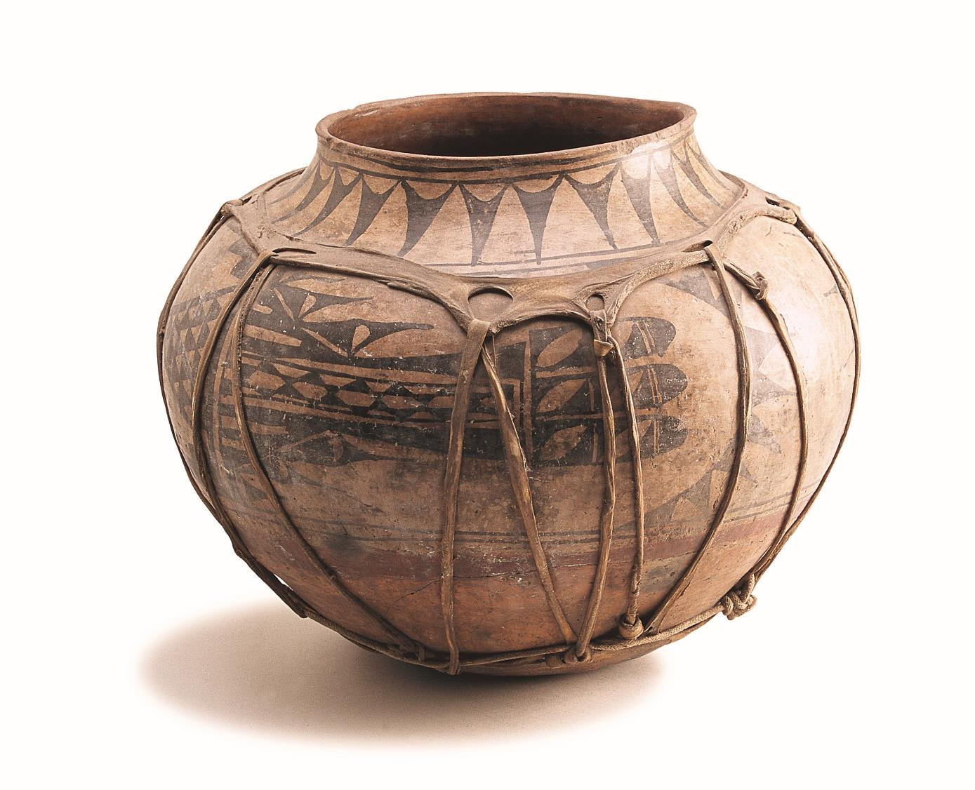
Powhage Polychrome Storage Jar, San Ildefonso,
1780-1820. Although made after the Pueblo Revolt, it is shown to illustrate the standard size storage jar that stored ½ fanega (1.3 bushels) of grain. Before the Pueblo Revolt, a Pueblo household owed their landlord one fanega of grain a year.
Barbara Gonzales said the design on the jar is a stylized bird wing. The rawhide strapping, applied wet, made the jar easier to move and held it together when cracks developed.

Slide 18
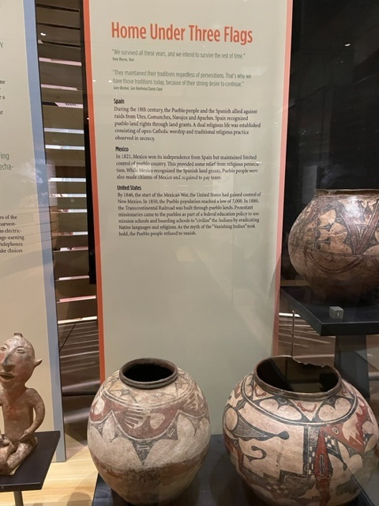
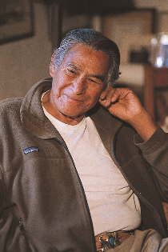
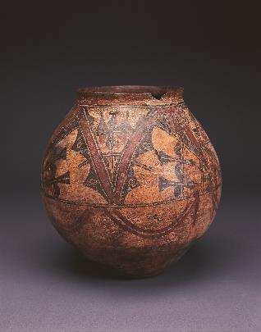
We survived all these years, and we intend to survive the rest
of time. Tony Reyna, Taos, 2002
Main Dates
Spain: 1540-1821
Mexico: 1821-1846
United States: 1846 start of Mexican War. U. S. is in control of New Mexico
1880: Transcontinental railroad built through Pueblo land
San Pablo polychrome jar, Zia Pueblo, 1740 to
1800. One of the oldest historic jars in the Heard’s
Collection. It is from the Fred Harvey Fine Arts
Collection, 112P.

Slide 19
Geographic Grouping of New Mexico Pueblo art in HOME
Northern Pueblos (North of Santa Fe)
Taos
Picuris
Ohkay Owingeh (San Juan)
Santa Clara
San Ildefonso
Nambé
Tesuque
Southern Pueblos (Most between Santa Fe and Albuquerque)
Cochiti
Santo Domingo
Zia
Santa Ana
San Felipe
Sandia
Jemez
Western Pueblos
Acoma
Laguna
Zuni

Slide 20
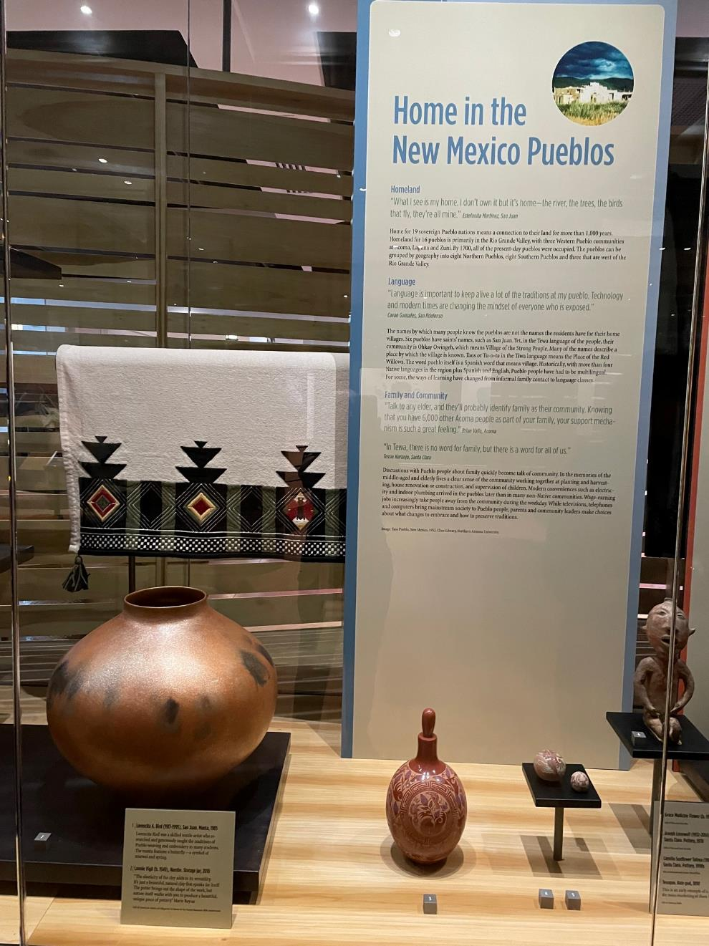
Northern Pueblos
Far left:
Lonnie Vigil jar
Nambé, 2010
Example of micaceous clay

Slide 21
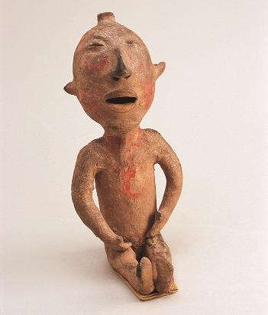
Rosemary’s family
Tesuque “rain god,” 1890. Mica and paint applied after firing.
1900 to 1940 these were mass marketed with some included in candy boxes.
Grace Medicine Flower
Santa Clara, 1991
Sgraffito stoppered jar
Joseph Lonewolf
Santa Clara, 1978
Sgraffito miniature ceramic

Slide 22
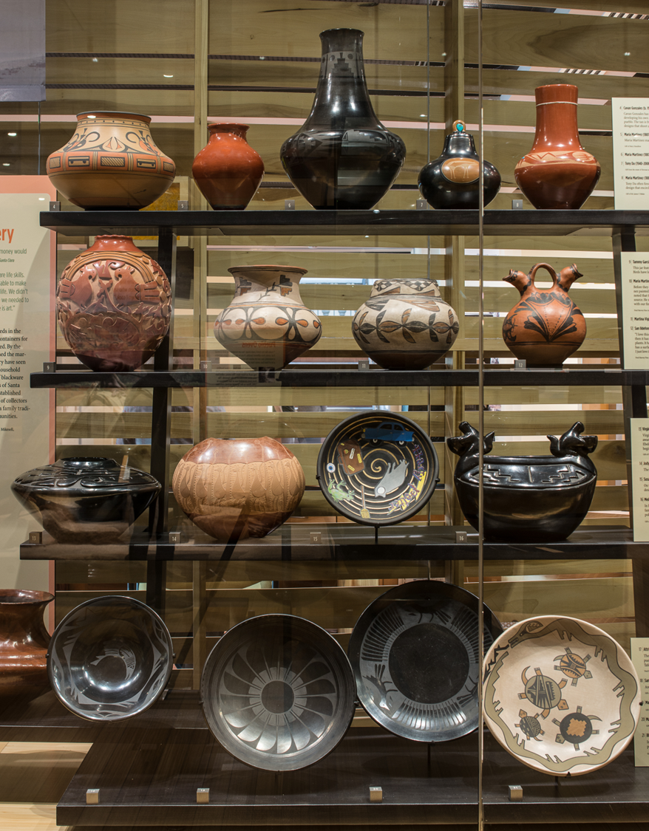
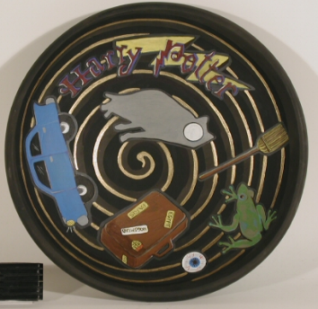
Focus is on San Ildefonso and Santa Clara
Top two shelves show how work by Maria and Julian Martinez
and family members innovated over the years. In addition to
Working with her husband, Maria worked with her son, Popovi Da and daughter-in-law Santana.
Note innovation from polychrome on the second shelf, to blackware with matte paint design, to sgraffito with stone and shell inset.
On the third shelf you could note some Tafoya family work including the impressive recurve and carving of the Virginia Ebelacker jar (far left), Margaret Tafoya’s eldest daughter, and far right, another daughter Mela Youngblood recognized for her ability to polish. More Tafoya family ceramics are located to the left of the shelves.
Note Susan Folwell “Harry Potter Plate.” You can brush up on your Hogwarts
symbolism

Slide 23
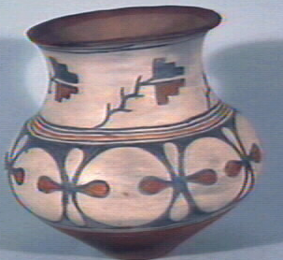
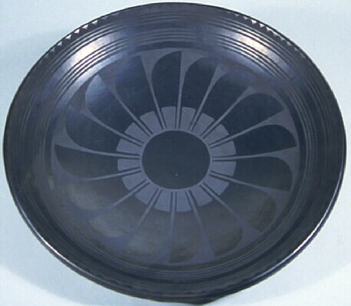
Martinez Family: Always Innovating
Maria and Julian Martinez polychrome jar, c. 1915
Maria and Julian Martinez plate with Mimbres inspired
feather design, c. 1925

Slide 24
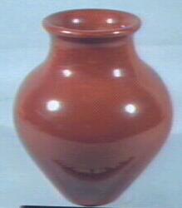
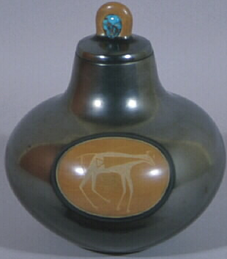
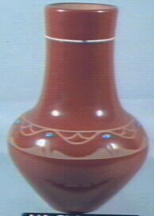
Maria Martinez and her son Popovi Da, 1960s
Tony Da, Maria’s grandson, late 1960s
Maria with Tony Da, 1972

Slide 25
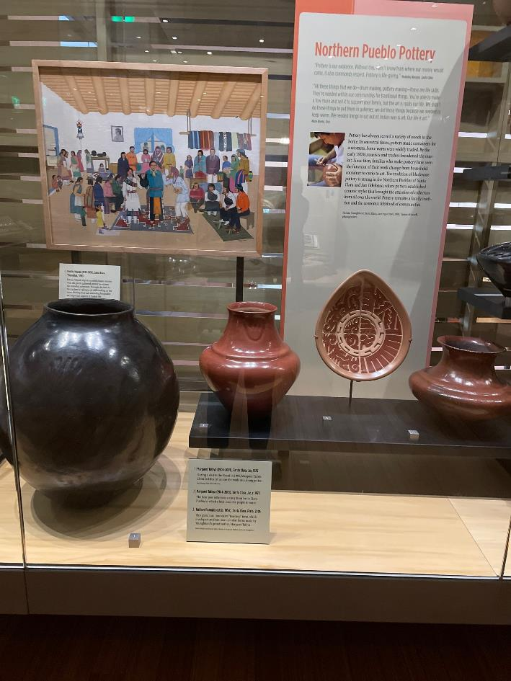
Tafoya family ceramics
Far left: Margaret Tafoya identified this storage jar as her early work, 1925, during a 1995 visit to the Heard.
A later work 1973 by Margaret Tafoya. This is a chance to talk about the bear paw referencing a story about leading the ancestors to water.
Nathan Youngblood has been an important advisor to the Heard. Here is an innovated teardrop shape. Santa Clara ceramicists are noted for their carving.
Far right Sara Fina Tafoya. Identified by her
great grandson Nathan Tafoya based upon the bear paw.

Slide 26
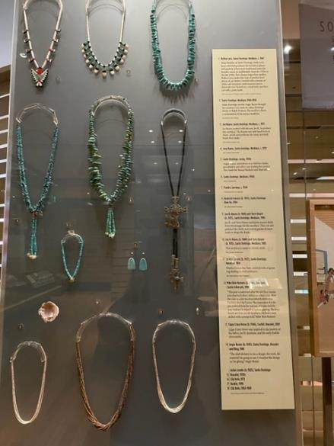
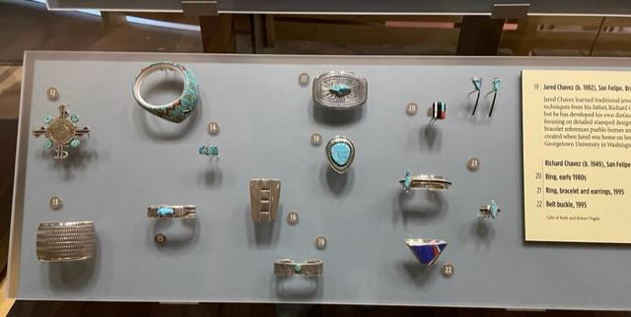
Rio Grande Pueblo Jewelry
Emphasize lapidary work, with newer examples of silversmithing
Artists carrying forward the tradition seen in the necklace in the Ancestral section

Slide 27
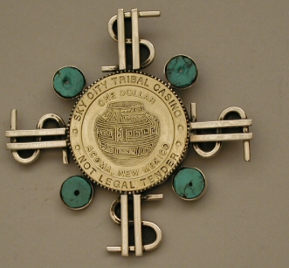
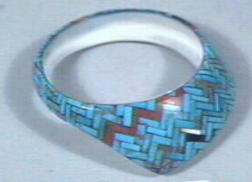
Mike Bird-Romero, Ohkay Owingeh
Casino Token Pin, 1999
“This pin is patterned after the old Zuni manta pins that held silver dollars
or other coins. Here the coin is a slot machine token from Acoma Pueblo’s
Sky City Casino. The inspiration for the pin evolved from the various attitudes
held by non‑Indians in regard to Indian gaming. The four beads are from
an old necklace; the holes were drilled with a pump drill." Mike Bird-Romero
Angie Reano Owen, Santo Domingo
Mosaic shell bracelet, 1986
“The shell dictates to me a design, the work, the material I’m going to use.
I visualize the design as I’m gluing.”
People will see in the ancestral Huhugam area another example of
shell mosaic.

Slide 28
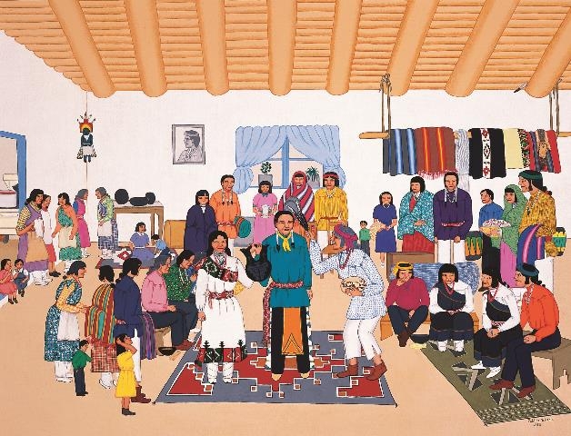
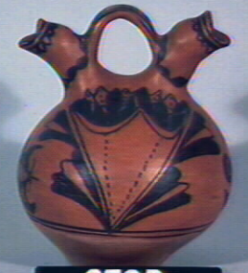
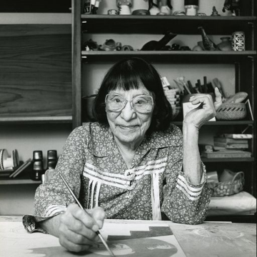
Wedding vase, San Ildefonso,
1890-1920
Kathy Wan Povi Sanchez commented on this in the label. “I love this. The mouths are like birds, you can see that little beak on either side. And then I love the flowers on here. That's a nice flower design and so you get the idea that it's nurturing and watering the flowers, the plants. And it has a butterfly on there, a bug coming to get the nectar, so I love the way that's zooming in. And on the other side also, this same plant, the dye and it's with the black "wuaco" and the San Ildefonso red and it also has a surface on the bottom that's polished, and it's not dye. It looks like just the same clay surface, but you can tell it's rubbed with a stone. But this is a little further take from the polychrome. The style is the same. I just love it! Springtime!”
Betrothal and Wedding Vase
Pablita Velarde, Santa Clara
Betrothal, 1953
Pablita Velarde remarked that she was the little girl watching from the kitchen.
It is in HOME, in part, because she included the glimpse of a kitchen. So many of the people who
discussed home, spoke of the greeting given in welcome to a pueblo home asking are you well and
have you eaten.

Slide 29
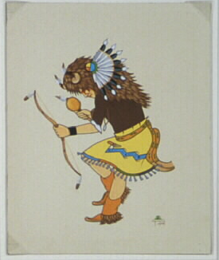
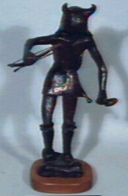
Animal Dances of Winter
Animal dances pay respect to those deer, antelope, rams and buffalo who have fed and clothed people for centuries.
They are a prayer for moisture necessary for all life.
Laurence Chinanana, Jemez
Buffalo Dancer, 1960
Watercolor on board
Michael A. Naranjo, Santa Clara
Buffalo Dancer, 1971
Bronze
You might direct visitors to
other sculpture by Michael on
our grounds.

Slide 30
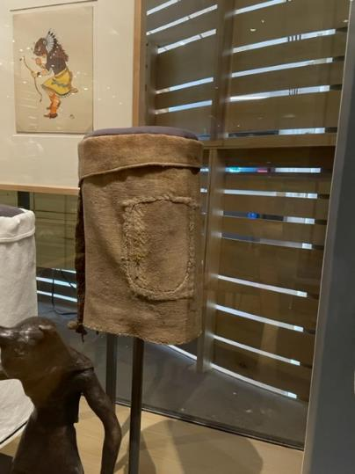
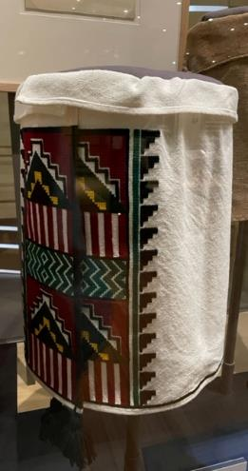
It takes hours and hours and once you sit down, it's just, you don't sit there and attempt to do it until it's done. It takes months, and depending on other activities that you're busy doing, if you have family or whatever, it takes a long, long time to make a kilt like this. It's -- in hours you can't really say because every article of clothing that we wear for our ceremonial dances, no matter what it is, everything is handmade, everything takes time to have it just the way it should be, because there are certain colors, certain dresses, certain things that we wear to put the dance together and it all represents something, the kiva steps, the rain, the lightning and repeating itself again. And the colors of the red representing the sky, the green colors representing the earth. So this is where I find that it's very beautiful, how we have to know the stories of all the clothing that we wear and put together for our ceremonial dances.
Regalia
Important points to be made with
this late 1800s boy’s kilt. It is handspun wool and handwoven and is stained with body paint. The patch is from another kilt with embroidery picked out. It is worn from repeated raising and lowering of the dancer’s leg in ceremony.
“The stitching is very beautiful also
and whoever did this took a lot of time
to put it together for someone.
These were also used in the same way
they are used today with eagle dancers,
buffalo dancers, deer dancers.
These things are very, very important to us, and we improvise. Everything I think that we use then and now it's still the same.”
Florence Yepa
Lorencita Bird commented that the edging on the bottom of the kilt kept it from wearing out faster
Florence Yepa
Kilt with cross
stitch embroidery,
2002.

Slide 31
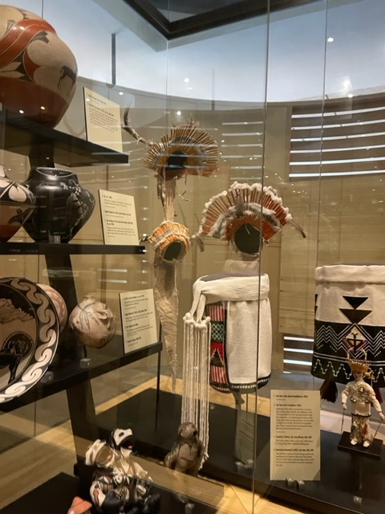
In this area you might want to note the San Juan deer dancer headdress that would be worn by a small boy. Speaking of his son’s participation in ceremonies, advisor Gary Roybal, San Ildefonso said, “It’s important to let the next generation know the importance of maintaining the dances, the songs, the traditions that we have, social as well as religious activities. We tell the next generation, ‘Please continue those traditions for your benefit and the benefit of others.’”

Slide 32
Horno
The ovens are a Spanish introduction. Spanish introduced wheat.
First recorded oven at San Ildefonso, 1591
Needed for baking leavened bread
Our oven is reduced in size and can only hold 10 loaves Flo Yepa joked in the flip book in front of the oven
that she had just built the first Pueblo microwave.
Because you need to bake multiple loaves when you use the oven, you need large dough bowls, which we have
arranged to the left as you face the oven.
Achieving the right temperature requires skill and knowledge.
Inspired great stories about home cooking. When Cavan Gonzales is participating in ceremony, he can tell who made
the food he is eating and can recognize his mother’s oven bread. This is included in the HOME publication.
Dan Simplicio told us a great story about raisin bread and ceremony that is also in the HOME publication

Slide 33
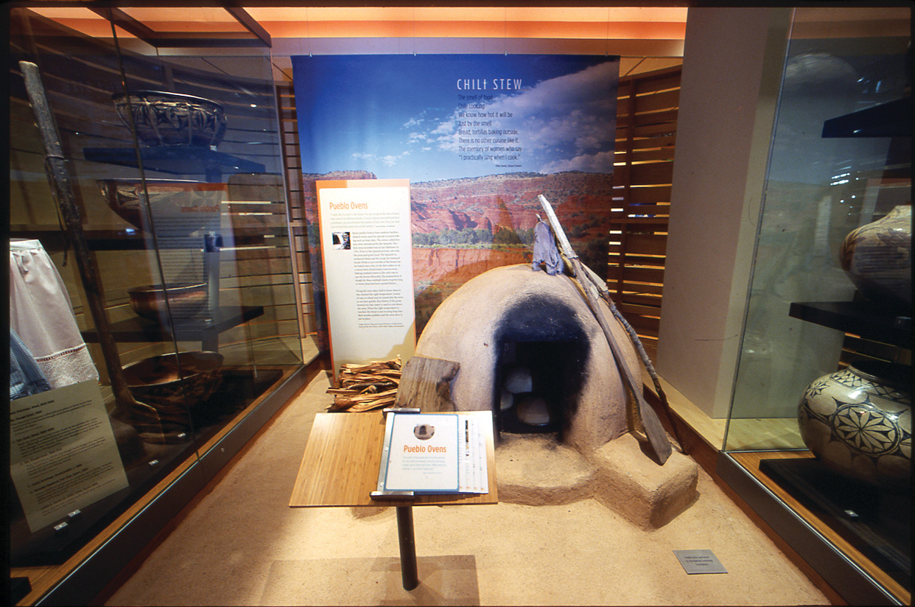

Slide 34


Slide 35


Slide 36

Zuni Dough Bowl, c. 1850
The design on the exterior represents bird feathers. It is a design appropriate for placement on the exterior of the bowl. Not shown in this photograph is the very fine painting on the interior of the bowl.
Baling wire is wrapped around the rim to keep the bowl from splitting further.

Slide 37


Zia Polychrome Jar
1875-1885
Naturalistic design expression originated with influence of Hispanic wares
Zuni Kiapkwa Polychrome Water Jar
1820-1840
An example of incredibly fine line painting

Slide 38

Southern Pueblo Homes: Pottery and the Railroad
I remember as a child our pueblo women sold crafts in front of the Alvarado Hotel and the Albuquerque railroad station. Some lived at the station in adobe homes made for them. It produced an income for the families. The passengers liked to have souvenirs. Isleta was the main seller, probably Laguna when the train stopped at Laguna. When the railroad vanished, it made it a little hard for the people who went and sold. Agnes Dill, Isleta, 2002
Agnes Dill, Isleta Pueblo

Slide 39

On the top shelf you could recognize the ability of some potters to work at a large scale. The Zia jar, on the right, was made by Vicentita Pino. 1950-1960. Her work is discussed in Harlow and Lanmon’s book, The Pottery of Zia Pueblo, 2003.
The second shelf, far right, includes a distinctive Zia 1970s jar by husband and wife Rafael and Sofia Medina. They also painted jars with colorful ceremonial figures on a white ground.
The third shelf includes a 2000 bowl by Diego Romero of Cochiti featuring the Chongo Brothers. Here they are the twin war gods.
The lower case includes a range of figurative pottery including three Helen Cordero figures. The one in the foreground is an early one, c. 1960 before she did storytellers. The drummer on the left is from 1976. Cordero did her first storyteller in 1964 and is credited with reengaging interest in figurative work.
The other works show the whimsical and humorous nature of figurative pieces—a rhinoceros, bathing beauties and two headed man. On the far right is a c. 1889 figure that displays the artist’s satirical impression of an opera singer.

Slide 40

Tourists traveling by train only stopped at the designated depots, but once U.S. 66 came through or near the reservations, people started to take driving excursions into native communities to sightsee. Near the local lava beds and U.S. 66, the Acoma women would build little shelters out of lava rocks, and they would sit under these to sell their pottery as the tourists came by. Theresa Pasqual, Acoma, 2002
If you want to continue mentioning potters who created large ceramics, the c. 1968 jar by Acoma potter Marie Z. Chino could be recognized. A very limited number of potters were able to work at this scale. If you could pick it up, you would be amazed at how little it weighs. Acoma potters are known for their thin-walled vessels.
.

Slide 41

Acoma Manta, 1850-1860
Woven of handspun wool in a plain weave, twill and brocade weave. The design combines earlier geometric
design elements with later floral motifs.
This is a truly amazing piece that ends up in this installation as a backdrop to ceramics.

Slide 42

Interesting pieces include the selenite slab from Acoma, late 1800s or early 1900s, that was used as window material. You couldn’t see through it but it let in light.
To the right of the selenite is a jar by Dorothy Torivio that the museum purchased at the 1984 Heard Museum Guild Native American Indian Arts Show in 1984. It won a Best of Class for Traditional Pottery. The artist said she uses her eye to measure the sectioning of the vessel.

Slide 43

The label calls out the importance of pottery and jewelry to the
economies of Acoma and Zuni respectively.
We have a very special storage jar, c. 1900, by Tsayutitsa, c. 1871-1959,
one of the earliest Zuni potters to be known by name. Potter Josephine
Nahohai identified the jar. Once again, Lanmon and Harlow are an
excellent source for Zuni pottery and information on Tsayutitsa.
Her massive rosettes are quite distinctive.

Slide 44

Zuni Ceramics
On the top shelf, you could connect Anderson Peynetsa’s jar, c. 1983, with your discussion of the animal
dances section. Here, the “deer in his house” design associated with bringing success in hunting.

Slide 45




In your home you always have one of each,
a stew bowl, a water jar, a canteen, a corn meal bowl and dough bowl. Milford Nahohai, Zuni, 2002
Canteen , c. 1900
The top little canteen with the vent hole probably has the hole because it was put on after the wall of the canteen was formed below it. The smaller canteens were formed by pushing the clay out rather than by adding like the top one. This held water at one time. Eileen Yatsattie
Stew bowl c. 1850
Dwight Lanmon noted its fine hatching lines.
Water jar, c. 1900
A few older people at Zuni still feel that no water tastes quite so good as that ladled from a native earthenware jar. The pot, full of water, is placed near an open window so that occasional breezes will evaporate moisture on the outside of the damp jar, thereby cooling the water inside. The wear below the rim is caused by continual abrasion from the curved end of the ladle handle as it is hooked over the rim.
Corn meal bowl with clouds and water animals, c.1900.

Slide 46


Josephine, Milford and Randy Nahohai Jar, 1983.
A great example of a rainbird and sitting next to a late 1800s jar
with a rainbird design. The label has a nice discussion of
how all three family members made it. Milford mentions that it
was the first pot he painted, and it started his career. The diagonal lines represent rain falling from the clouds.

Slide 47




Zuni Jewelry
Here, as with the earlier jewelry section, lapidary work is dominant.
Many pieces in the collection were given by long-time trader, C. G. Wallace
Deborah Slaney has written about the collection in Blue Gem, White Metal and in Leekya: Master Carver of Zuni Pueblo.
Many of the artists are identified by name and often date from
Wallace records.
Visitors may be surprised at size of some of the jewelry, thinking of what
they would choose to wear. Dan Simplicio, Jr., whose father’s work is in the
case said that when the ancestors look down, they see people who are well and surrounded by beauty.
Wallace paired artists on a single piece with one person doing lapidary work and one doing silverwork.
The box in the upper right corner is an example of a pairing
With Mary Kalestewa (Zuni) creating the inlay and Roger Skeet (Diné) creating the silver box.

