Slide 1
Huhugam, O’odham and Yoeme

Slide 2
This is the only other place in HOME that has ancestral works.
We used the spelling Hohokam, but Huhugam is the conventional
spelling now.
Huhugam ancestors moved with the seasons. Around 1 C. E. Huhugam
are settling in farming villages along the banks of desert rivers that ran
year-round. By around 50 C. E. they were building canals and by 600 C. E.
systems of main and secondary canals existed on both sides of the Salt
River. By the peak years, 1150 – 1450 C. E. there were more than 300
miles of canals just in the Salt Rive Valley, based on very sophisticated
engineering. Control of canals involved siting of villages and some centralized
leadership structure.

Slide 3
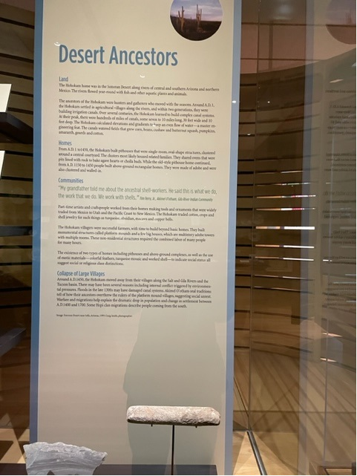
Mention that the Huhugam were living along rivers that flowed
year round in central and southern Arizona and into northern
Mexico.
Homes were pithouses from 1 C. E. to 1450 C. E. with walled
in rectangular adobe structures built between 1150 and 1450 C. E.
They were successful farmers growing corn, beans, squash, gourds,
pumpkins, amaranth and cotton.
Their ovens were stone-lined pits where agave hearts and cholla
buds were baked.
We have a section on the panel called “Collapse of Large Villages”
that refers to a period around 1450 C. E. to 1700 C. E. when
floods, drought, and/or social unrest led to movement away from
large villages.
No one “vanished.” Some Hopi migration stories speak of
movement from this area.

Slide 4
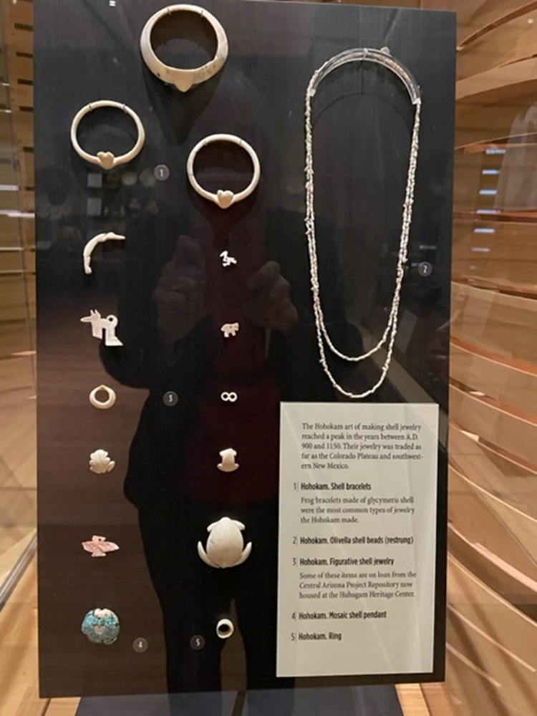
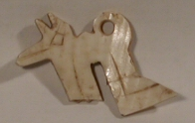
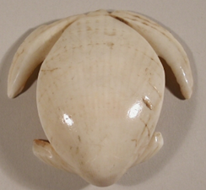
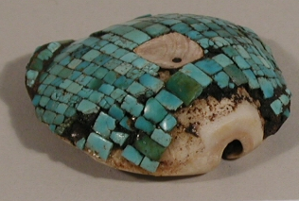
Shell Jewelry
These are made from marine shells, many made
between 900 and 1150 C. E.
Shells were brought in primarily from the Gulf of
California.
Archaeologists have found sites where people
camped and worked on shells.
Shell jewelry was traded into the Colorado Plateau
and southwestern New Mexico.
Frogs, turtles, birds, dogs or coyotes were animals depicted.
900-1150 C. E.

Slide 5
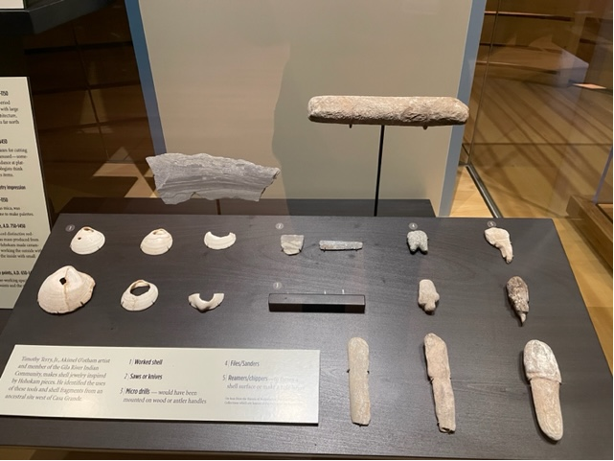
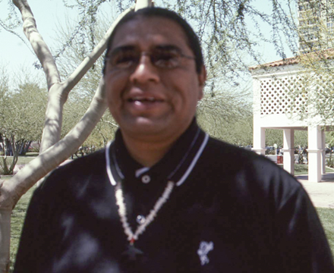
My grandfather told me about
them, the ancestral shell-
workers. He said this is what
we do, the work that we do.
We work with shells; this is
how they did it.
Timothy Terry, Jr.,
Gila River Indian Community, 2004.
We borrowed shell working tools from the Huhugam
Heritage Center. These are the only things in HOME that
were borrowed.
Shell art is included in Substance of Stars.
Tools include reamers/chippers, files/sanders, cutting tools—saws and knives, drills and micro-drills.

Slide 6
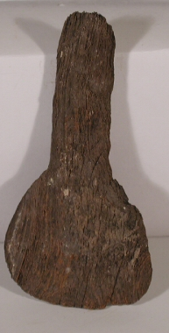
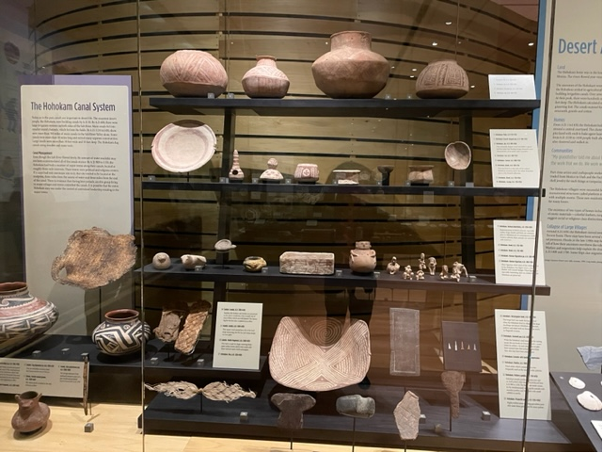
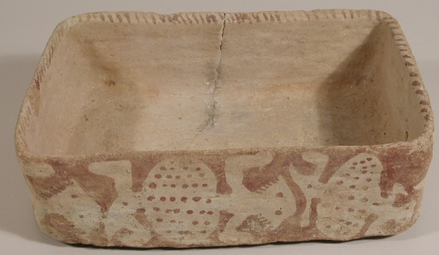
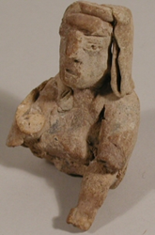
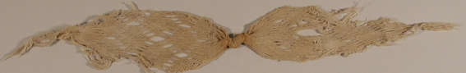
Red on Buff Pottery: the red is from hematite.
Made with a paddle and anvil technique.
900-1150 C. E. Gila monsters
decorate this rectangular bowl.
Pottery from this period is found
as far north as Flagstaff. The term
mass produced has been used.
Mention the ceramic figures that are
Especially important given the lack of
information about clothing, due to
Huhugam practice of cremation. .
Cotton belt, finger woven of finely-spun fiber. Entire shirts
were made using this technique. 1200-1450 C. E. Once
again, mention the amazing preservation in the Southwest.

Slide 7
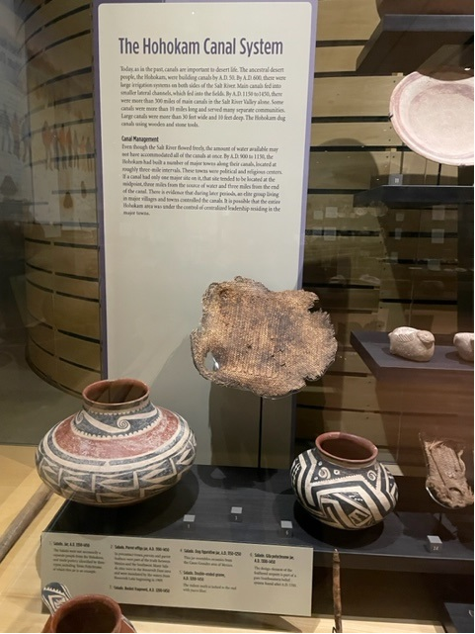
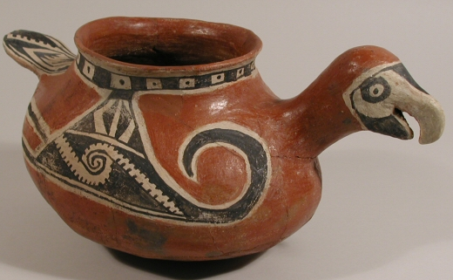
The Salado lived around the Tonto basin and what is now the Roosevelt Lake
area. The were not necessarily a separate people from the Huhugam, perhaps
a branch or at least neighbors.
Their ceramics shown date from 1100-1450 C. E.
The whole Huhugam, Salado area was part of
a wide trade network with Mexico that brought
up parrots and copper bells among other things.

Slide 8
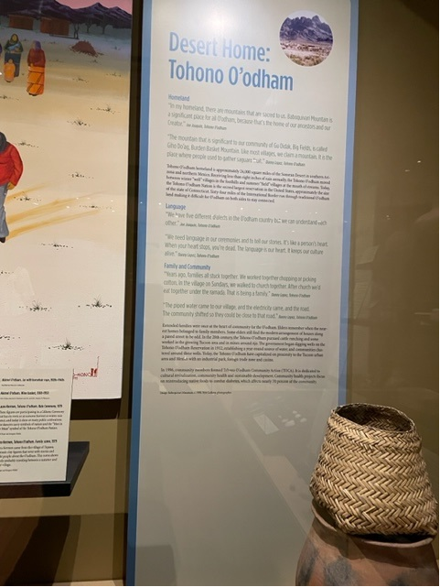
Tohono O’odham and Akimel O’odham,
Desert People and River People
The groups listed below are members of the Four Southern Tribes working group who have assisted us in so many ways including repatriation and the land acknowledgement.
Reservations include:
Gila River Indian Community, established in 1859 making it the oldest in Arizona.
Salt River Pima-Maricopa Indian Community, established in 1875 by people from Gila River seeking adequate water for farming after Anglo water users redirected water and left too little for their
needs. Subsequent damming in the early 20th century made matters much worse.
Ak-Chin Indian Community, established in 1912, started with 47,600 acres. The next year it was more than cut in half down to 22,000. Ak-Chin Farms cultivates 15,000 acres making it one of the largest farming enterprises In the U.S. It has the Ak-Chin Him-Dak Eco Museum.
Tohono O’odham Nation, main reservation was established in 1917. The earliest of the three smaller reservations San Xavier was established in 1874 with Gila Bend in 1882 and Florence in 1978.
It has the second largest land base in Arizona, comparable to the size of Connecticut. 64 miles of International Border cross O’odham land.

Slide 9
We have five different dialects in the O’odham country, but we can understand each other.
Joe Joaquin, Tohono O’odham
We need language to tell our stories and in our ceremonies. It’s like a person’s heart.
When your heart stops, you’re dead. The language is our heart. It keeps our culture alive.
Danny Lopez, Tohono O’odham

Slide 10
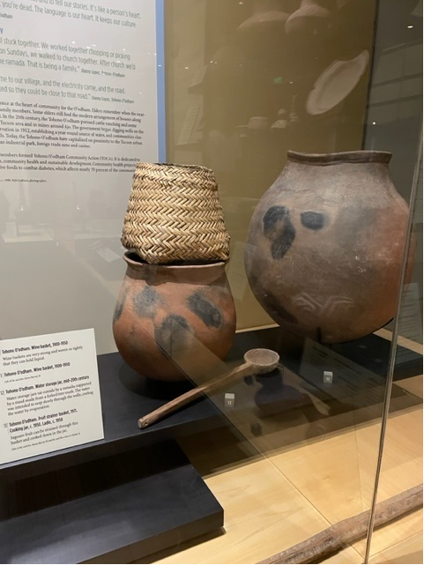
A basket to strain juice from crushed saguaro fruit is on top of a pot used
to cook down the juice to a syrup. You can talk about this in connection with
Mike Chiago’s painting.
The really large jar is a water jar that was low-fired to be slightly permeable
letting some water seep out to the surface, so that evaporation would cool
the water inside.

Slide 11
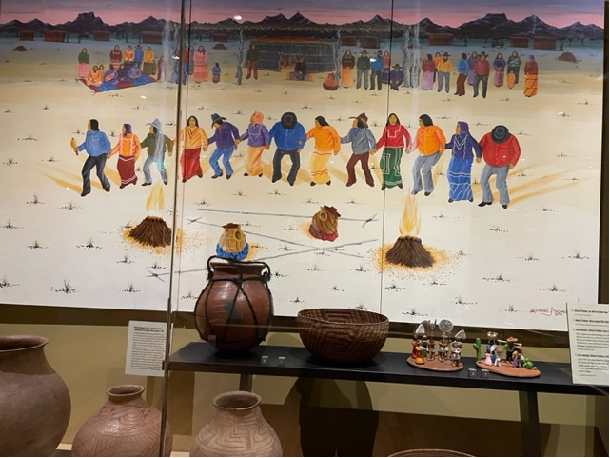
In a sense the ceremony Mike is depicting is a New Year
celebration that occurs at the ripening of saguaro fruit in
late June—just as people are coming out of the leanest
months of the year.
Michael Chiago (b. 1946), Tohono O’odham. “Rain House and Saguaro Wine Festival,” 1993. “In the old days, the saguaro
provided the people with fresh fruit, syrup and a cake made from the seeds. The syrup-making process produces a juice, which
ferments for three days in the rain house under the care of the Keeper of the Smoke, the village headman and ceremonial leader.
Rain songs are sung, and men and women dance at night. At noon of the third day, the headmen gather to recite poems over the
baskets of wine. The men of the village sit in a circle and pass the baskets until they are drained. The planting of crops takes
place after the wine festival to make use of the rains that are bound to follow. Today, many families still prepare the saguaro
wine for their own use, and the custom to cover the wine with a song continues; anyone who accepts a drink of the wine recites a
poem, which invariably relates to clouds or rain.” Michael Chiago 3458-1

Slide 12
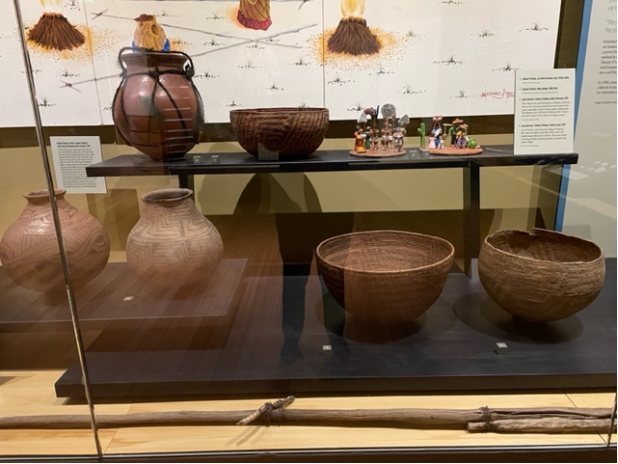
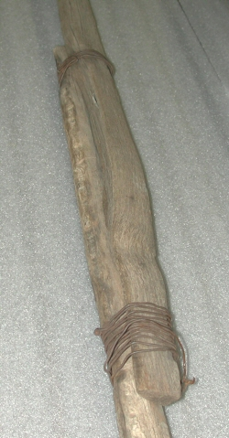
Some of the jars and baskets pictured in the painting
are clustered below.
Be sure to point out that the wine baskets actually
hold wine because they are so tightly woven.
Kui’pad made by Baptisto Lopez. A saguaro fruit-picking stick. Made of
saguaro ribs wired together. 2 long ribs with short picking pieces bound
across near top and bottom of the upper segment. Purchase price $15.
It was used for several years (up to summer of 1976). During the winter
Baptisto stored the sticks at the saguaro camp, standing upright, tied to
a tree to prevent them from rotting.

Slide 13
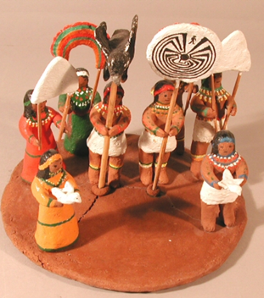
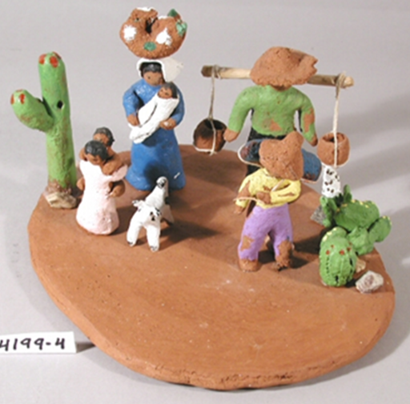
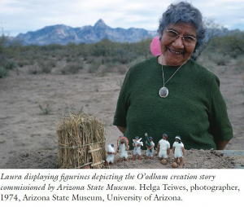
Laura Kerman figurative scenes, 1979. Laura Kerman, from the village of
Topawa was a schoolteacher before finding ways to teach through pottery.
Here is a Célonka Ceremony done at public celebrations with roots in
autumn harvests and winter rain dances. Symbols include clouds, a rainbow,
Mountains, birds and the Man in the Maze you can learn more about in SOS.
The lower scene also done in 1979 seems to show a family moving from one
seasonal village to another. This is a way to point out that Tohono O’odham
people living away from rivers would travel between summer field villages at
the mouth of streams and winter well villages higher up near springs.
Laura Kerman froma photograph by Helga Teiwes
Used in the Journal of the Southwest Autumn 2019
Issue in a story written by Karen Louise Reichhardt.

Slide 14
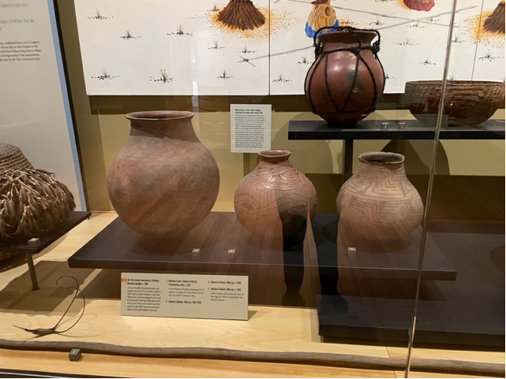
Most of the wine jars are c. 1930. It may be interesting to
note that when we were working with he wine jars we
noticed a sweet syrup-like smell even after many years.

Slide 15
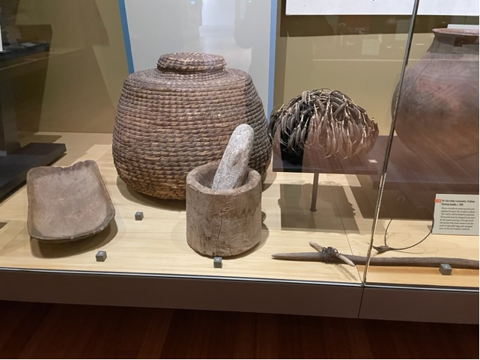
This is an important spot to talk about desert foods and
The baskets used to process the foods. We have a
martynia “hat,” which is a convenient way to store the
pods. Also called devil’s claw. One pod is detached. Tell
people that weavers would collect and plant the seeds of
pods with long claws, desirable for basket elements. The
mortar and pestle are for processing mesquite pods. The
wheat straw storage basket if for storing the wheat grains.
Here you can see the end of the kui’pad.

Slide 16
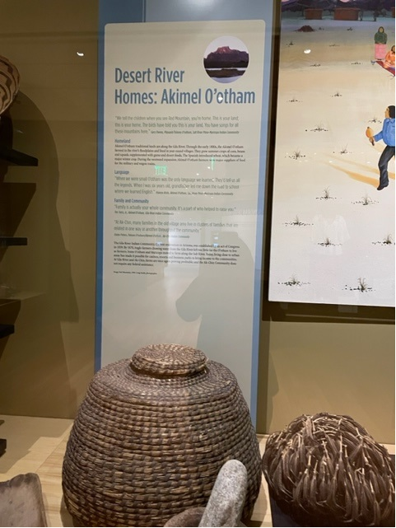
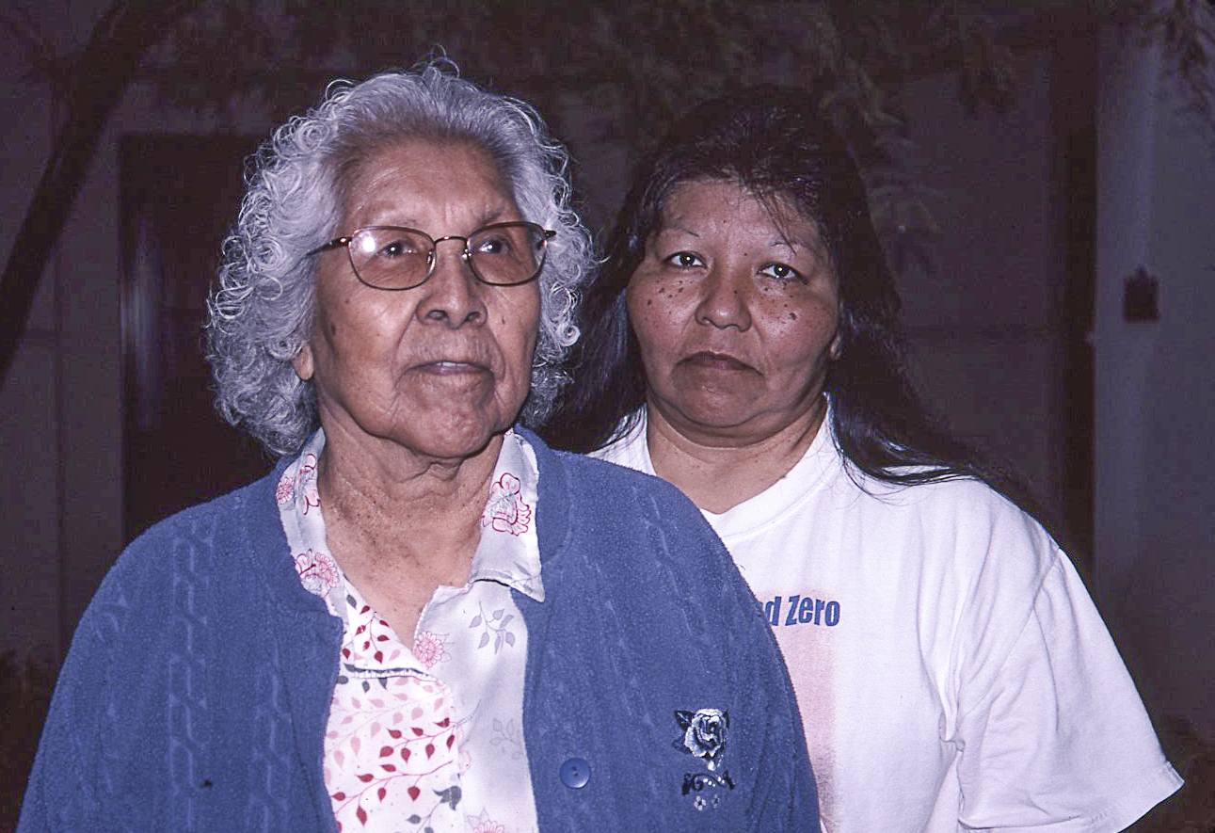
Language
When we were small O’odham was the only language we learned.
They’d tell us all the legends. When I was six years old, grandfather led
me down the road to school where we learned English. It was good that
they taught us English, but I would like to have the people learn more
about O’odham. Frances Kisto, Akimel O’odham, Salt River Pima-Maricopa Indian Community
Family and Community
Life changes so fast that we forget we have our relatives.
In the O’odham way, your first cousins are your brothers and sisters;
your grandparents’ siblings are your grandpa and grandma. Family is
actually your whole community. It’s a part of who helped to raise you.
Tim Terry, Jr., Akimel O’odham
At Ak-Chin, many families in the old village area live in clusters
of families that are related in one way or another throughout the
community. Elaine Peters, Ak-Chin Indian Community

Slide 17
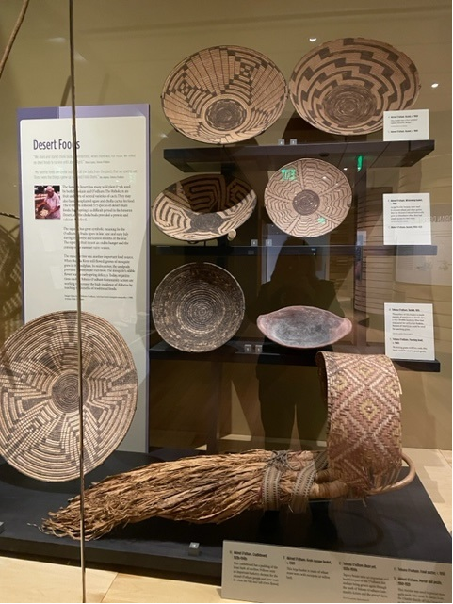
This is where we put lots of wonderful Akimel O’odham coiled baskets
made of willow and martynia sewing elements on a bear grass bundle. You
can point out that the willow was available to weavers because of the
rivers. When you get to the Tohon O’odham baskets, especially the newer
ones you will see yucca as the dominant sewing element.
Most of the baskets are c. 1900 and could be used for winnowing wheat.
These also became very collectible baskets during the Arts and Crafts movement. Note the martynia center on baskets, made to guard against wear. You should check SOS to see O’odham comments about basket designs. The large basket has a five-petal squah blossom desig.
Also shown is a pottery parching tray used to parch wheat and a
cradleboard with a beautifully colored hood and padding of the inner bark
of willows

Slide 18
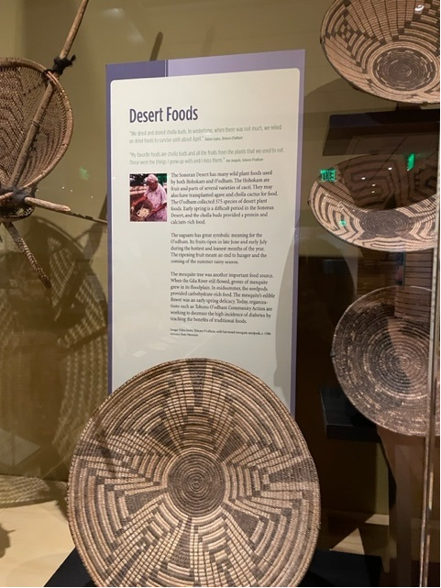
We dried and stored cholla buds. In wintertime when there was not much,
we relied on dried foods to survive until about April.
Danny Lopez, Tohono O’odham
My favorite foods are cholla buds and all the fruits from the plants that
we used to eat. Those were the things I grew up with, and I miss them.
Joe Joaquin, Tohono O’odham
Creating an appreciation for the many ways O’odham
people nourished themselves from desert plants is
important. They collected over 375 species of desert plant
foods. Cholla buds (protein and calcium) and mesquite
pods (carbohydrates) were important.

Slide 19
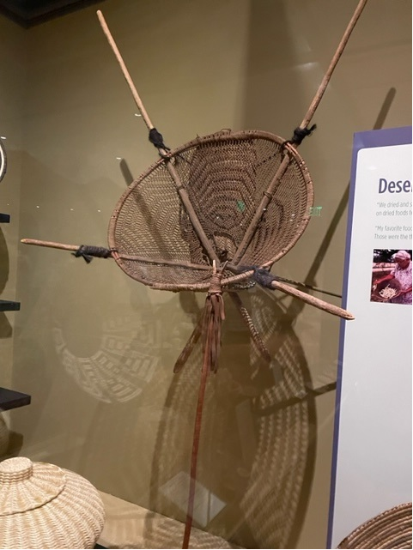
Kiaha or burden basket, c. 1890. The extended sticks made it possible
For a person to carry a large load of firewood. The utility stick
supported the person carrying the burden and kept the basket from
tipping over when it wasn’t being worn. Royce Manuel of SRPMIC
recreated the netting method by which these were made. He
was a recipient of a Heard Museum Spirit of the Heard award.

Slide 20
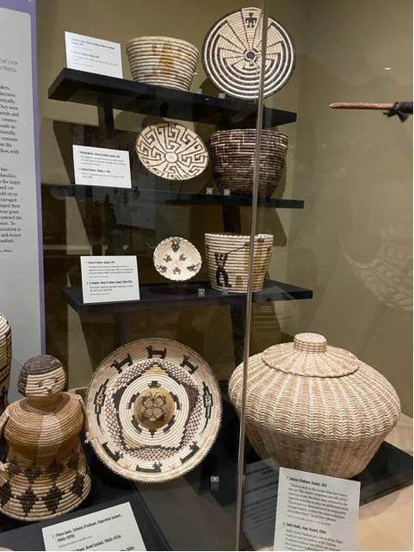
In this section you see Tohono O’odham baskets made for sale,
Including the split stitch technique that employes bleached and
Unbleached yucca to partially expose the coil. Terrol Dew
Johnson said it was a descendant of the big grain storage baskets
where you could see the bundle base of the coil.
The turtle basket is a hybrid made by Sadie Marks, 1990s. Sadie
Marks is Hopi married to a Tohono O’odham man and she
blended the two basketry traditions here.

Slide 21
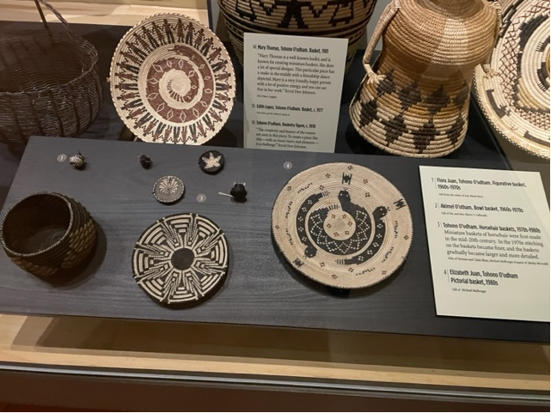
Fortunately as we get to more recent baskets, we
the weavers names. The basket with the people
surrounding a snake is a friendship design by
Mary Thomas. Terroll Dew Johnson said that “Mary
Is a very friendly, happy person with a lot of positive
energy and you can see it in her work.”
Elizabeth Juan, Tohono O’odham, large
horsehair basket, 1970s. The weaver told
Bruce McGee that she made the horsehair
rattlesnake basket in the HOME exhibit.

Slide 22
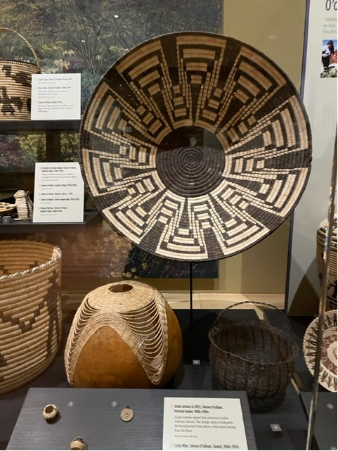
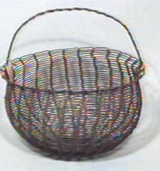
Terrol Dew Johnson (b. 1971), Tohono O’odham. Basket, 2001.
“This basket is one of my contemporary pieces. This was made with
a gourd as a base and bear grass for the top. I do traditional and
contemporary work. This reminded me of ripples of water.
When you drop a stone in the water the water comes up, but it also
ripples.” Terrol Dew Johnson
Eugene Lopez, Tohono O’odham. Basket, c. 1970.
“Eugene Lopez is the weaver who brought the wire basket to the
public. He has done a lot of wire baskets that have amazing shapes
and sizes. He has taught classes. He now works with baling wire
baskets. He gets the wire from cowboys who leave it out when they
are finished with the bales of hay. He strings it and works it and
weaves baskets. He also taught his niece how to weave wire.”
Terrol Dew Johnson.

Slide 23
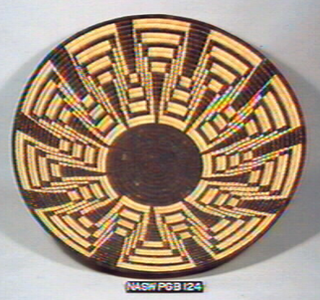
Dorothy Lopez, Tohono O’odham. Squash blossom basket, 1974.
Advisor Terrol Dew Johnson commented on the skill with which
the weaver managed to keep the design balanced and the petals of the blossom perfectly
spaced.

Slide 24
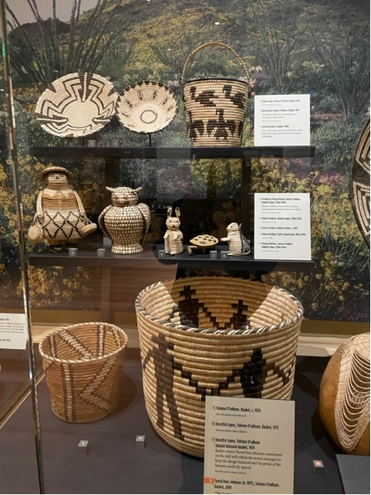
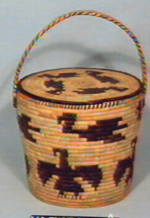
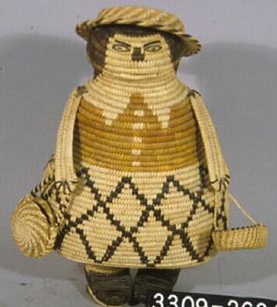
Really clever effigy figures. The turtle is a bank.
Lidded basket, c. 1970. Note the transition to
Baskets with flat bottoms that can sit on shelves.
also, baskets with well-fitted lids are challenging
to make.
Virginia Miguel, c. 1970.
“The creativity and humor of the weaver are seen in this piece.
To create a pieces like this—with so many layers and elements—is a
challenge.”
Terrol Dew Johnson

Slide 25
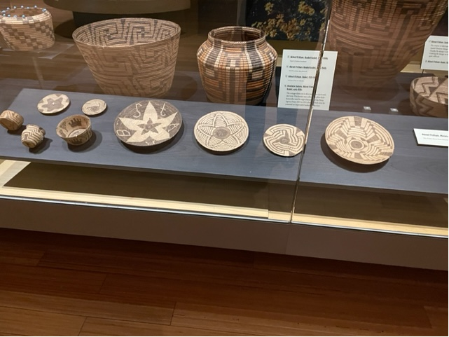
Miniature baskets really came to the fore in the early
1900s as the water was taken from the Akimel O’odham
baskets became an increasingly important source
of income, especially given the proximity to urban
areas.

Slide 26
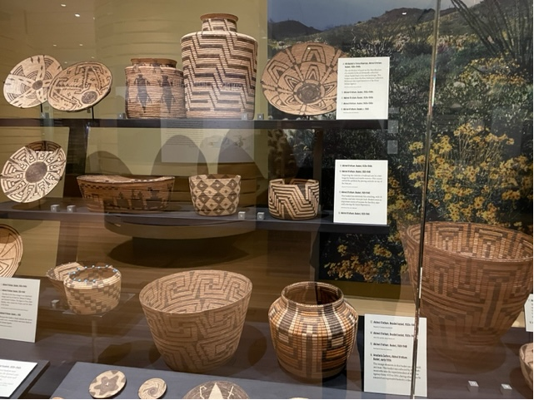
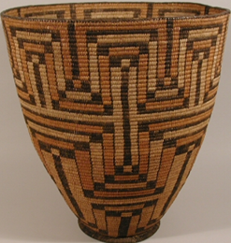
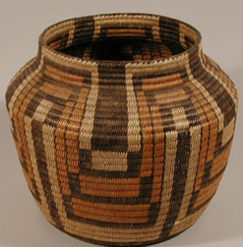
Polychrome basket, dyed with utoi
root, c. 1920. Tammy Kisto referred to this as a pumpkin flower design.
Working this design on a vase-shape
basket instead of a flat basket would have been a challenge. From the original Heard collection
Anastasia Zachary, early 1930s
From the Bert Robinson collection.
Robinson developed his collection
between 1935 and 1951 when he
Was the superintendent at the
Pima Indian Agency.

Slide 27
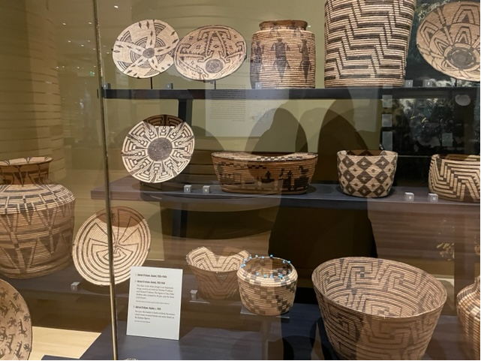
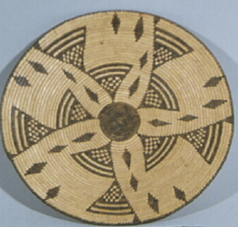
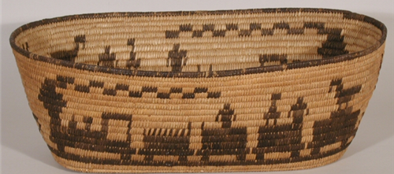
Attributed to Teresa Newman, 1920s-1940s
Another from the Robinson
Collection. The maker’s name
Attribution was made after seeing the exhibit of the Breazeale collection at the Huhugam Heritage Center and comparing the basket to the one pictured in Figure 75 on page 87 of the book about the Breazeale collection "The Pima and His Basket" by James Frank Breazeale.
Train Pictorial basket, 1920-1940. Another depiction of a train on an unusually shaped basket that the weaver created to fit her design. From Carolann Smurthwaite’s collection.

Slide 28
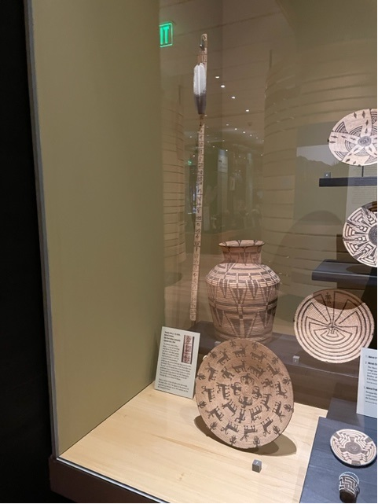
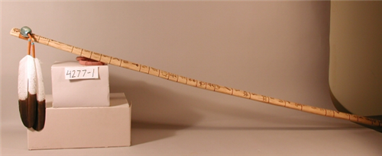
Tim Terry, Jr. Calendar stick, 2004
The artist created a replica of a calendar stick from the mid-1800s. One
Of the images on the stick is a reminder of an 1859 meteor seen by the
Akimel O’odham. Remind people of the calendar stick in Indigenous
Evolution. Calendar sticks recorded important events in the maker’s life
and in the community.

Slide 29
Yoeme (Yaqui)
Home in Two Countries

Slide 30
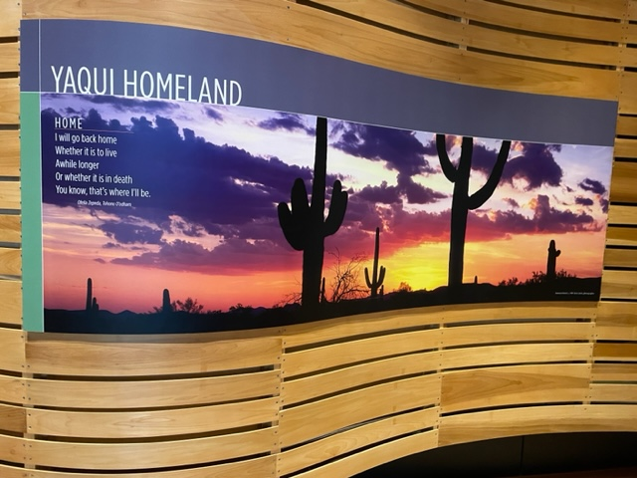

Slide 31
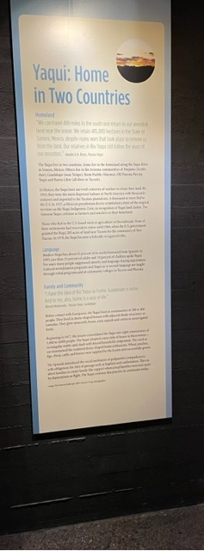
We can travel 400 miles to the south and return to our ancestral land near the ocean. We retain 485,000 hectares in the State of Sonora, Mexico, despite many wars that took place to remove us from the land. Our relatives in Rio Yaqui still follow the ways of our ancestors. Amalia A.M. Reyes, Pascua Yaqui, 2000.
Home is the Rio Yaqui area of Sonora. Warfare with the Spanish and Mexican governments led
to them, by 1910, being the most dispersed Indians in North America with thousands enslaved and
deported to the rubber plantations of the Yucatan.
They established communities in Penjamo, Guadalupe, Yoem Pueblo (Marana) Old Pascua, Pascua
Yaqui and Barrio Libre. New Pascua was the name given to the 200 acres of reservation land near
Tucson in 1964, and in 1978, the Yaqui became a federally recognized tribe.
Modern Yaqui has 65% of words borrowed from the Spanish. The Jesuits relationships with the
Yaqui was quite different than that of the Franciscans in the New Mexico Pueblos. The result
created not just a merging of language but of customs.

Slide 32
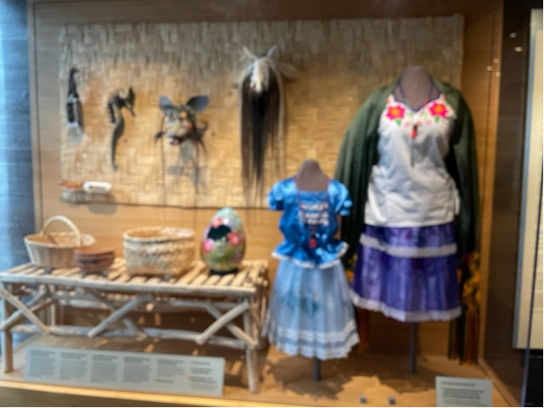
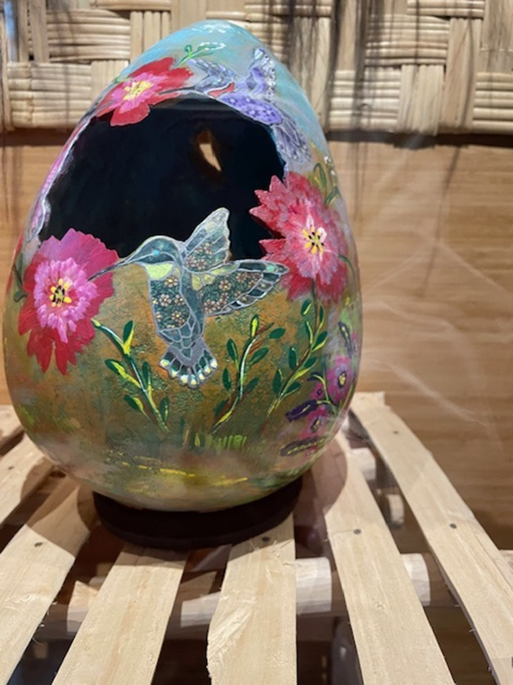
Janet Cantley went down to the Rio Yaqui and
Collected some of the clothing and baskets shown here.
The Maldonado family of Guadalupe Merced, Beatrice
and Alex created many of the pieces in these cases.
Beatrice Maldonado,
Flower World Gourd, 2004
the Flower World is one of
several Yoeme worlds. It is
a metaphor for all that is good and
beautiful. The flowers on the
blouse are also a reference to
the Flower World.

Slide 33

Merced Maldonado (b. 1956), Pascua Yaqui. Torim mask, 2004.
“This is the mask of Torim. He’s like a tree rat. In our stories, he is the first
drummer, but we also call him Tampaleo. But he doesn’t just drum, he also
carries a melody. He whistles through his teeth, and he’s the one that originated
our cane flute. We don’t have teeth like he does or a mouth shaped like his;
his mouth is actually like a flute. The red spots on his chin represent
pomegranates When I made this mask, I imagined that he was eating
pomegranates--really enjoying them--and he’s got all these seeds on his chin.
I carved the teeth out of a buffalo rib that I had at home, because I wanted
something that was just like teeth. You can see the little hole that he would be
whistling through. So this is Torim.” Merced Maldonado

Slide 34

Merced Maldonado (b. 1956), Pascua Yaqui. Sea horse rattle, 2004.
“My dad used to bring us sea horses from Rio Yaqui, and he would give
them to us for good luck. My dad would say when times are bad, you have
to remember the sea horse. When the currents is against him, he grabs
onto that seaweed and he holds on with his tail and all that force just goes
past him.
And when the current changes, then it carries him forward. And that’s
the way life is. There will be times when everything is against you and
you’re trying to swim against the current. So the seahorse teaches you to
hold on during the hard times when everything’s against you and save your
energy, and when things change, you’re full of energy and ready to go.”
Merced Maldonado

Slide 35

As a Pascola when we’re in ceremonies, especially funerals
and anniversaries, we bring the humor, and we really have
to turn around all the sadness at funerals.
It almost sounds like we’re making fun, but we’re not.
We’re just turning feelings so that people are not so sad-
-feeling so much pain. Merced Maldonado, Yoeme
Every fiesta must have a Pascola. Pascola is a combination
Of two Yaqui words, pahko which means fiesta and ‘ola
Which means old man.

Slide 36

Alex Maldonado (b. 1959), Pascua Yaqui. Harp, 2004. “Harps have been used for a long time since they were introduced to our tribe by the Spaniards. Catholicism was also introduced into our culture. So there’s a combination of old traditions and what we consider new traditions even though it was introduced probably almost 400 years ago. The harp is usually used in our ceremonies whether it’s funerals, or a baptismal, or celebrations, and also social events. Generally, when the harp is being played, we have a dancer called the pascola, and he dances in front of the harp. The harp is accompanied by the violin. So that’s what we consider the newer tradition. The old traditions would consist of a drum and a flute played at the same time by a person called tampaleo.” Alex Maldonado

Slide 37

Alex Maldonado (b. 1959), Pascua Yaqui, Figure, 2004.
“The pascola in this carving is just waiting his turn to dance. He’s taking
a little rest. And he’s also the elder. There are usually three pascolas that
dance, and there’s always an elder. Sometimes four, but generally there’s
three. When he’s not dancing, he’s got a wooden mask on the side of his
face because he’s not going to be wearing that all of the time.
Sometimes he’ll put it on the side, sometimes he’ll move it all the way on
the back of his head. The necklace that he wears, hopo’orosim is also part
of the regalia. It’s for protection. Around his ankles, he would be wearing
butterfly cocoons. Tenevoim is what they’re called in our language.
They’re like rattles. They’ll make a lot of noise and they’re filled with little
pebbles. A pascola dances with rhythm.” Alex Maldonado
Esteban Matus (b. 1962), Pascua Yaqui. Figure, 2004.
According to the artist, many Yaqui young people play baseball and also
are learning about traditional Yaqui culture, so he carved a
baseball-playing Pascola figure as a way to connect with young people.

Slide 38



Remember to tell people about Mario Martinez mural to their right as they enter the museum. He called it a cultural portrait of the Yaqui people and included notable events and leaders in his community.

