Slide 1
Colorado River Tribes and Pee Posh/Piipaash

Slide 2
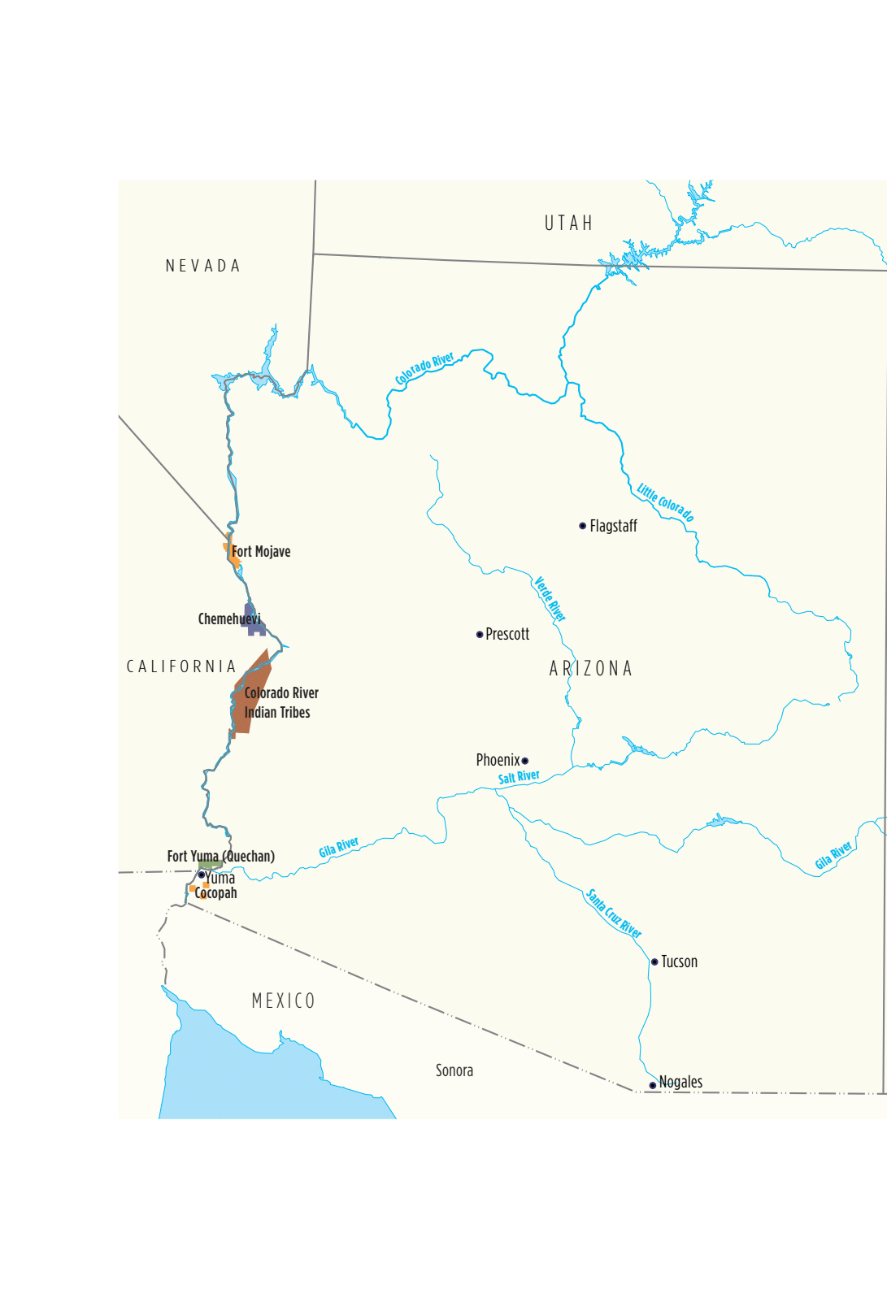
Colorado River Lands
Sonoran Desert is on the east; the Mojave Desert is on the west
Annual rainfall approximately 4.5 inches
Traditional lands lie along the Colorado River where people
farmed and employed floodplain farming techniques. Diversion of
Colorado River water began in 1877 by settler colonials irrigating
the Imperial Valley. Construction of Hoover dam 1931-1936, shifted
agriculture to irrigation. Agriculture remains important as needs for
Colorado River water increase throughout the region.
Federal and state boundaries cross through their traditional lands.
The tribes from north to south are:
Fort Mojave
Colorado River Indian Tribes
Quechan
Cocopah
The Colorado River was our lifeblood, and it still is today because we
are an agricultural community, and everything that we live on comes
from the river. Veronica Homer, Mohave

Slide 3
Fort Mojave Indian Tribe: Federally Recognized 1910
Based in Needles, California, the Pipa Aha Macav (People by the River) includes more than 1,120 members
living on nearly 42,000 acres in Arizona, Nevada and California. Their traditional lands are along the
Colorado River, where they were farming when the Spanish first encountered them in the 16th century.
According to the tribe’s website, at that time the Mojaves were the largest concentration of people in the
Southwest with trade networks that stretched to the Pacific Ocean. The name of their reservation derives
from the military outpost established in 1859, as the people protected their lands from colonizers traveling
west to California. The military fort closed in 1891. Agriculture and tourism are important contributors to
the tribe’s economy.
Colorado River Indian Tribes: Federally Recognized: 1865 CRIT is unique because of our tribal makeup. We are in two states and three counties and have a non-Indian town [Parker] within the reservation.
The Colorado River Indian Tribes (CRIT) land is located along both sides of the Colorado River in Arizona and California. A portion of Parker, Arizona, lies within CRIT land. When the reservation was established, the Mohave (spelling preference) and Chemehuevi peoples lived there. The Hualapai, Yavapai and Quechan were initially supposed to be moved there but refused to leave their ancestral homelands. In 1945, land was set aside for Hopi and Navajo people who wished to settle there because of their work on the Grand Canal, part of the Central Arizona Project. Agriculture remains an important part of the community’s economy. The ‘Ahakav Tribal Preserve, established in 1995, offers opportunities for recreation and learning about sustainability of the Lower Colorado River basin.
You can suggest that people watch the video in the alcove to learn
more about the ‘Ahakav Tribal Preserve

Slide 4
Quechan Tribe: Federally Recognized: 1884
The lands of the Fort Yuma Quechan Reservation lie along both sides of the Colorado River, bordering California and Baja
California, Mexico. In 2013, the Quechan (Kwatsáan) tribe had more than 3,200 enrolled members and encompassed
45,000 acres. Agriculture is an important part of the tribe’s economy, with thousands of acres leased to both Indian
and non-Indian farmers. The reservation is bisected by Interstate 8, and its location makes it a popular destination for
winter visitors with the Quechan Casino Resort in Winterhaven, California; the Paradise Casino in Yuma, Arizona;
five trailer and RV parks; and the Fort Yuma Quechan Museum. For all of the Yuman peoples, special gatherings
featuring Bird Song singers and dancers are important traditions.
Cocopah Indian Tribe: Federally Recognized: 1917
The Kwapa are known as the River People for the location of their traditional homelands along the lower Colorado River and its delta. They are part of the Yuman language family, which includes the Yavapai, Havasupai, Hualapai, Maricopa, Quechan, Mojave, Kumeyaay, Ipai and Pai Pai tribes. When steamboat traffic was active on the Colorado River, prior to the arrival of the railroad, Kwapa men were valued as river pilots. They were split between the United States and Mexico at the time of the
Gadsden Purchase.
The 6,500 acres of tribal lands are located 13 miles south of Yuma, Arizona, consisting of three non-contiguous parcels: the North, West and East reservations. The tribe has slightly more than 1,000 enrolled members.

Slide 5
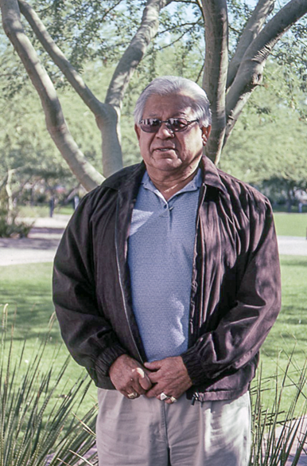
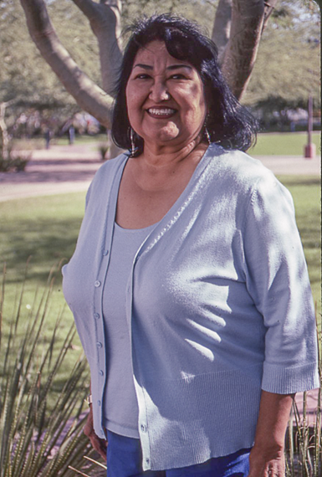
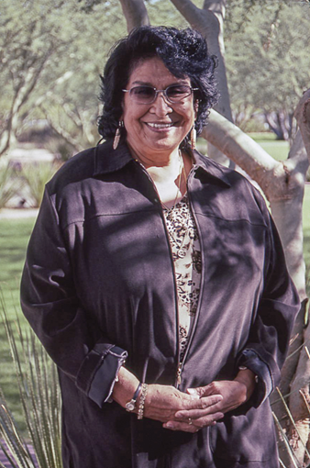
Spirit Mountain is where we were created.
The Colorado River goes through our
reservation and we’re protected by the
mountains, Monument Peak, the Black
Mountain, Riverside Mountain,
Mesquite Mountain, Moon Mountain,
the Big Marias protect our reservation.
They're all sacred to us.
Herman “TJ” Laffoon
Mohave, CRIT
You learn English to progress in the
White world and your own language to survive forever.
Veronica Homer
Mohave, CRIT
What gives me hope for the future are the elders and parents who are teaching tribal tradition,
culture and tribal history to our youth and just families that stay together, work together
and all the blessings we’ve received from the creator to make our lives better. Vicki Laffoon
Mohave, CRIT

Slide 6
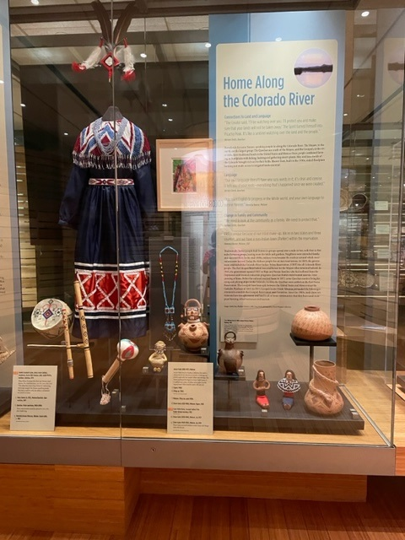
When Elissa Percharo, Pee Posh and Yolanda Hart Stevens, Pee Posh, Quechan, saw this dress they said, “This dress has many songs behind it,” referencing bird songs sung by the Yuman-speaking people.
Arranged around the dress are drums, flutes, and a rattle that would be played by men accompanying the singers. Bird songs are not bird imitations. They are lengthy, complex song cycles that speak of origin stories and other oral traditions.
To the right in the case are Mohave effigy ceramics by Annie Fields and Elmer Gates,
featuring facial tattoos and traditional dress.

Slide 7
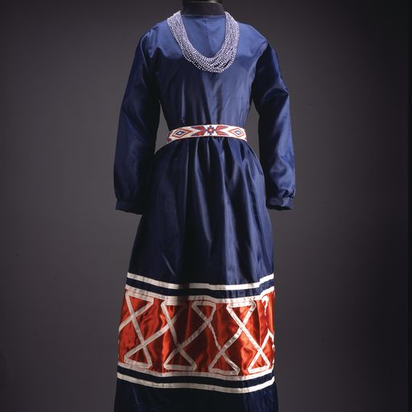
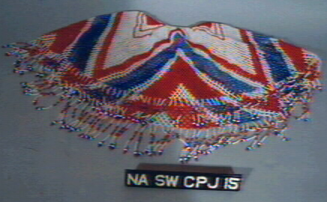
Amelia Escalanti Caster, Quechan. Dress, 1974.
This dress could be worn for either a ceremonial or a social occasion.
Anona Hills Qualupe, Quechan. Belt, 1974; and
Judith Piretta, Quechan. Necklace, 1974.
This cape necklace by Daisy Simms, Mohave/Quechan,
1987 is shown on this dress in HOME.

Slide 8
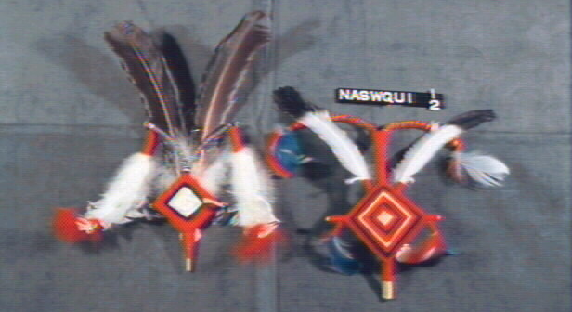
Headpiece on the left is on the figure in HOME.
Lorey Cachora, Quechan, Heard Museum purchase in 1974. Made from a mesquite root, decorated
with yarn and two large chicken buzzard feathers. The headdress at one time was worn by merely
sticking the base into the hair at the back of the head. Today, with the short hair styles the
ceremonial headdress is held in place by a beaded headband. The men have quit using this headdress
but the women wear it for their dances.

Slide 9
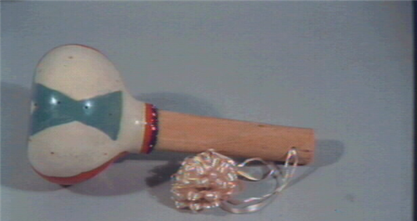
Henrietta Graves Peterson, Mohave, Gourd Rattle, c. 1963
The diamond pattern represents the Colorado River.
Only men make and use the gourd rattles. When they sing the
songs they are telling history. The gourd is dried in ashes
for bird songs. This is a bird gourd. Anybody can sing bird
songs. Longer gourds have a deeper sound and tell history
from the cradle to the grave. Louise Patch

Slide 10
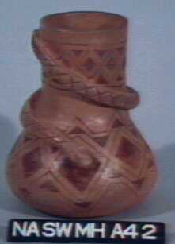
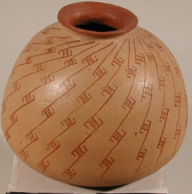
Elmer Gates, Mojave, (1929-1990), Jar, Purchased from the 1973 Heard Museum Guild Arts and Crafts
Exhibit, where it received an Honorable Mention award.
Gates lived in Poston on the Ft. Mojave Reservation. Traditionally Mojave women were potters. Gates
learned pottery making from his aunt.
He taught people to make pottery and enjoyed experimenting with pottery styles and techniques.
Elmer Gates based this 1974 jar shape and design on Huhugam ceramics.

Slide 11
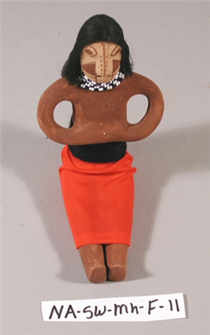
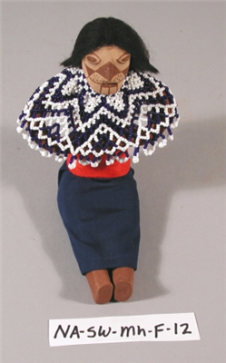
Elmer Gates received a blue ribbon for this pair in the Heard Museum Guild 1980 Arts and Crafts Exhibit.

Slide 12
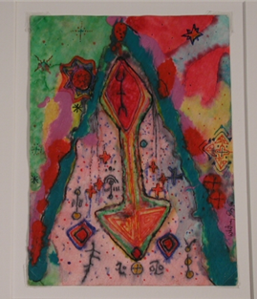
Whitney Grey (b. 1949) Mojave/Tohono O’odham, watercolor
Representation of a pictograph in the Mojave homelands near Needles,
California. It is a pictograph of a spirit being.

Slide 13
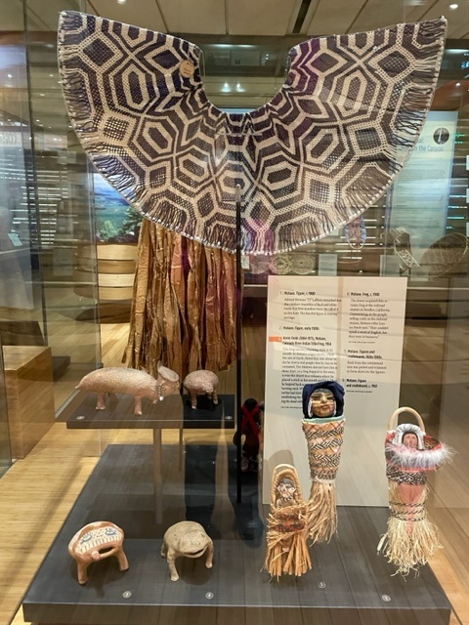
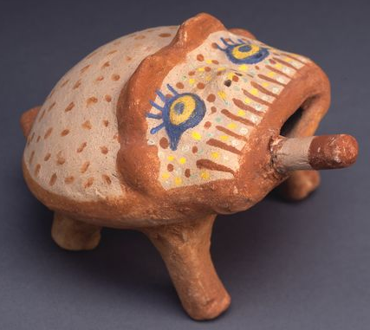
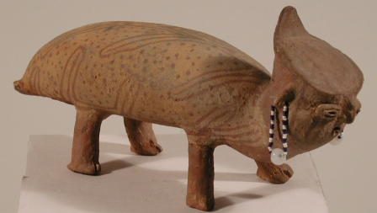
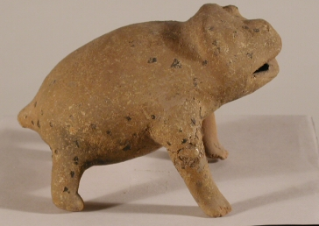
Annie Fields, Mojave (1884-1971) Enrolled at CRIT.
Frog, 1964
The figure references origin stories about Mutavilya,
the son of Earth. When he was about to die, he
instructed that he should be cremated, but the Mohave
didn’t have fire. A frog hopped across the desert to
gather fire from a volcano. When he returned, carrying
a burning stick in his mouth, Mutavilya was cremated,
establishing the Mohave tradition of cremating the
dead with their belongings.
Looks like a "hoonapnap," a black and white beetle that lives in the willow tree. (TJ Lafoon)
Frog, c. 1940. The frog was purchased at the
Santa Fe depot in Needles, California. Mohave elder
Louise Patch referred to people selling at the railroad
station saying, “They couldn’t speak a word of English
but they were in business.”

Slide 14
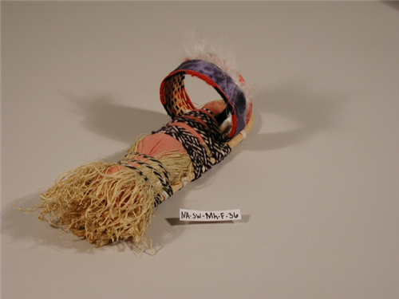
Henrietta Graves Peterson, Mohave, Miniature cradleboard for
an infant boy. c. 1963 Peterson made the rattle we saw earlier.

Slide 15
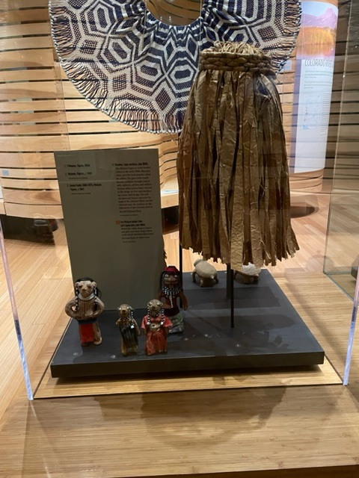
The dolls in front are older figures c. 1900 from the Fred Harvey
Company collection.

Slide 16
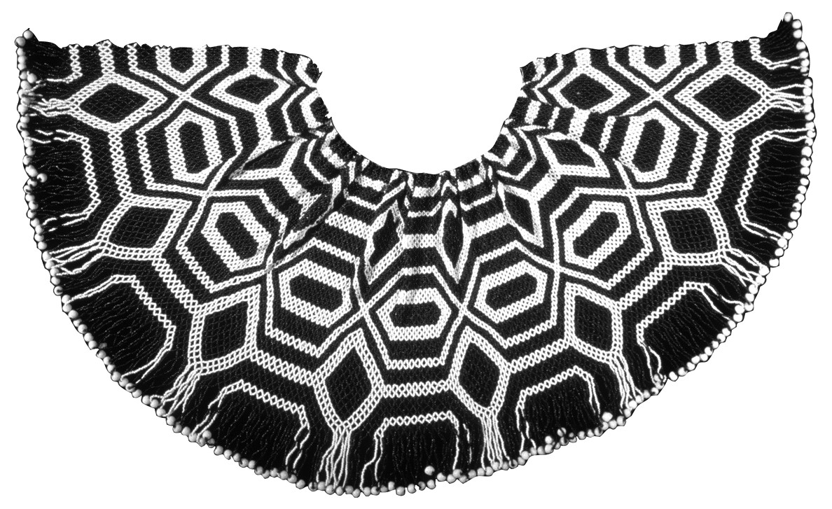
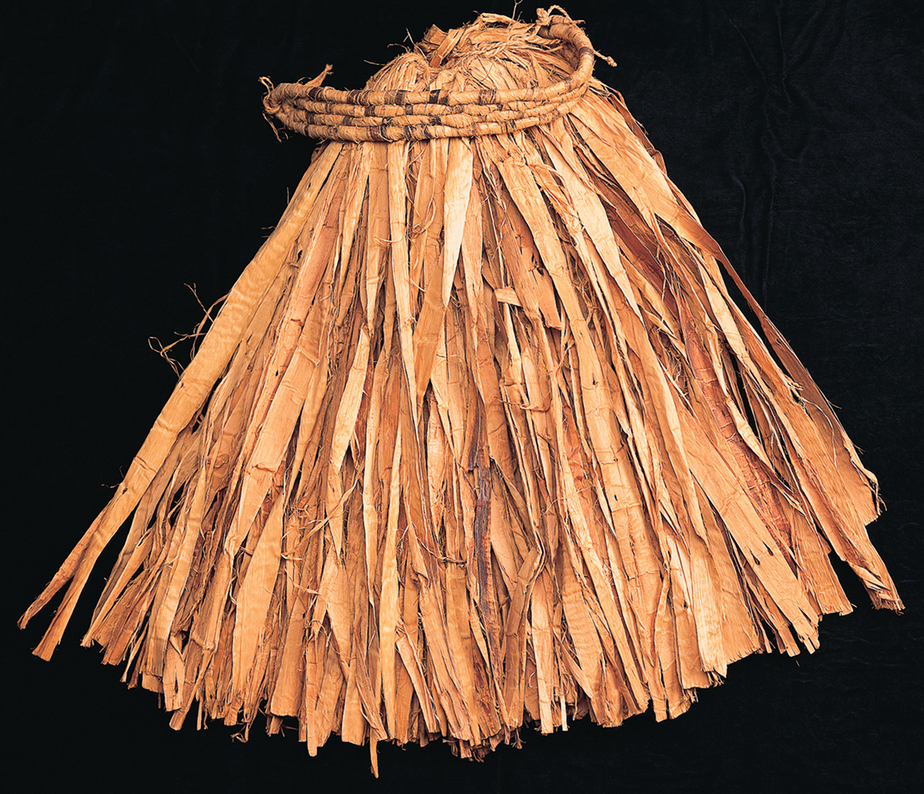
Mohave. Cape necklace, late 1800s.
The Mojave began to make beaded collars in the early 1880s. Blue and
white were the most popular colors for collars. The glass trade beads
became available through contact with explorers, settlers and soldiers.
Mohave elder Louise Patch referred to the design on this cape necklace as
a turtle shell design. She said the diamond shapes represent the bank of
the Colorado River, and the elements near the neckline are the tributaries
of the Colorado, such as the Bill Williams River.
Mohave. Bark skirt, mid-1800s. Before the 1860s, Mohave women wore
knee-length skirts made of soft shredded fibers from the inner bark of
willow trees.

Slide 17
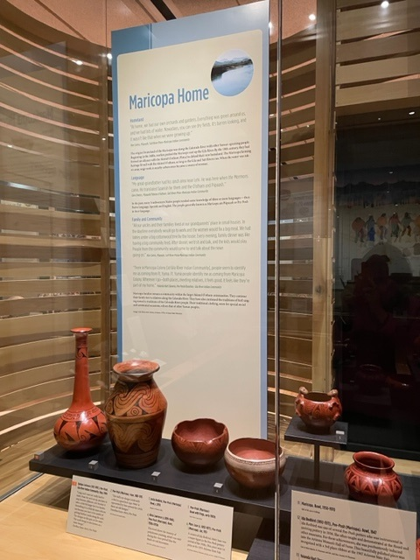
Maricopa---Pee Posh/Piipaash
Intertribal warfare among Colorado River peoples, over several
centuries gradually pushed the Yuman-speaking Pee Posh eastward
along the Gila River, forming defensive alliances with the O’odham
by the eighteenth century.
Communities within communities. Today, Maricopa communities are
part of the Gila River Indian Community and the Salt River
Pima-Maricopa Indian Community.
Many Maricopa families reside in the western portions of the
Gila River Indian Community and in the southern Lehi portion of the
Salt River Pima-Maricopa Indian Community.

Slide 18
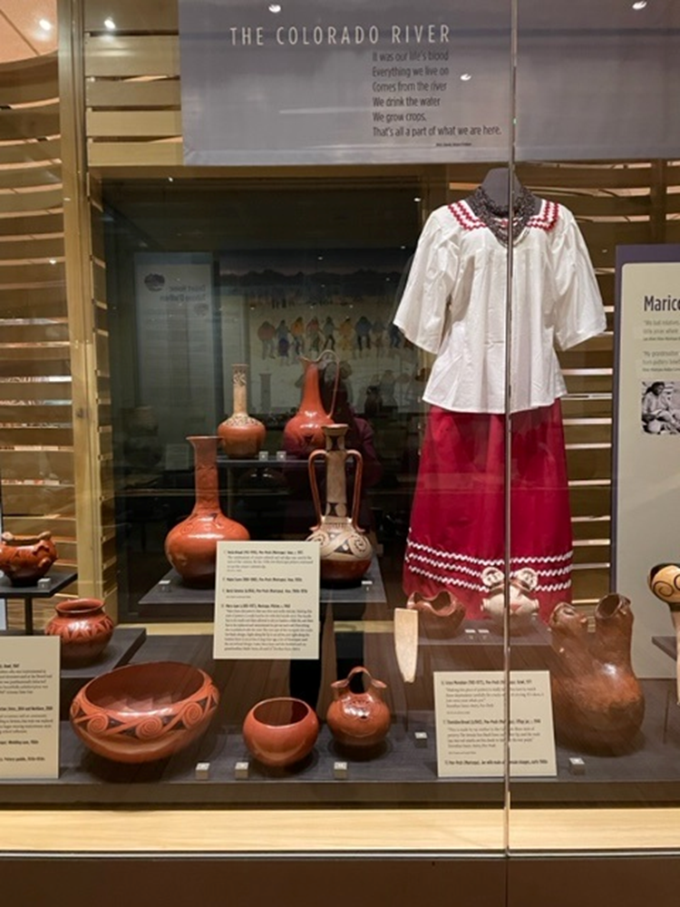
Yolanda Hart Stevens, Pee Posh/Quechan.
Dress, 2004 and Necklace, 2000.
This dress style is worn for social and formal occasions such as
community celebrations or cremation ceremonies. At cremation
ceremonies, women would wear this traditional attire to honor the
deceased and then at the end of the ceremony it is sent along with
the departed. The dress is in the style worn by adults and older women
in that it has two rows of jumbo ric-rac. A dress for a younger woman
or girl would have smaller ric-rac. According to Stevens, this style was
replaced as an everyday dress in the 1940s when women began
wearing mainstream style clothing, possibly as a result of the
boarding school influence. A traditional dress would have had a
wrap-around skirt.

Slide 19
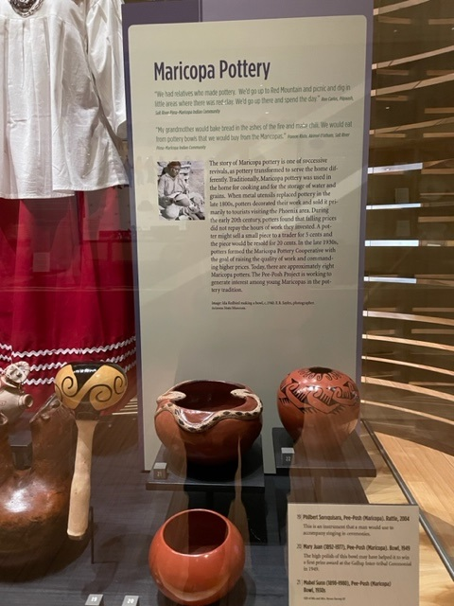
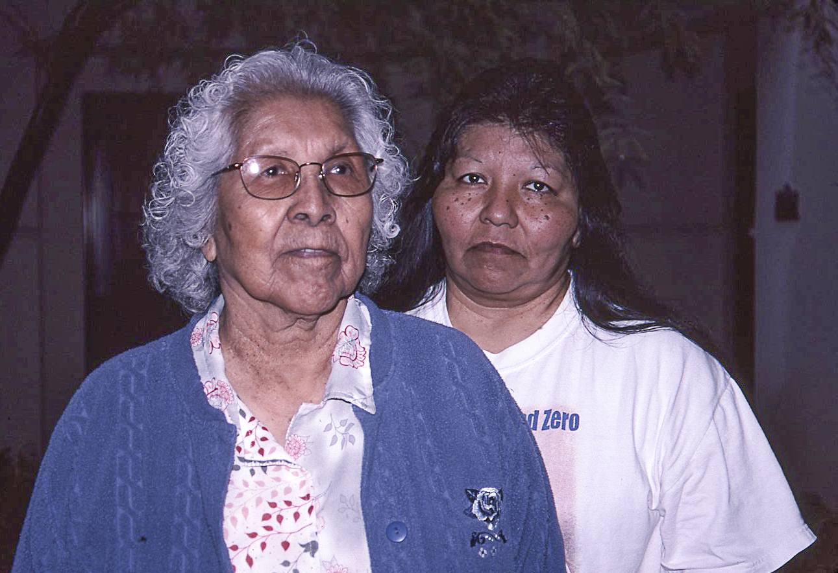
We had relatives who made pottery. We’d go up to Red Mountain
and picnic and dig in little areas where there was red clay. We’d go up
there and spend the day. Ron Carlos, Piipaash
My grandmother would bake bread in the ashes of the fire and make
chili. We would eat from pottery bowls that we would buy from
the Maricopas. Frances Kisto, Akimel O’odham
Maricopa Pottery: Serving the home in different ways through time
Original utilitarian forms for home cooking and storage
Late 1800s, sales to tourists brought income to the home.
Poor compensation led to the formation of the Maricopa Pottery
Cooperative in the 1930s aiming at raising prices and standards.
In the early 2000s, the Pee Posh Project began work with young
people to encourage interest in pottery production.

Slide 20
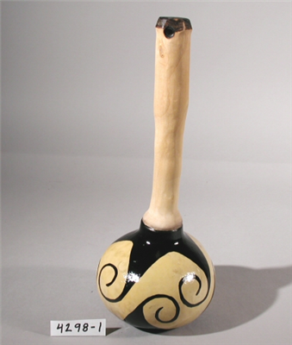
Philibert Soroquisara, Pee Posh, Gourd rattle, 2004.
Similar to instruments in Quechan case that accompany dancers.

Slide 21
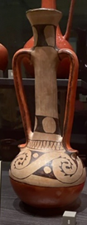
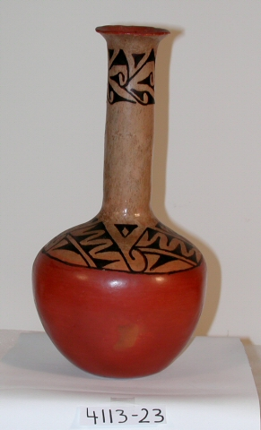
Mabel Sunn
Polychrome Vase, 1930s
The combination of cream-colored and red slips was used at
the turn of the century. By the 1930s few Maricopa potters
continued to use the cream-colored slip.
Beryl J. Stevens
Polychrome Vase, 1960s-1970s

Slide 22
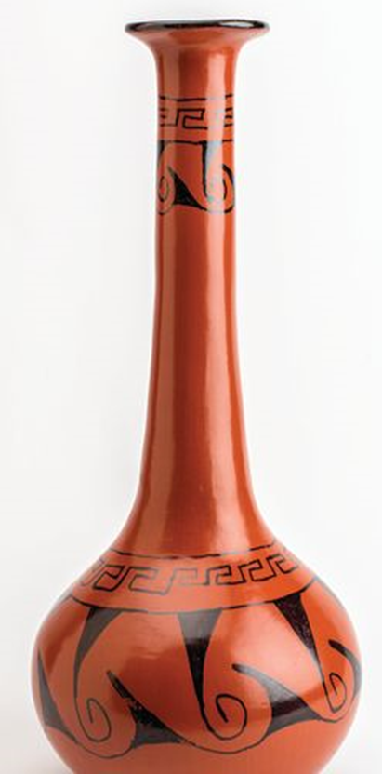
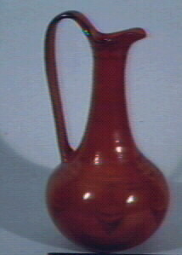
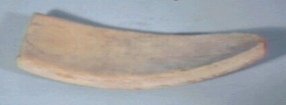
Barbara Johnson
Redware vase with water design, 1984
For this vase and the pitcher Dorothea Sunn Avery commented on the difficulty of getting judging when
the coils of the neck are sufficiently dry to support the next coil. Hairline cracks are a problem when
smoothing the very delicate surface.
Mary Juan
Redware Pitcher, 1950
Purchased by Maie Heard from Fred Wilson's Indian Trading Post in Phoenix on 4/3/1950
and donated to the museum. “Making this style of pottery is really hard to do with this handle on it. The handle has to be made and then allowed to dry, to harden a little bit, and then has to be replaced and remoistened to put on each end. Everything else is polished with the rock. The two saps of the Mesquite tree make the black design. Right along the lip is an arrow, and right along the bottom there is an arrow. A long time ago, a lot of Maricopas used the arrowhead design. Later, Mary Juan and Ida Redbird and my grandmother, Mable Sunn, all used it.” Dorthea Sunn-Avery
Mary Juan pottery paddle. It is shown without an anvil. It would be helpful to
explain the paddle and anvil technique of pottery shaping. The anvil is held in the hand
inside the vessel and the paddle flattens and shapes the clay against the anvil.

Slide 23
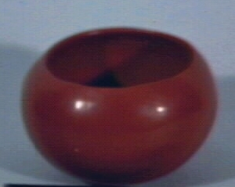
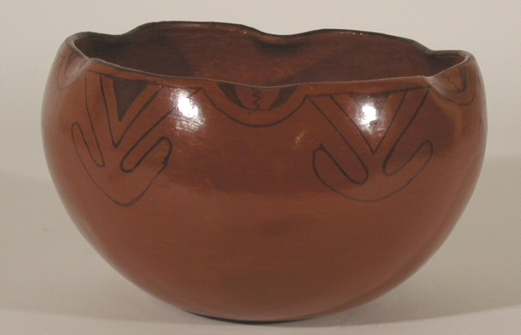
Ida Redbird, Pee Posh, 1892-1971
Bowl, 1947
This bowl won Third Prize at the 1947 Arizona State Fair. Ida Redbird demonstrated pottery-making at "patio workshops" held at the Heard Museum in the 1950s. She is in the Arizona
Women’s Hall of Fame, was part of the 1937-1940 Maricopa Pottery Revival, and was the first president of the Maricopa Pottery-Makers Association. She is a cousin of Mabel Sunn and
Mary Juan.
Anita Redbird, Pee Posh
Bowl, 1972
Ida Redbird’s daughter-in-law

Slide 24
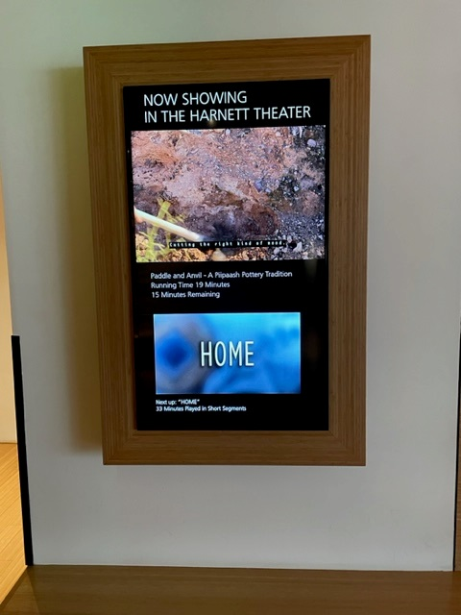
As part of your studies, please watch the 15-minute video on Piipaash pottery making in the Harnett Theater. When you tour, mention it to visitors. Also mention the 33-minute HOME presentation at the conclusion of your tour.

