Slide 1
Apache and Pai
Central Mountains and High Plateaus

Slide 2
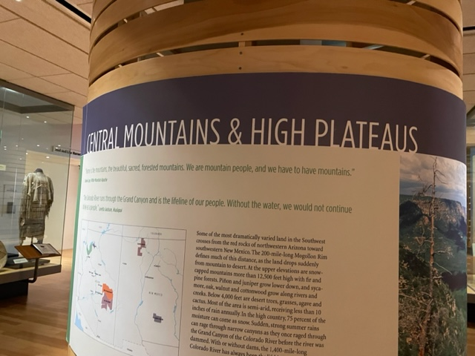
In guiding, you might just briefly reference the photo
to give people a visual sense of the land.
The area includes the Mogollon Rim with sudden
drop from mountain to desert.
Upper elevations are as high as 12,500 feet.
Snow provides 75% of the moisture in the upper
elevations.
The entire area is semiarid and the Colorado River
is the lifeblood blood of the region.
Home is the mountains—the beautiful, sacred forested mountains. We are mountain people, and we have to have mountains.
Ronnie Lupe, White Mountain Apache
The Colorado River runs through the Grand Canyon and is the lifeline of our people. Without the water we would not continue
to live as a people . Loretta Jackson, Hualapai

Slide 3
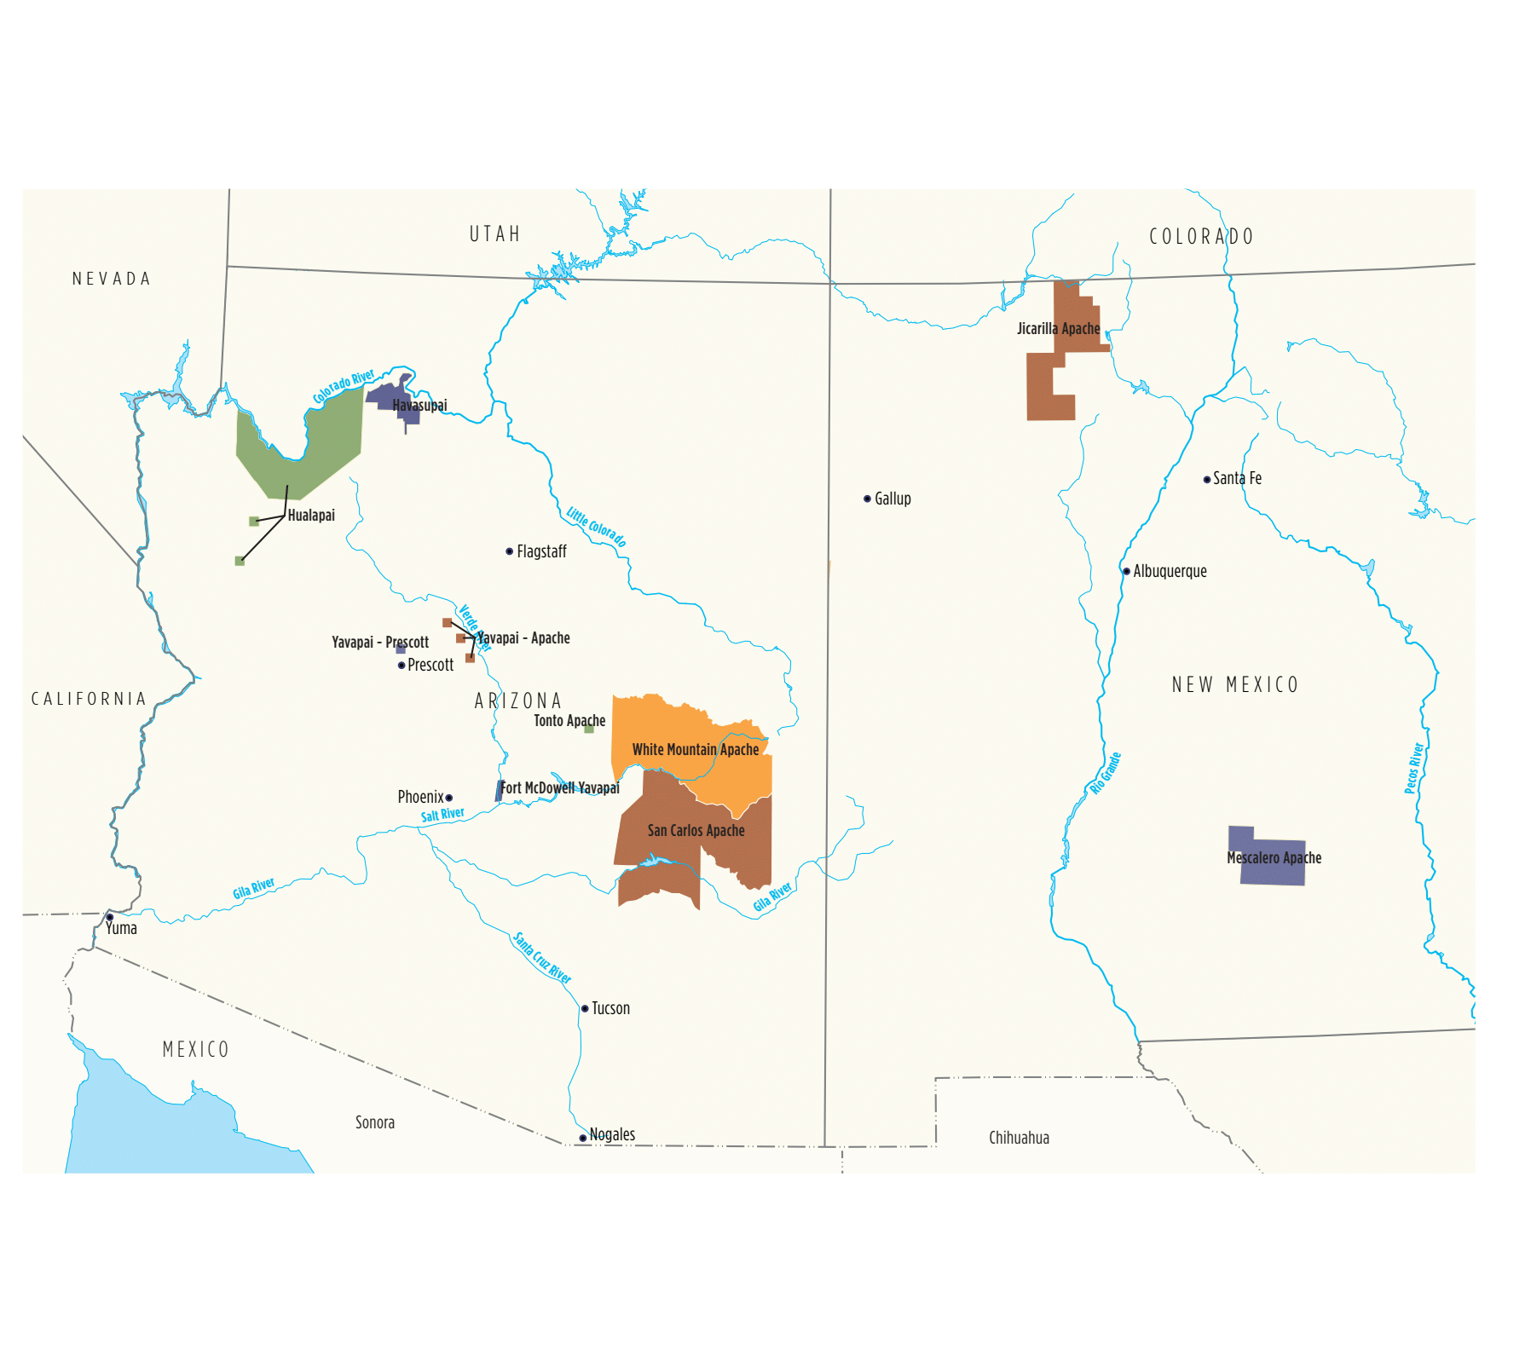
Tribal Lands
Pai Peoples (Upland Yumans)
Fort McDowell Yavapai Nation
Yavapai-Prescott Indian Tribe
Yavapai-Apache Nation
Havasupai Tribe
Hualapai Tribe
N’dee
San Carlos Apache Tribe
Tonto Apache Tribe
White Mountain Apache Tribe
Yavapai-Apache Nation
Jicarilla Apache Nation
Mescalero Apache Tribe

Slide 4
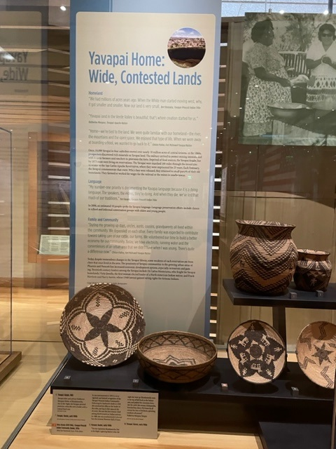
10 million acres of central Arizona were once home to the Yavapai.
The discovery of valuable minerals in the 1860s brought in prospectors,
the military to protect miners and ranchers to provision settlers. Struggles
to avoid starvation led to conflict over a ten-year period.
As with the Navajo, the Yavapai in 1874 were force marched in the winter
180 miles through the mountains to the San Carlos Apache Reservation.
They were kept there for 25 years before being allowed to return to
much restricted reservation lands.

Slide 5
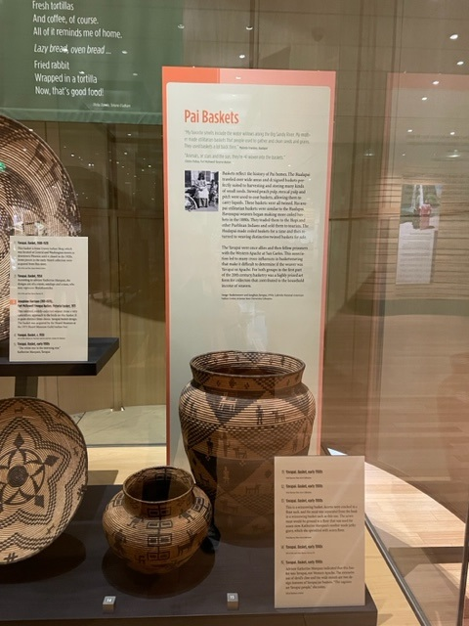
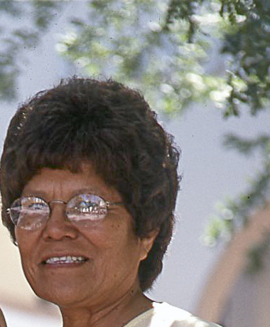
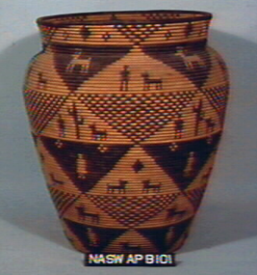
Yavapai. Basket, early 1900s. Advisor Katherine
Marquez identified this basket as Yavapai,
not Western Apache, based on the extensive use
of devil’s claw and the wide mouth,
are two design features of Yavapai jar baskets.
She said, “The saguaro are Yavapai people.”

Slide 6
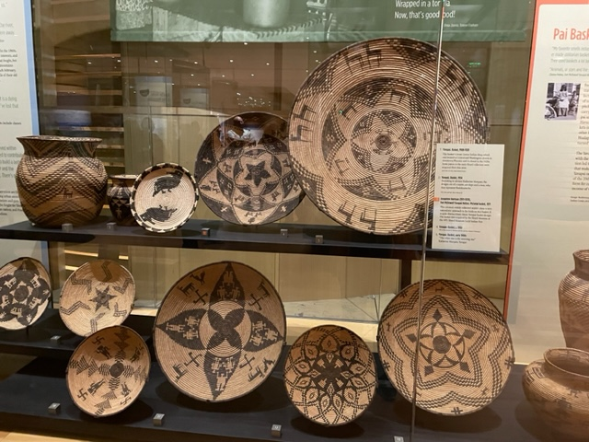
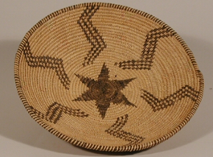
Animals, or stars and the sun, they’re all woven into the
baskets. Clinton Pattea, Fort McDowell Yavapai Nation.
Notice how many baskets
begin with a star center.
Yavapai. Basket, early 1900s. “The star represents
Skatakaamcha, Star in the Night or One that Wanders.
Lightning flashed when the night star went up. Yavapai oral
histories tell how Skatakaamcha went to the top of
Bell Rock, in the Sedona area, and pushed the mountain
down into the earth. Bat woman, Kampanyika, knocked him
down. His bones lay all around the base of Bell Rock,
spreading medicine all around.” Katherine Marquez, Yavapai.
Yavapai. Basket, early 1900s (far right). This is a winnowing basket.
Acorns were cracked in a flour sack, and the meat was
separated from the husk in a winnowing basket such as this one.
The acorn meat would be ground up on a trough-style grinding
stone with a two-handed mano. The flour would be used for acorn stew.
Katherine Marquez’s mother made jerky gravy, which she sprinkled with acorn flour.
Deer meat was sprinkled with acorn flour.

Slide 7
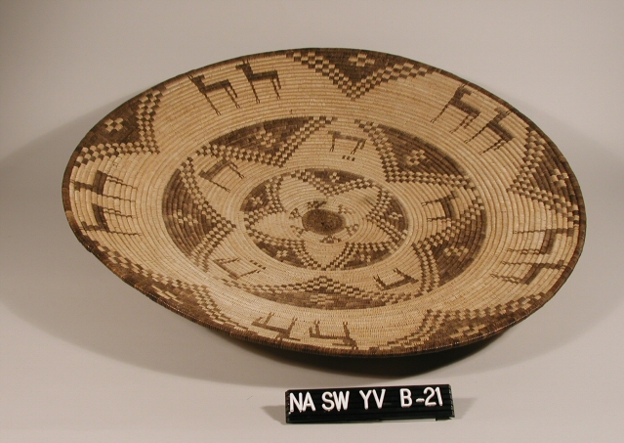
Basket, early 1900s. Katherine Marquez called the
white star in the center of the basket the Morning Star.

Slide 8
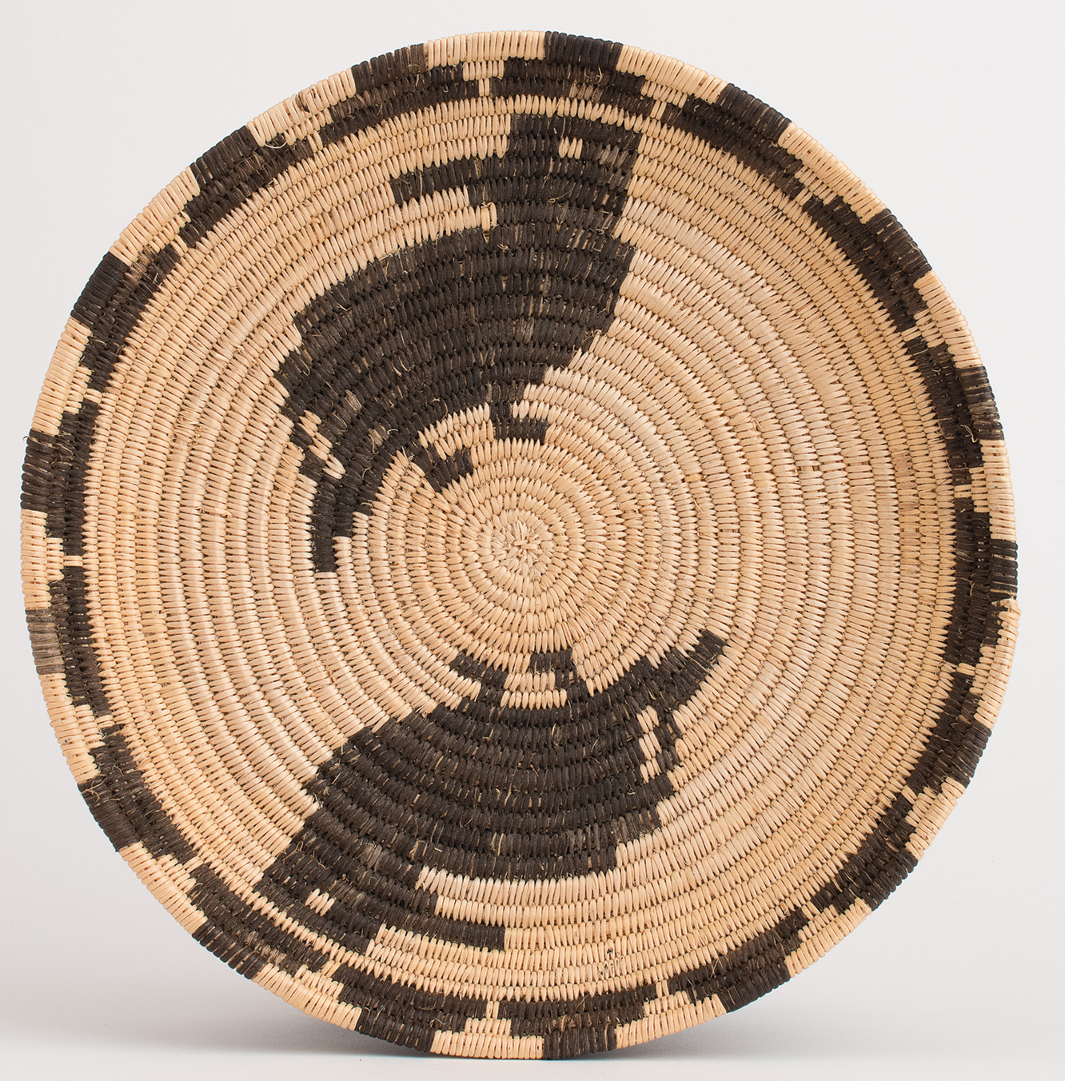
Josephine Harrison, 1911-1978
Basket, 1971. Harrison’s work is in a number of public collections,
including NMAI. Purchased incomplete at the Heard Museum
Guild Indian Fair and finished later. It is a fairly recent addition to
HOME, and it’s naturalistic bird depictions are entirely unique.

Slide 9
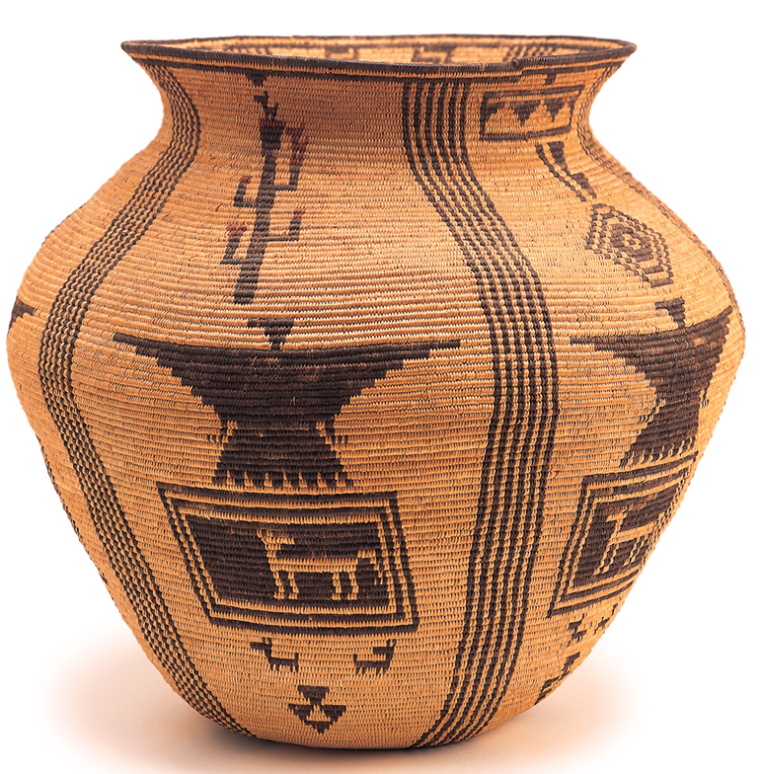
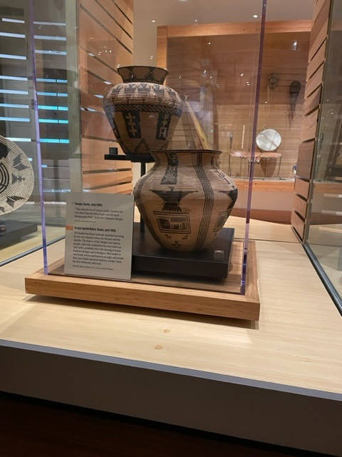
Basket, 1900. The basket has been variously identified as Apache and Yavapai.
It is extremely finely woven with 23 stitches per inch. Terrol Johnson noted
that those vertical parallel lines are extremely difficult to weave. Some have
suggested that the motif above the eagle is military medal.

Slide 10
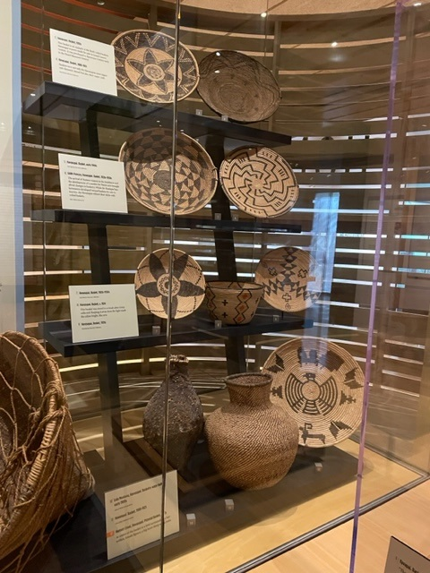
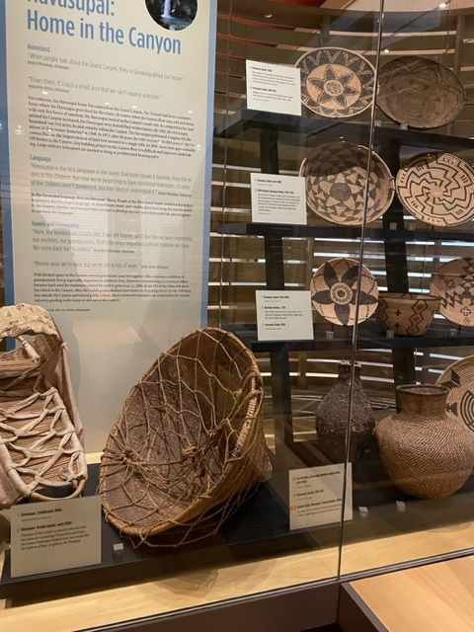
The Havasupai
Make sure people know that the Havasupai
once lived during the summer in the Canyon and
up on the plateau in the winter. In 1919 the
establishment of the Grand Canyon National Park
Left the Havasupai with 518 acres within the
southwest corner of the Canyon. In 1975, when the
Grand Canyon National Park Enlargement Act
became law, it returned to the Havasupai people
more than 185,000 acres, including some of their
former lands on the plateau outside of the Canyon.
This return of the land was the most ever returned
to a tribe by the U.S. government.
The baskets shown reflect the shift from utilitarian
baskets to baskets that could be sold to the many
visitors to the Canyon.

Slide 11
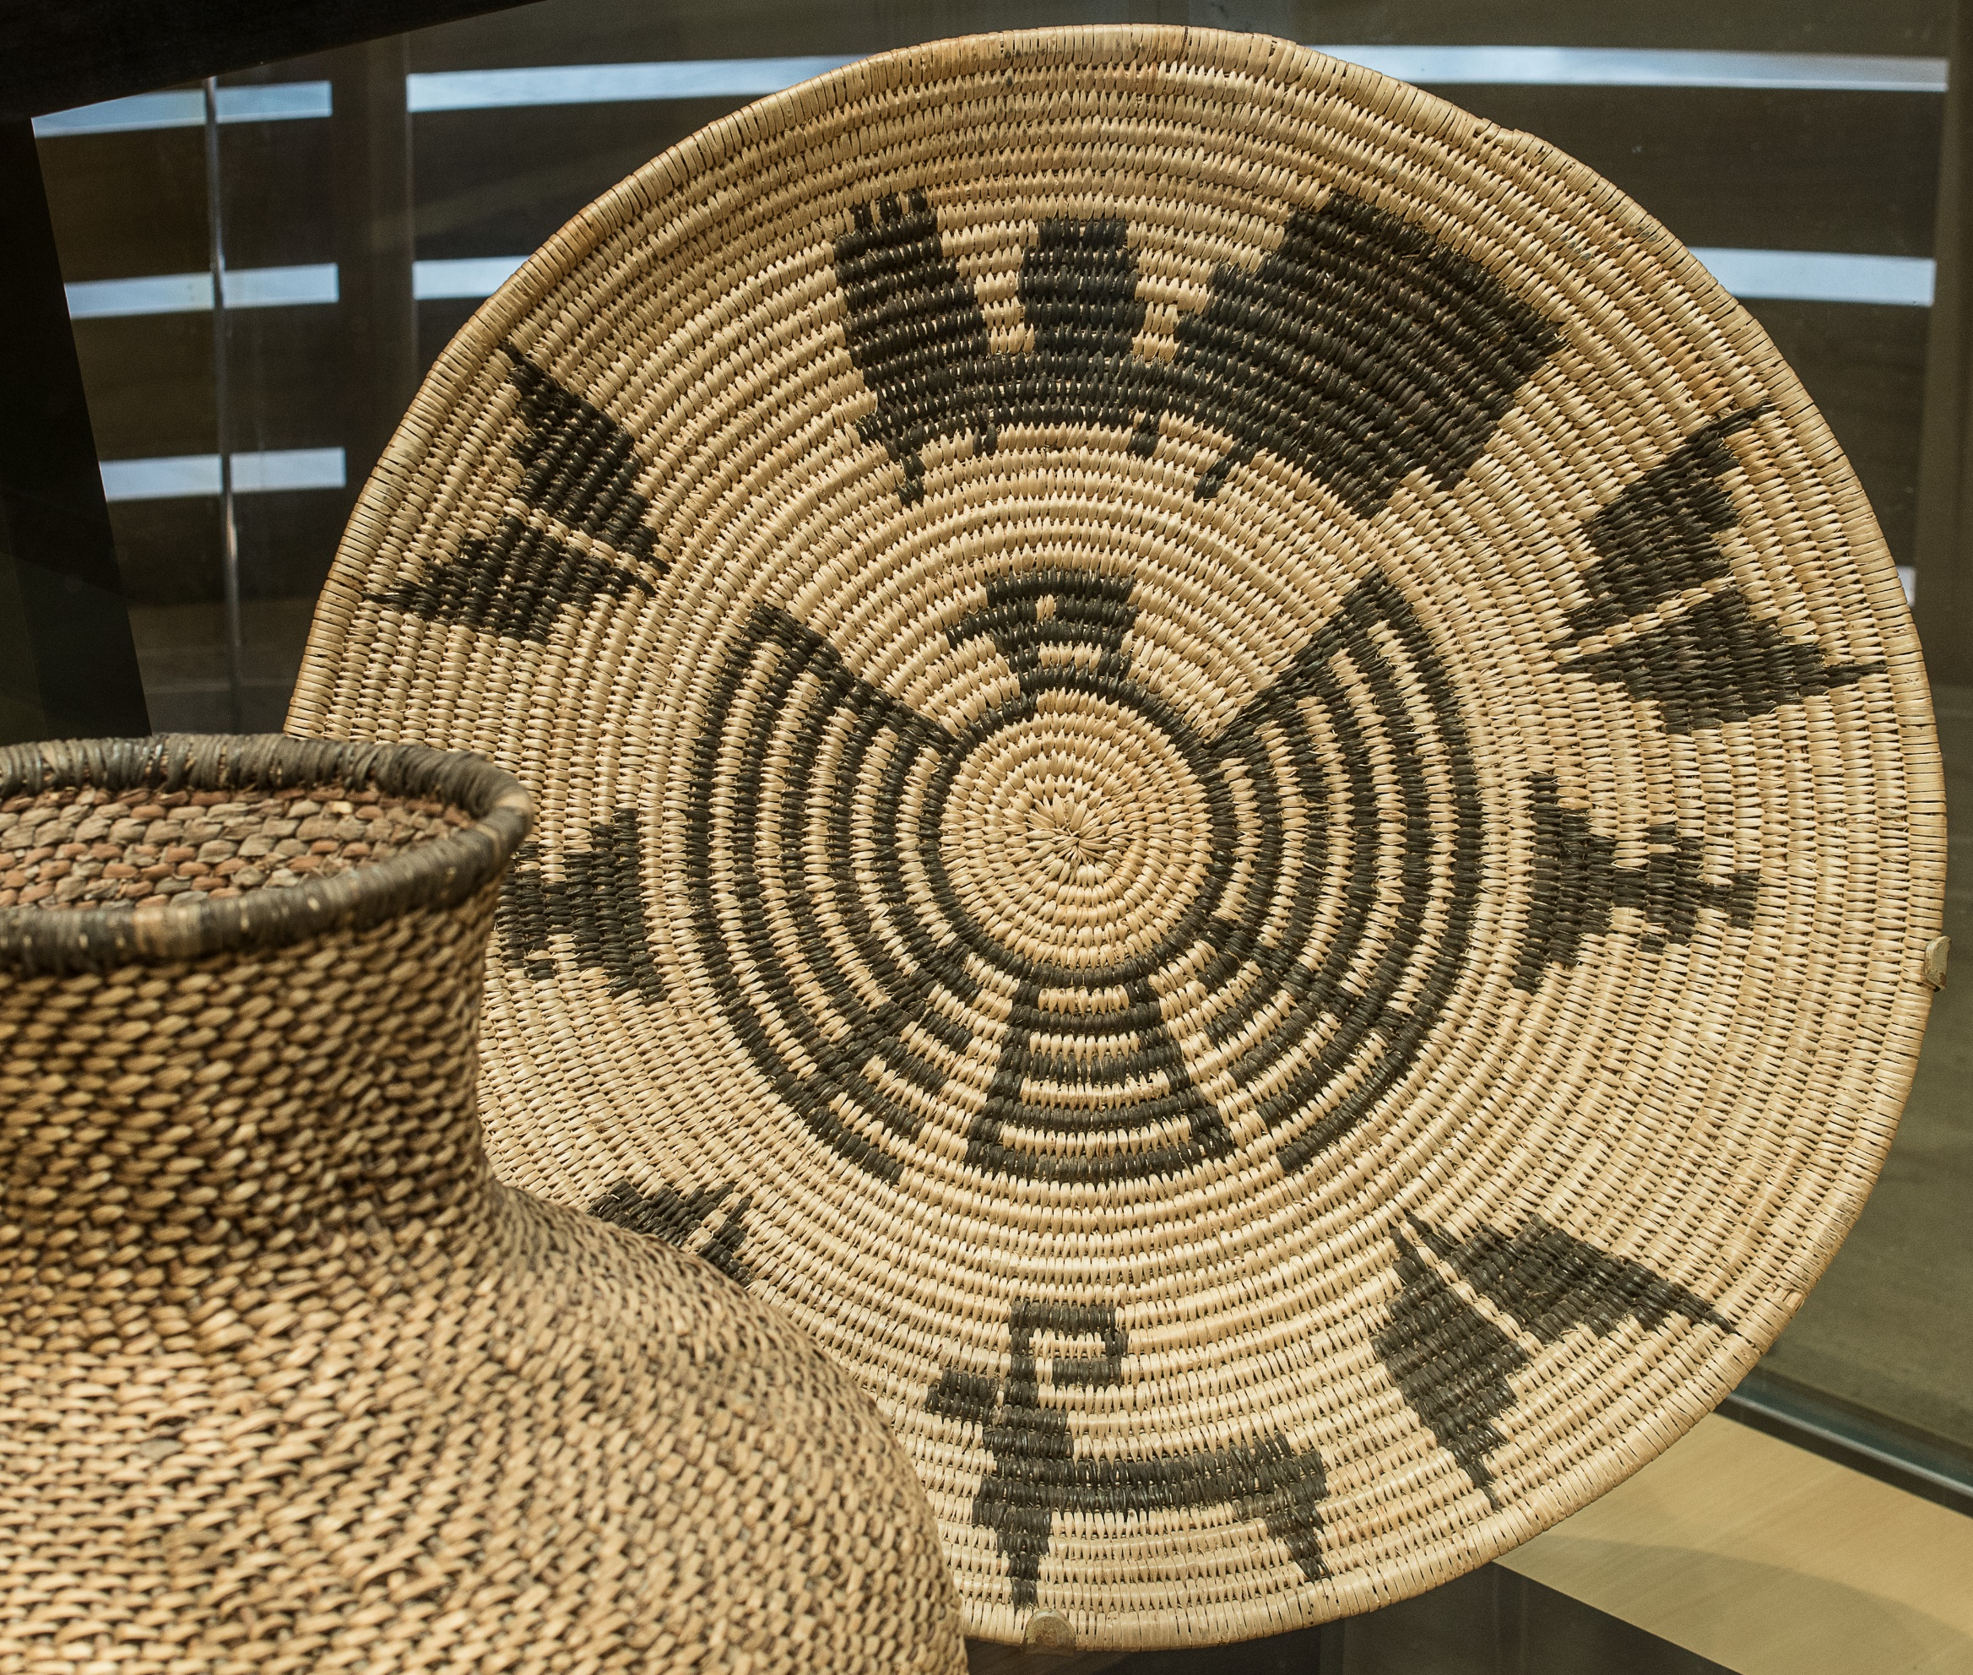
Herbert Crook wove this basket and another in 1972
in trade for four Supai-style dresses. In addition to
butterflies, an eagle, humans and a big horn sheep, he
also included a train.

Slide 12
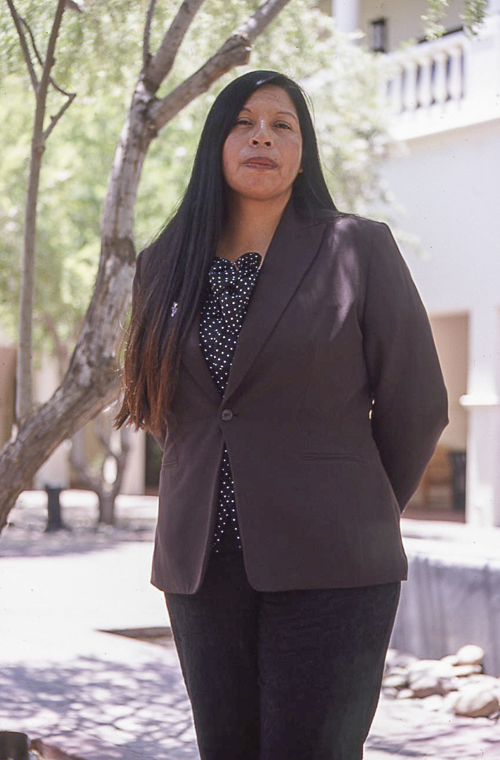
Home is northwest Arizona, over seven million acres. We cover large landscapes
--over 100 miles a day, and several hundred miles to get groceries in Kingman.
We're pretty unique. Loretta Jackson, Hualapai
In the late 1800's, Anglo ranchers employed Hualapais as cowboys. That adopted
tradition is one of the first things we were allowed to learn in order to keep our land.
They said that we would have to run cattle on our land. I'm proud that my father
taught us those ways. Loretta Jackson, Hualapai
My dad grew a lot of produce, had an orchard and planted alfalfa. We’d use a
John Deere horse-drawn manual baler for the alfalfa. My job was to sit on
Old Texas and make sure that he kept going around in a circle. He was the power
behind the machine. Malinda Powsky, Hualapai
Once, it was easy to take over your family’s livelihood. Over the generations that
began to break up. My grandfather was a tribal herd manager, and it was easy
for my dad to take over that role. Everything was set in a certain way in the
early 1900's when we were just starting to become part of the melting pot of Anglo
society. Loretta Jackson

Slide 13
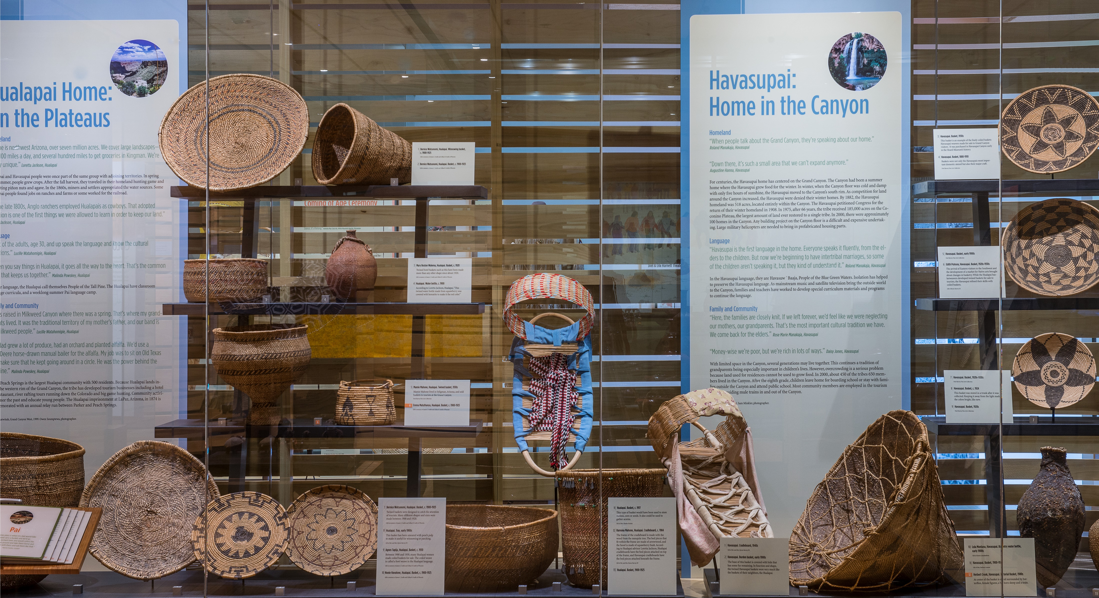

Slide 14
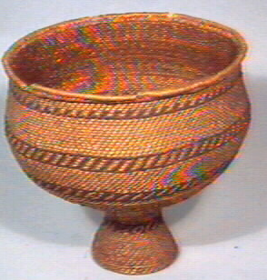
Mamie Mahone, Hualapai. Twined basket, 1930s.
Mamie Mahone lived in Seligman, Arizona, and sold baskets to tourists at the
Grand Canyon. Fred Harvey Fine Arts Collection 994ba

Slide 15
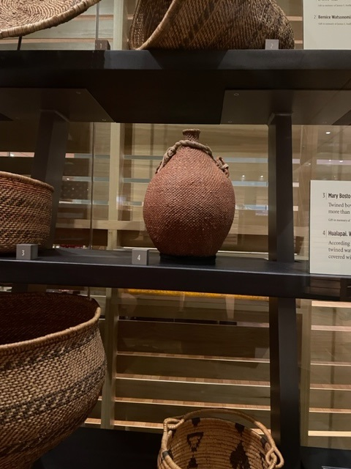
Hualapai. Water bottle, c. 1900. According to Loretta Jackson,
“This twined water bottle made from squawberry was covered
with hematite to make it the red color.”
Loretta Jackson.

Slide 16
N’dee Western Apache, Jicarilla Apache, Mescalero Apache

Slide 17
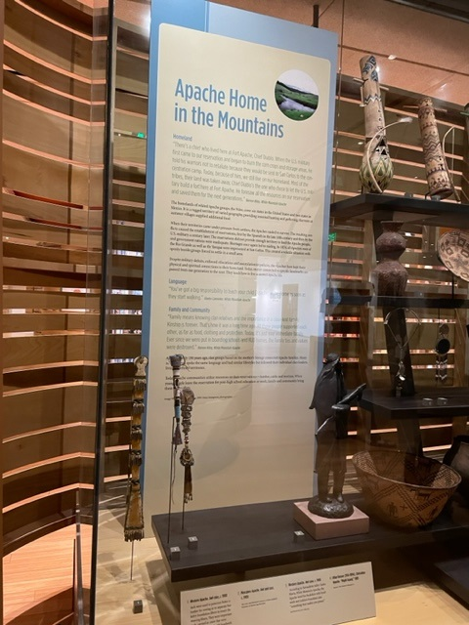
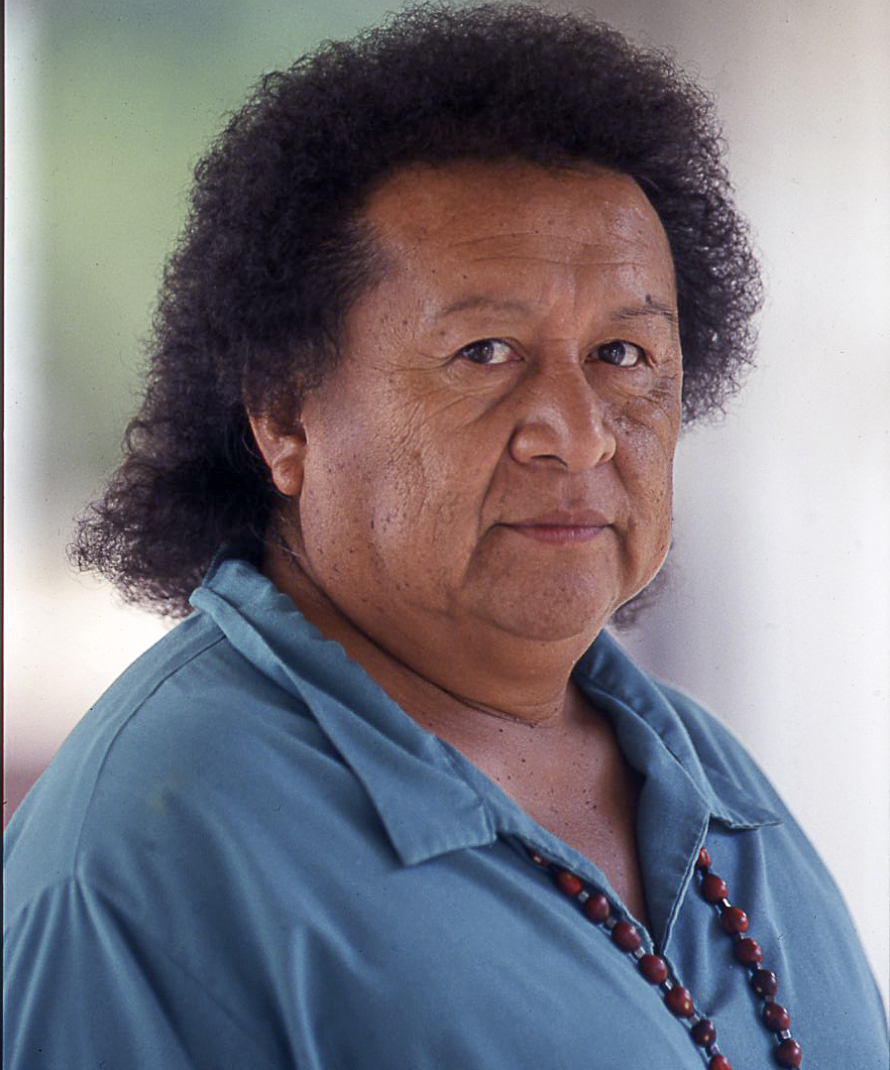
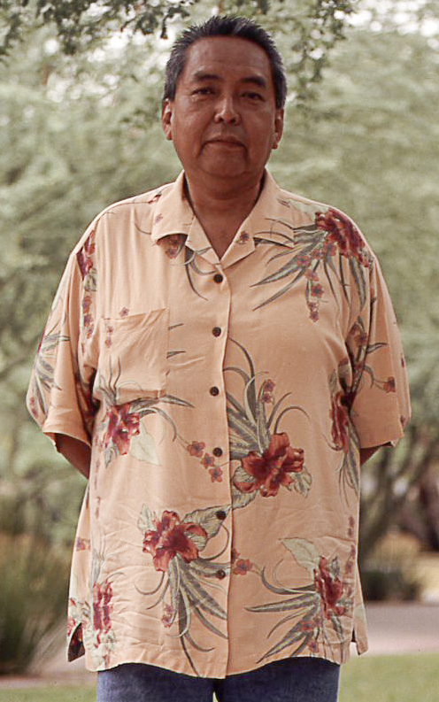
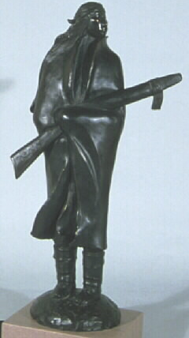
Herb Stevens, San Carlos Apache
Larry Brown, San Carlos Apache
Night Guard , 1985, by Allan Houser,
Chiricahua (Warm Springs) Apache,
Is one of three artworks by the artist
In the Apache section.

Slide 18
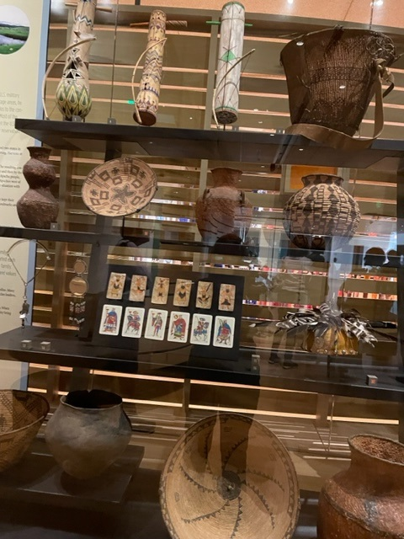
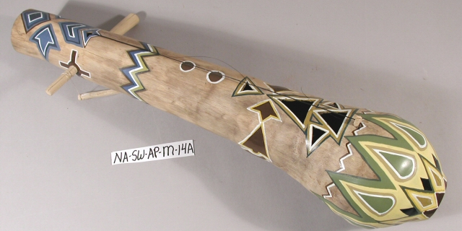
Salton Reed, Sten’aye Clan, 1981
Made of hollowed agave stalk with
horsehair strings. "He made the violin talk.
You could actually hear the words.” -- Larry Brown and Karen Kitcheyan Jones
Fiddles are played primarily for social
occasions. “You have to hollow the agave
out and then put it back together before
painting it. In Apache, the word is,
tsee bedodahe, meaning a singing century
plant, a singing agave.”
Herbert Stevens, San Carlos Apache

Slide 19
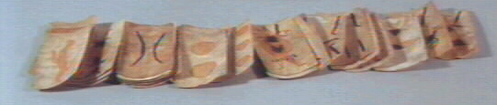
Apache. Playing cards, c. 1885. These playing cards are based on
19th century cards from Spain, brought to Mexico and obtained
by the Apache. There are four suits: Clubs, cups, coins and
swords.
Modern playing cards, 2000. These cards are still purchased in
Mexico. Herb Stevens commented the elders play several times
a week at the San Carlos Apache Cultural Center.

Slide 20
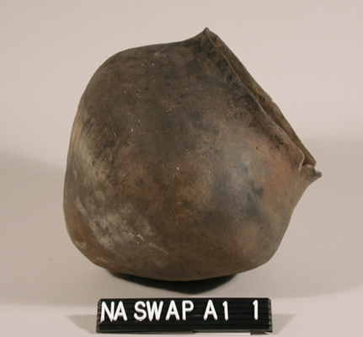
Apache. Olla, late 1800s. Before 1900, Apache home life meant moving from
camp to camp on horseback, and possessions had to be few and practical. Baskets
were easy to transport, less breakable and lighter in weight than pottery. Pottery
making was discontinued after the late 1800s. Jars such as this were used to cook
meat, corn or to melt pitch for coating basketry water bottles. Sometimes pots were
used as drums, but this isn’t a water drum pot.

Slide 21
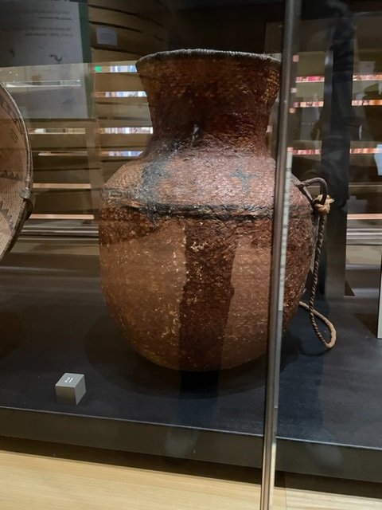
The tus [pitched water jar] is so important to the Apache heritage that
it is part of the White Mountain Apache great seal.
Ramon Riley, White Mountain Apache

Slide 22
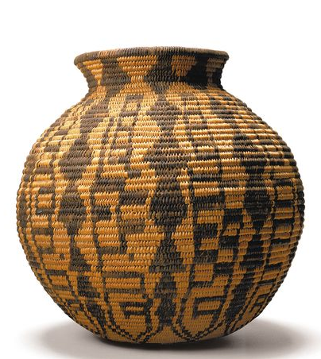
Basket c. 1900. This basket can be seen in 1910 photographs of the Heard’s
home.

Slide 23
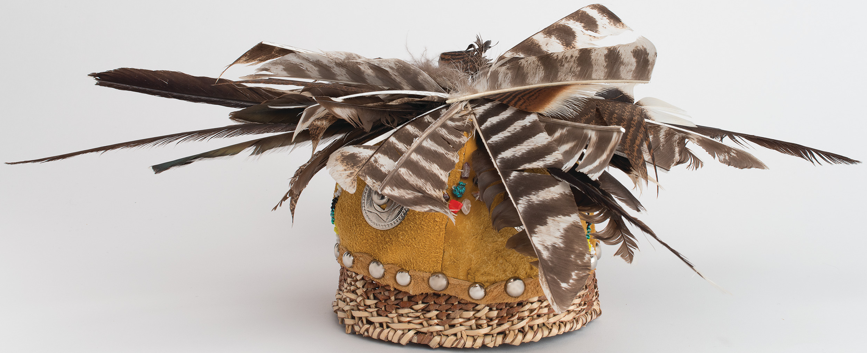
Timothy Ward, San Carlos Apache, Warrior’s cap. The artist was 17 and a junior in high school, when he entered the cap in the 2002 Guild Native American Student Arts and Crafts Show, where it received an award. The beadwork is in the color of the four directions--white, yellow, green and black--placed on the cap for the protection of the wearer. (statement of artist to Andy Eisenberg)

Slide 24
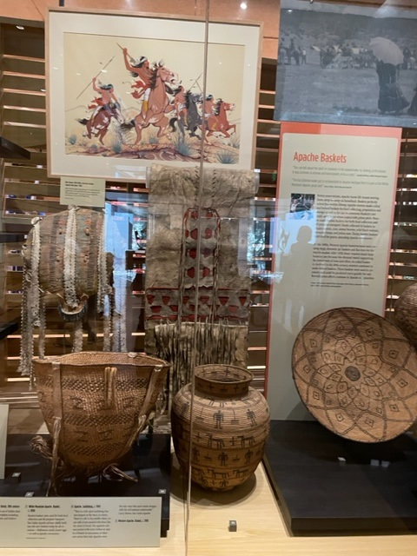

Slide 25
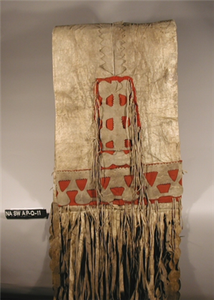
Full-size saddlebag, late 1800s. Deer hide, sinew, red trade cloth. “This is a typical
Western Apache saddlebag. You make this using the largest piece of hide you
can find, stitch it up, make an opening and add cut-outs. One side is used for
clothes, the other side is for food--ash bread, coffee. Saddlebags were important
in movement from camp to camp.” -- Larry Brown and Karen Kitcheyan Jones

Slide 26
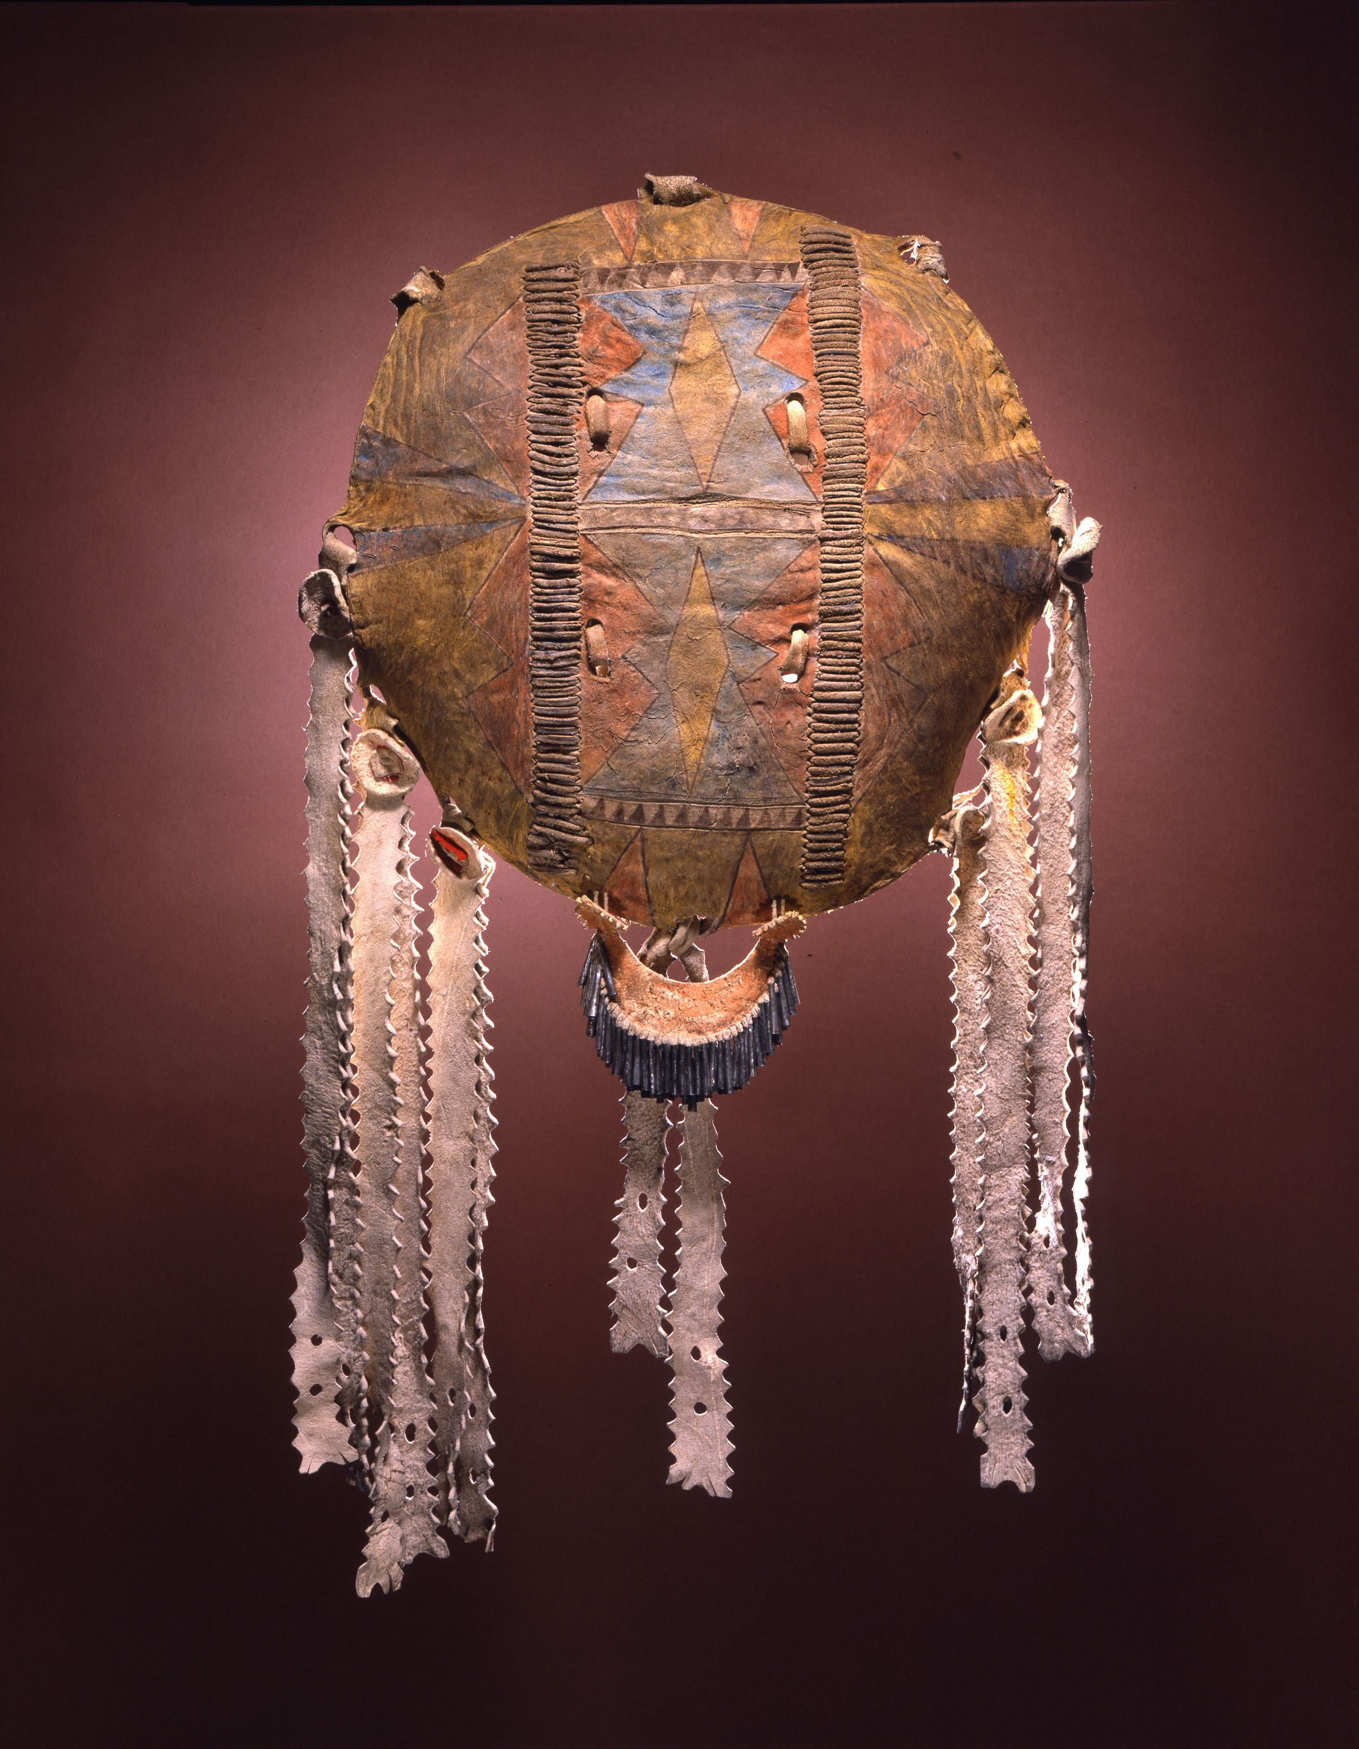
Mescalero Apache Shield, late 1800s
Made of buffalo hide, Herb Stevens referred to
this as a “show shield.”

Slide 27
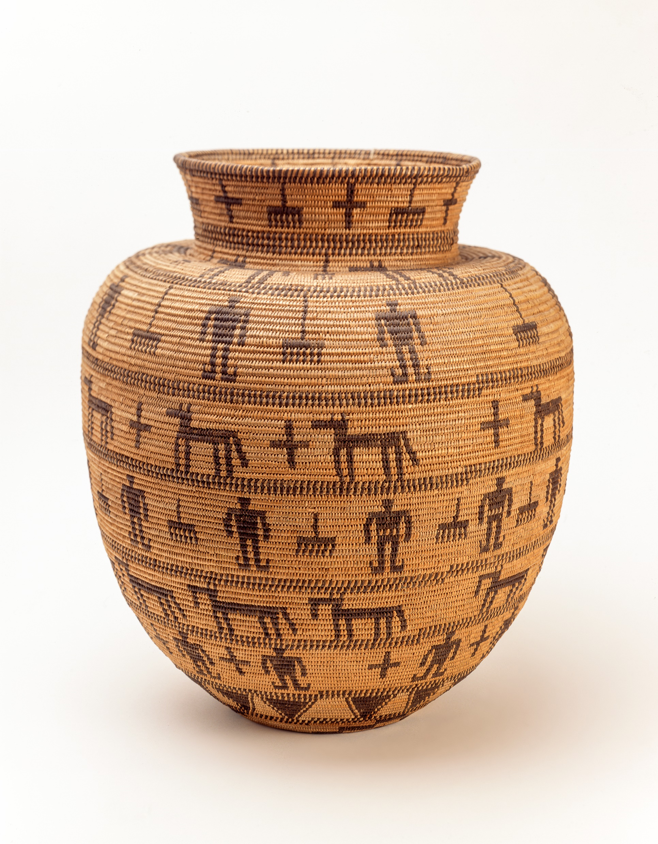
Pictorial basket, c. 1900, San Carlos Apache
Ramon Riley, White Mountain Apache Cultural Preservation
Officer, noted the toe tabs on the figures’ moccasins.
Adela Swift thought it looked like the work of Katie Francis,
Yavapai Apache from Prescott.

Slide 28
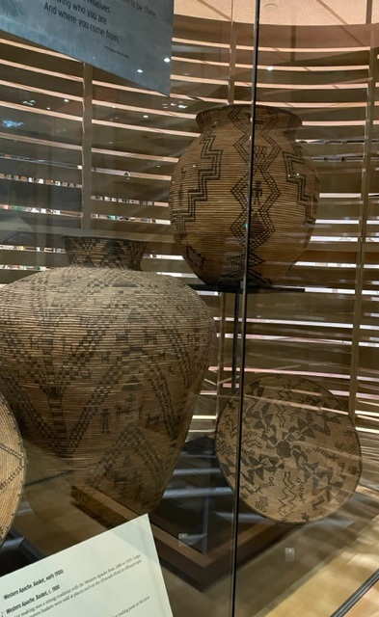
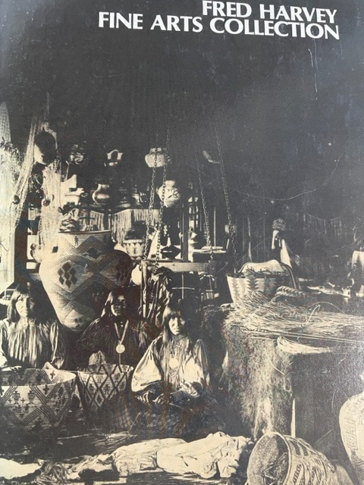
By the 1880s, Western Apache basket weavers were
creating large, dramatic jar baskets and flat trays for the
tourist market. After 1900 fewer weavers made large basketry jars
because the market didn’t support the investment of time and effort.
Fred Harvey’s main buyer, Herman Schweizer,
arranged for Navajo weavers and Hopi or
Navajo silversmiths to demonstrate the
making of cultural arts at the Indian
Department at the Alvarado Hotel in
Albuquerque. On special occasions, he also
brought in basket weavers from distant
communities.
Such was the case in 1903, when three
Apache basket weavers from Arizona traveled
to New Mexico.

Slide 29
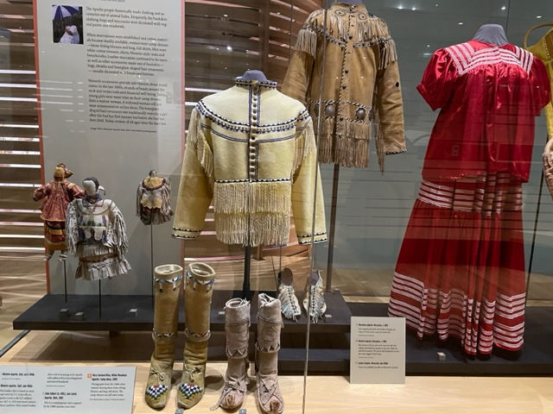
Everything is made in prayer. Larry Brown, San Carlos Apache

Slide 30
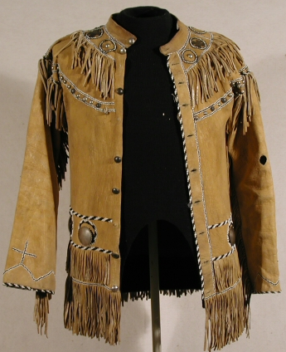
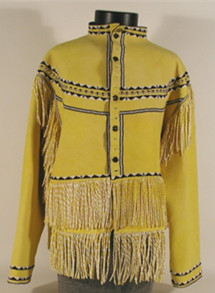
This leather shirt, late 1800s, is based on the full-dress coats worn by U.S. Army officers during the Indian Wars.
The Apache scouts who served in the U.S. military from 1871 to 1923 were never issued a military uniform.
They created leather shirts full of meaning to the Apache—yellow ochre, a sacred pigment, and rows of buttons,
beadwork and fringe typical of Apache clothing and accessories. Serving as a scout was a source of income and
pride, a status worthy of special attire. Larry Brown said, “Black and white beads (or red and white or blue and
white) are what were available in this early Reservation period. Longstreet (David?) and his mother were known
for making and wearing this style jacket. Cavalry coats were taken apart and used as patterns. Yellow ochre was
used to paint the leather. Four-day ceremonies were held to make jacket impenetrable by bullets. "
Dale Gilbert made this modern version
of elk hide in 2001, when it won a Best
Of Class award at the Guild Indian Fair
and Market.

Slide 31
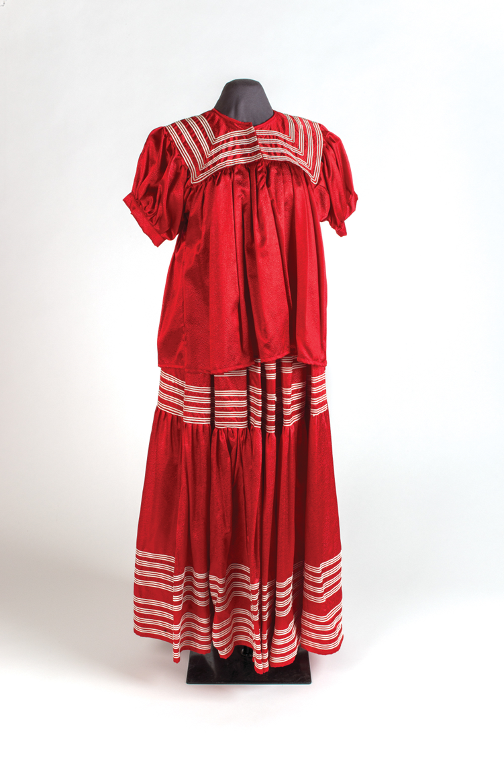
Camp dress by Mary Garland Riley, White Mountain Apache, 2000.
When cotton materials became readily available, women wore these
loose-fitting blouses and long, full skirts, seen in photographs from
the 1880s on. The camp dresses are still worn today. The amount of
decoration on the dress is related to the age of the wearer with a
younger woman’s dress being more elaborate.

Slide 32
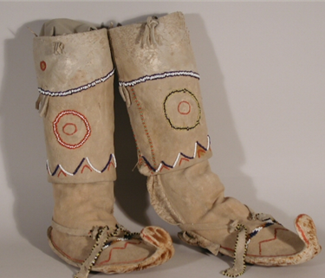
Western Apache. Moccasins, c. 1900. Moccasins with toe tabs were worn by
the Chiricahua and Western Apache in the late 1800s for special occasions.
The paint and beadwork on this pair also suggest dress wear.
Fred Harvey Fine Arts Collection. 159BE

Slide 33
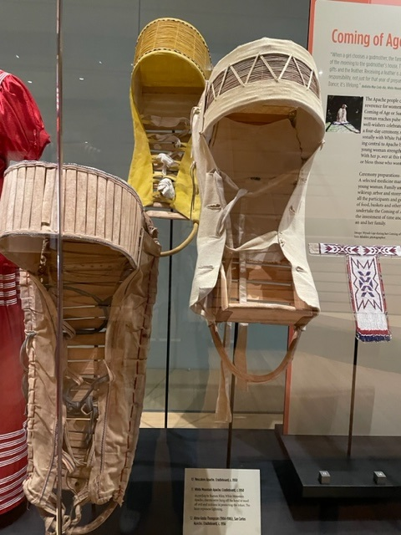
White Mountain Apache. Cradleboard, c. 1950. According to
Ramon Riley, White Mountain Apache, charms were hung off the hood
to protect the infant. The laces represent lightning. (on the left)
Mescalero Apache. Cradleboard, c. 1950 (on the right) This is a girl’s
Cradle, based on the way it is laced, per the Mescalero Apache tribe.
Alma Gusta Thompson (1904-1986), San Carlos Apache. Cradleboard,
c. 1956. “The frame of this cradleboard is made from mesquite root.
You have to go down to the wash after a real heavy rainstorm and the root
sticks out. That’s when we go and cut it. I remember going with my
grandmother. We used to go up to Dry Wash with just jerky and maybe
ash bread and a canteen of water. It would get to be 100-degree weather,
scorching hot. But we would leave the first thing in the morning.
And we would see the roots coming out of the mesquite. She would chop it
off and leave it there, continue on, keep on going until she thinks she has
enough. And then we would go back and collect each one and return home.”
“To form this upside-down U-shape, you have to soak it in water for maybe
a week. When it’s thoroughly soaked, you form the U-shape by massaging
and pressing it slowly. This bottom part of the cradleboard--the bed--comes
from sotol. Sotol is a cousin to the agave and yucca. The hood is made from
desert willow.” Herbert Stevens, San Carlos Apache AP-Q-2

Slide 34
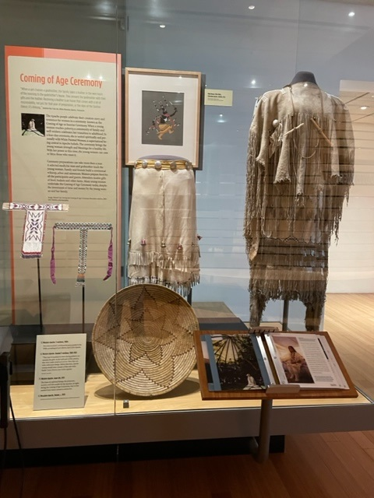
Coming of Age Ceremony skirt and poncho, early 1900s. When a young
woman reaches puberty, a community of family and well-wishers celebrates
her transition to adulthood in a four-day ceremony. A special garment is
either made for the occasion or passed down from a family member.
The skirt and poncho appear very fluid because of the long fringes hanging
from the shoulders and all around the skirt. The sound is musical with
hundreds of small tinklers.
The touch screen features Tia Torivio shaking the poncho to show how it
sounds.
The beadwork is characteristic Mescalero Apache. The tail is
deer legs. There is a song in the Coming-of-Age ceremony that
is about deer and legs. Songs are handed down in the family.
Larry Brown and Karen Kitcheyan Jones

Slide 35
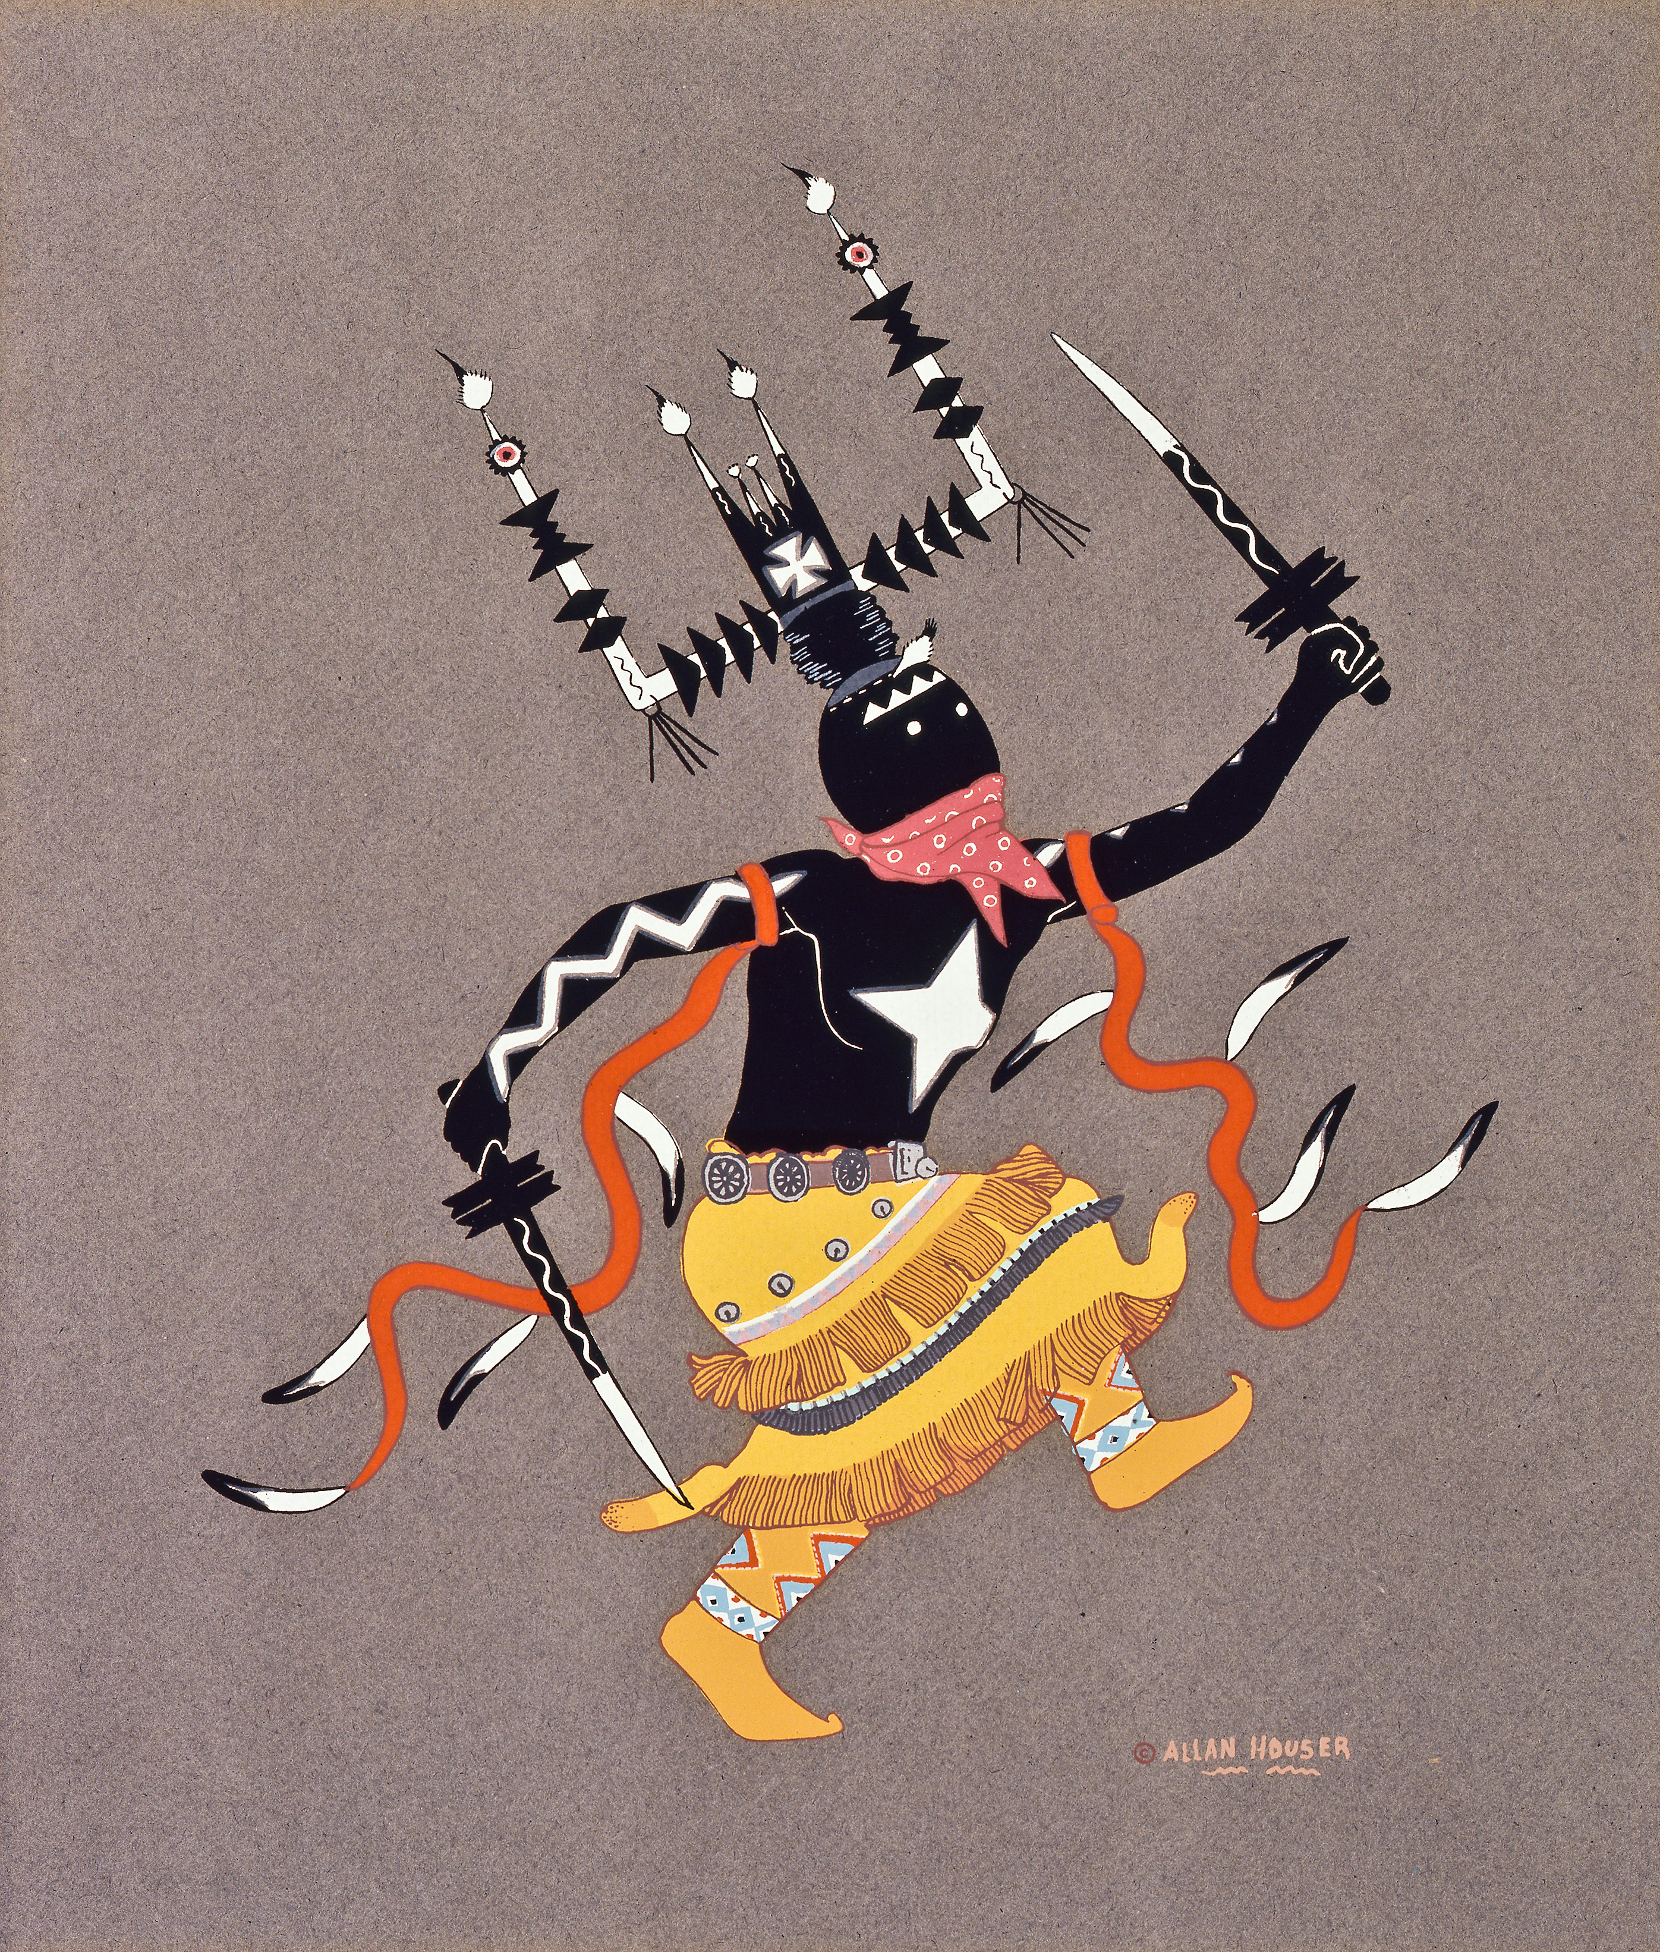
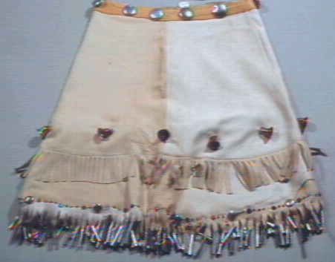
Allan Houser, silk screen print of a Gaan dancer, 1952.
Western Apache. Gaan kilt, 1970, made of commercially tanned
hide. The Gaan are spiritual beings, the protectors, teachers and role models for the Apaches. At night during the Coming-of-Age
Ceremony four or five masked Gaan dance around a central fire, accompanied by a group of singers.
The kilt was approved for display, as it has never been worn.

