Slide 1
Diné (Navajo) and Southern Paiute

Slide 2
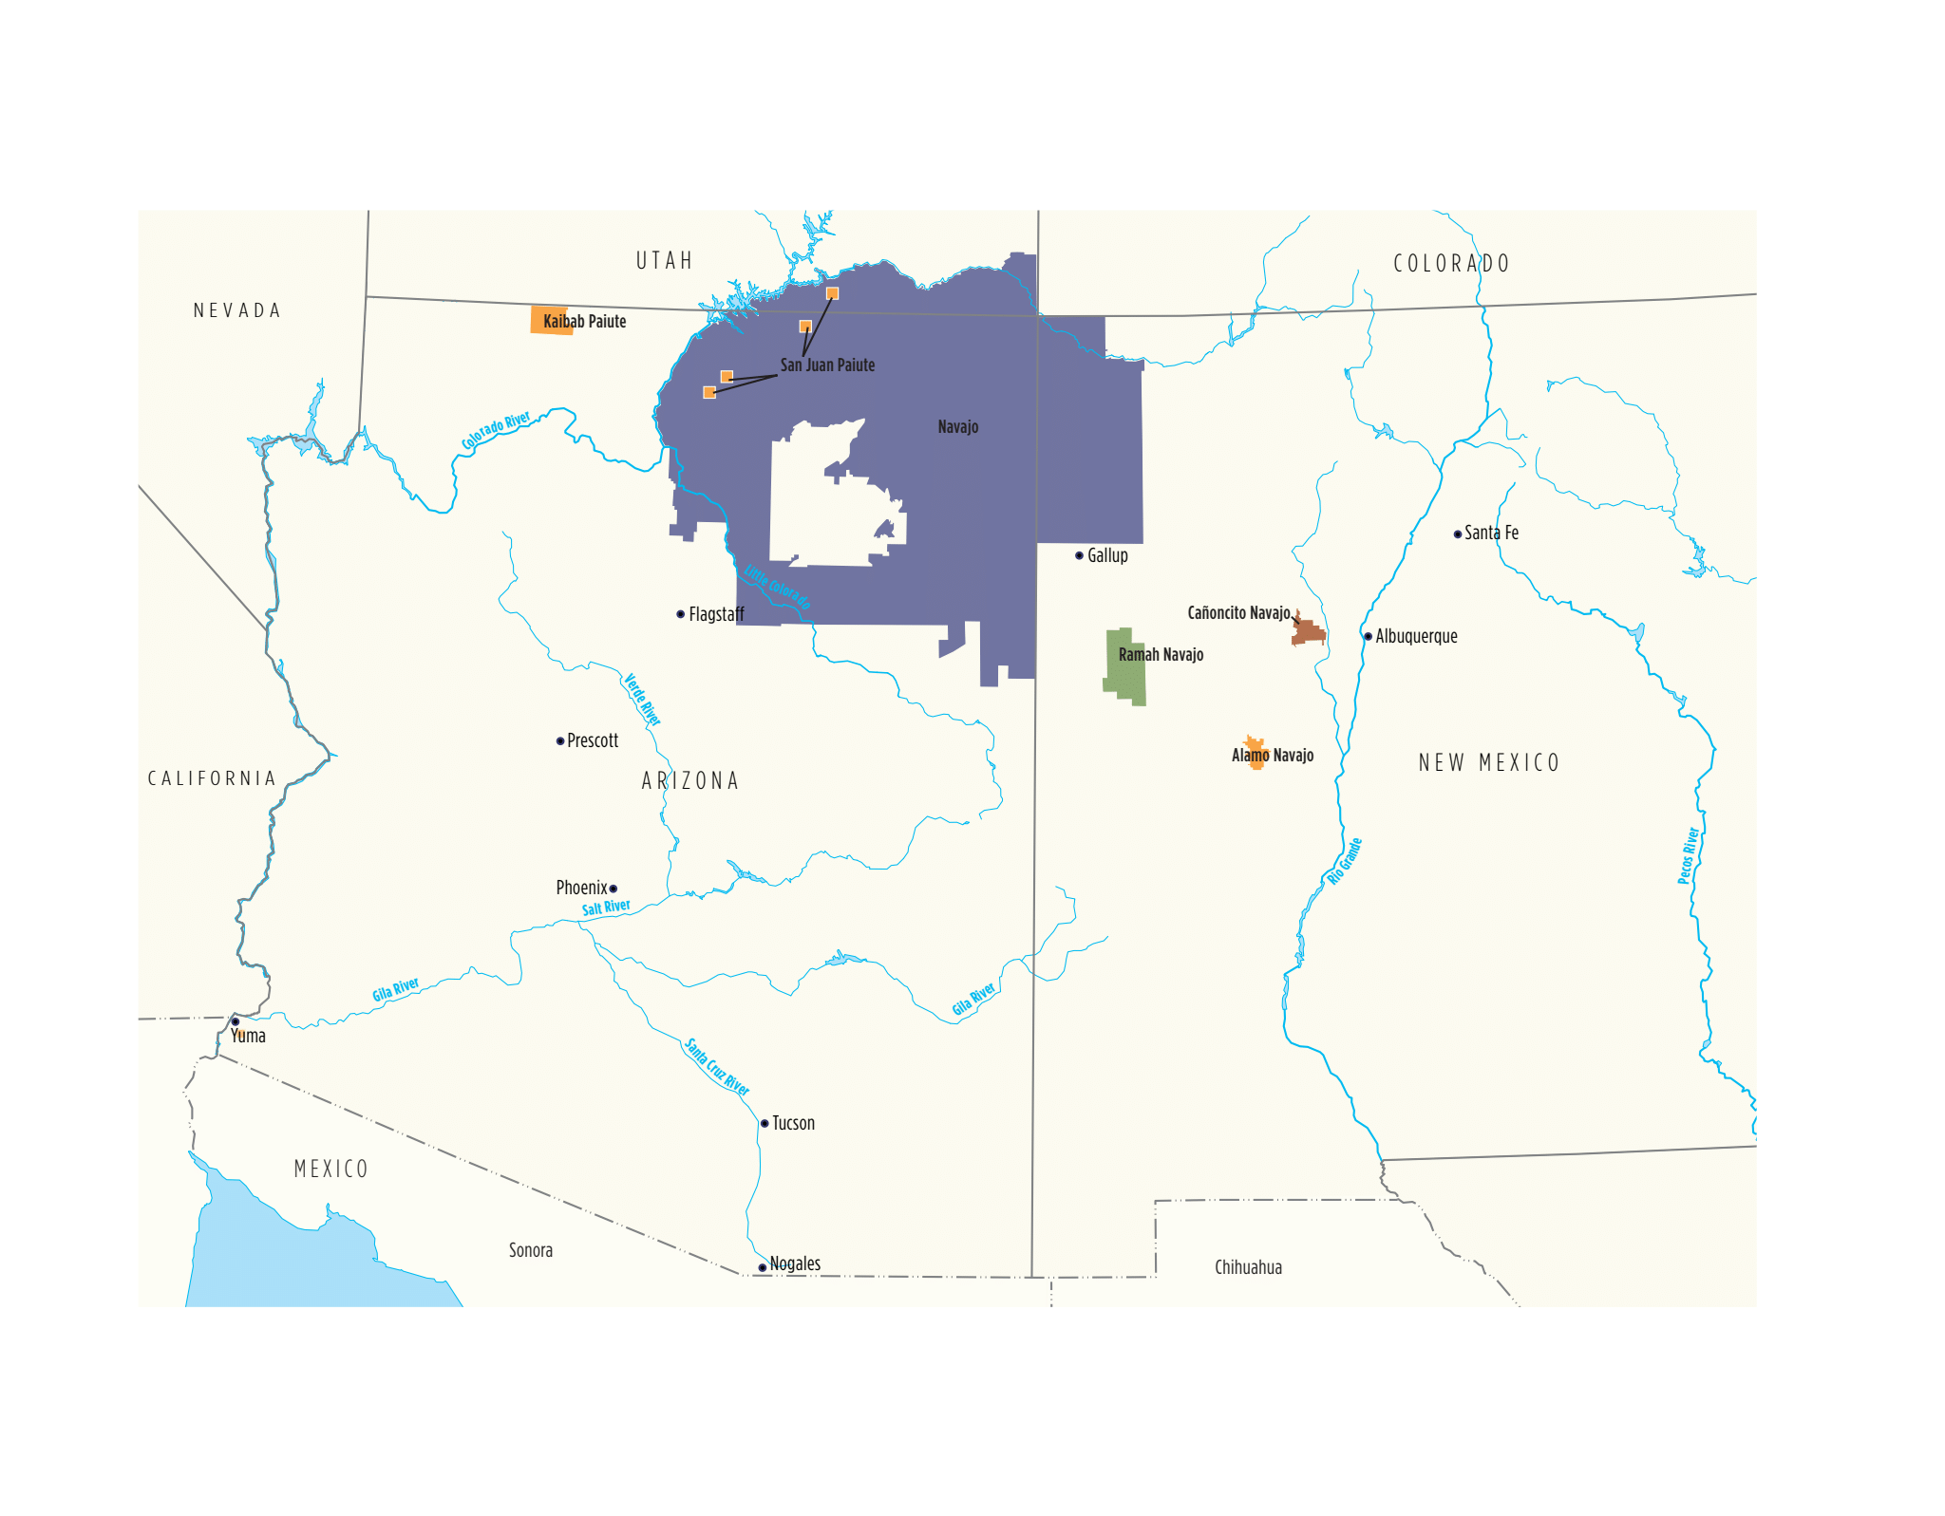

Slide 3
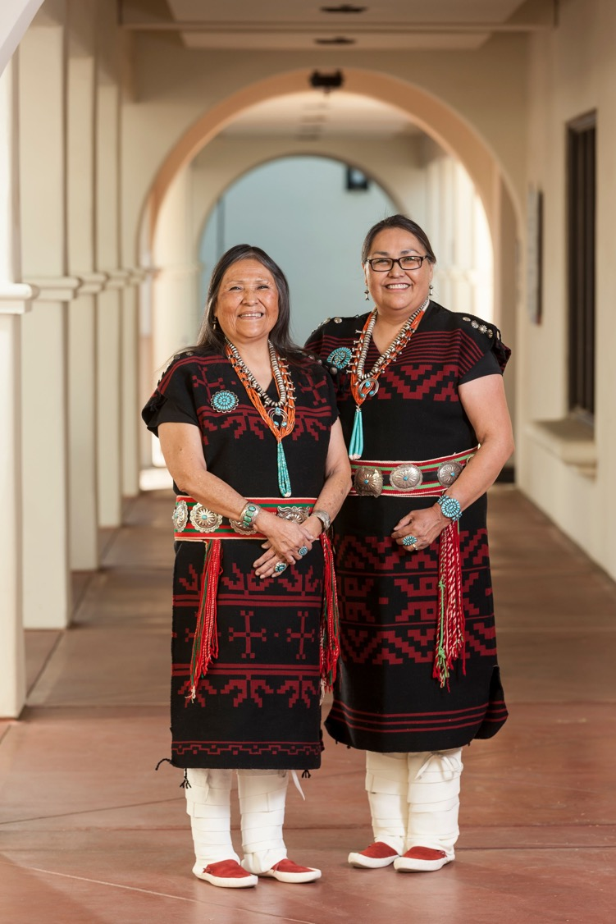
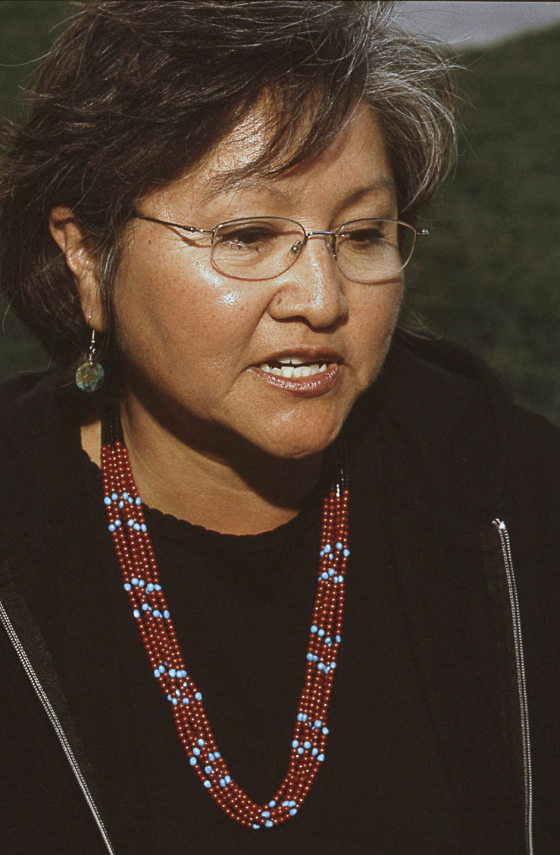
Barbara Teller Ornelas and Lynda Teller Pete
Rena Martin

Slide 4
The Navajo Nation is the largest Indigenous Nation in the United States with more than
400,000 enrolled members and 27,000 square miles (larger than West Virginia).
The mountains remind me of home. It just feels like you're in a big bowl and protected
from all outside forces.
Michael Ornelas, Diné
The Four Sacred Mountains
Sisnaajini (White Shell) or Blanca Peak (white) in the east
Tsoodził (Turquoise) or Mr. Taylor (blue) in the south
Doko’oosłiid (Abalone Shell) or San Francisco Peak (yellow) in the west
Dibé Nitsaa (Big Sheep) or Hesperus Peak (black) in the north

Slide 5
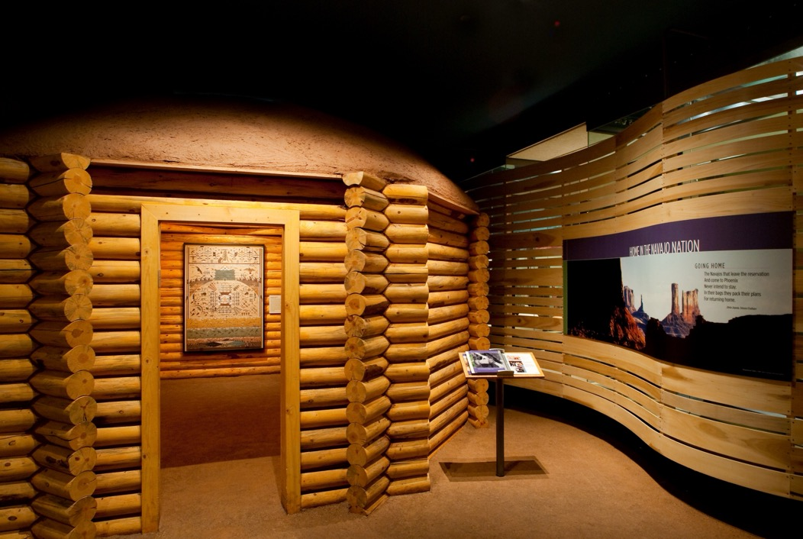
Female Hogan simulating the roundness of the female
body and Mother Earth.
It was made from a kit and is full size. Its door faces east.
We left it unfurnished. You can tell people that some
families may choose to have a hogan for ceremonies but
not as their primary residence.

Slide 6
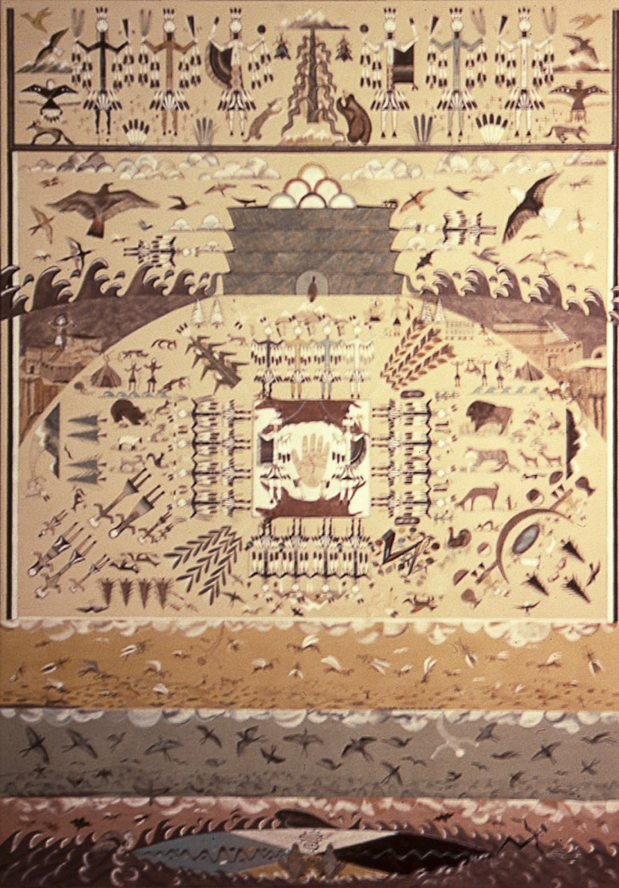

Rosie Yellowhair (b. 1950), Navajo
“Emergence Story,” 2004
Rose Yellowhair’s sandpainting depicts the Navajo Creation or Emergence Story. The First World had a great deal of water. When there was dissention, the Insect People moved up to the Second World of the Swallow People. Dissention occurred again, causing the Insect People to move up to the Third World where the Grasshopper People lived. Again, dissention caused the Insect and Grasshopper People to move to the Fourth World, where they found the Four Sacred Mountains that border the Navajo homeland, Dínetah. In the Fourth World, they met the Animal People as well as the Ye'ii, who gave instructions on how to live.
Rosie depicted Turkey barely escaping from the rising waters. His tail feathers got wet and turned white.
In the sandpainting you could:
Point out the Four Sacred Plants
Corn
Beans
Squash
Tobacco

Slide 7
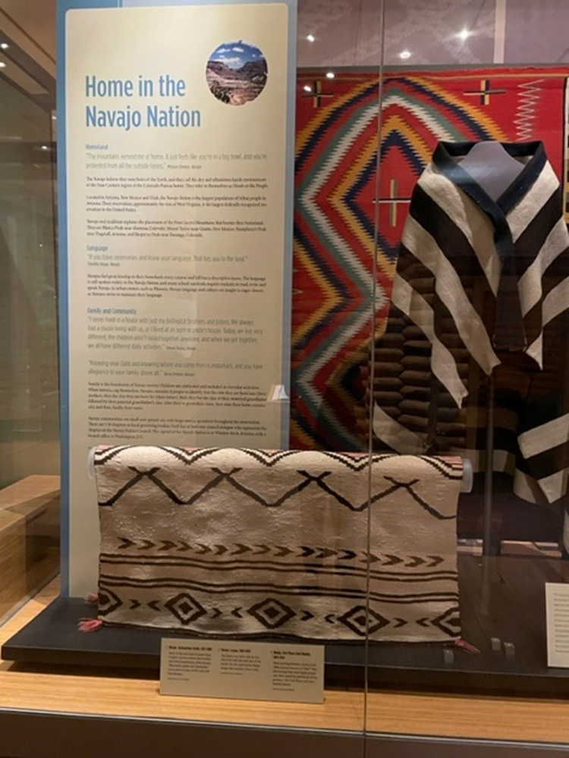
In times of surplus, in times of tragedy, we have found a way to evolve with the times, adopting new ideas, and systems, while still retaining a sense of cultural ownership. Although these garments had a sensible function, to clothe and bring warmth, the style of each is permeated with the pride and ideas of the weavers who created it -- dresses made for daughters, and granddaughters, for girls becoming women, and women becoming mothers. Each blanket and dress is as a symbol of the weaver’s emotions toward the recipient of the respected piece.
Sierra Nizhonii Teller Ornelas, Navajo

Slide 8
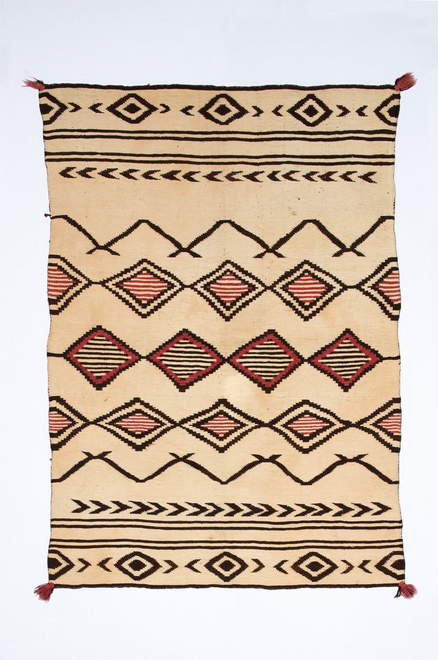
Sarape, 1800-1850
The white is cotton making this an entirely unique
garment.
It is so early and so important that I think it merits
calling attention to it. The condition is amazing. It also
is possible to mention that at one time (pre-Bosque Redondo)
the Diné grew cotton. According to textile scholar Joe Ben
Wheat, the latest mention he found of Diné growing cotton
was 1804.

Slide 9
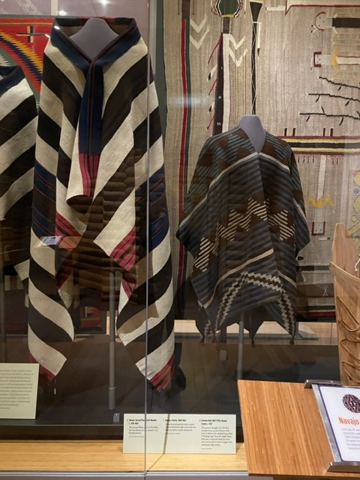
Navajo garments were traded widely and highly prized.
Weaving was traditionally a woman’s art, but as years have passed,
many men are recognized for their award-winning weaving.

Slide 10
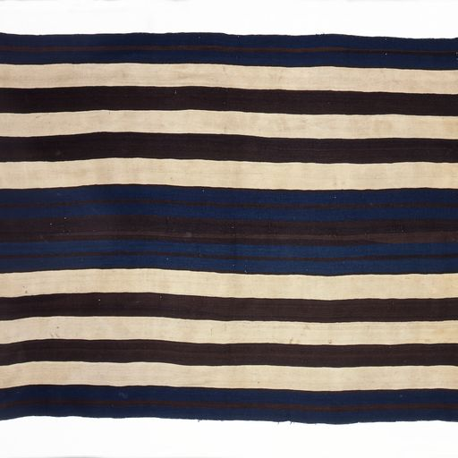
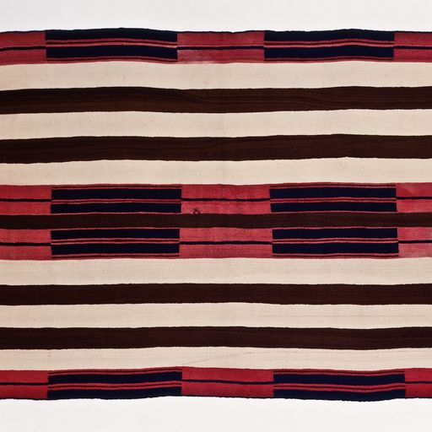
Second Phase Chief Blanket,
c. 1860-1865
First Phase Ute-Style Chief Blanket, c. 1850
245Bl
216Bl

Slide 11
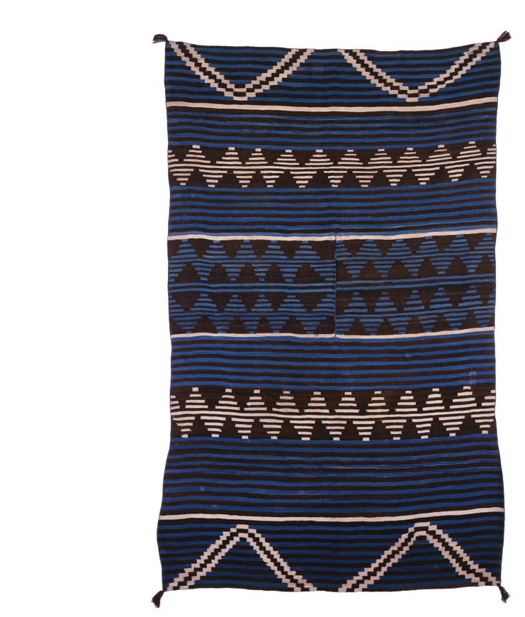
Poncho, 1840-1860
As with wearing blankets, Navajo ponchos were
prized. With tight weaves and lanolin from sheep wool,
they were warm and had good water-repellent qualities.
Bosque Redondo
The times of tragedy Sierra Ornelas referred to included the
1864 genocidal, scorched earth policy that drove the Navajo
on a forced marches from their homeland to southern New
Mexico more than 300 miles away at Fort Sumner, the Bosque
Redondo. In 1868, a treaty returned the Navajo to a much
diminished reservation home, approximately 10% of the land they
once occupied.
231Bl

Slide 12
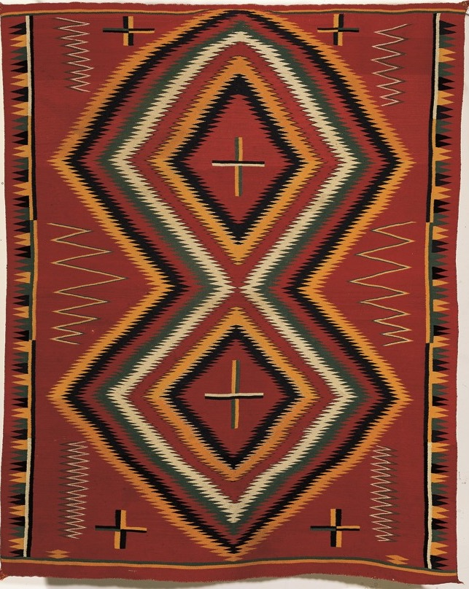
Germantown Eyedazzler, 1875-1880
Trading posts and government supplied annuity goods included commercial wool that had already been introduced during imprisonment at the Bosque Redondo.
The sheep flocks had been decimated during
imprisonment, so new breeds of sheep were introduced. Also, weavers had been introduced to new design patterns based on Hispanic design during imprisonment.
You can see the Color Riot catalogue if you want more discussion of the period.
219Bl

Slide 13
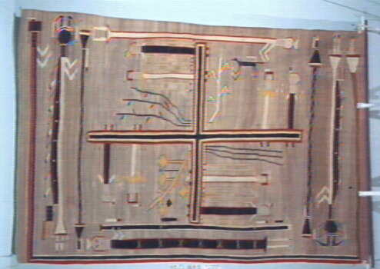
Hosteen Klah, Whirling Logs, c. 1921. From the Night Chant and thought to be Klah’s first depiction of a sandpainting. This is difficult to see, but another chance to point out the four sacred plants. The Mountain Sheep Gods flank the main design carrying sacks of black clouds on their backs.

Slide 14
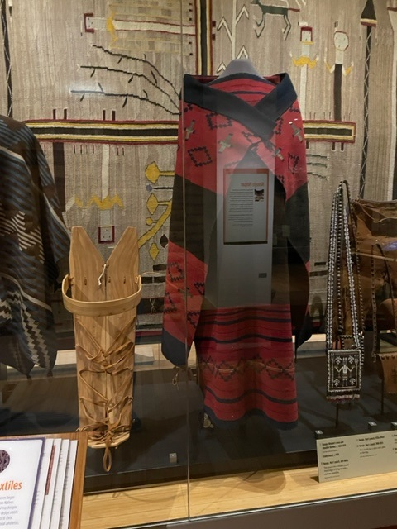
Dress, c. 1870, 181Bl
Manta, c. 1860, 156Bl
The Ornelas family review of textiles
determined that this dress was a maternity
dress based upon lack of belt wear and
uneven length of panels.

Slide 15
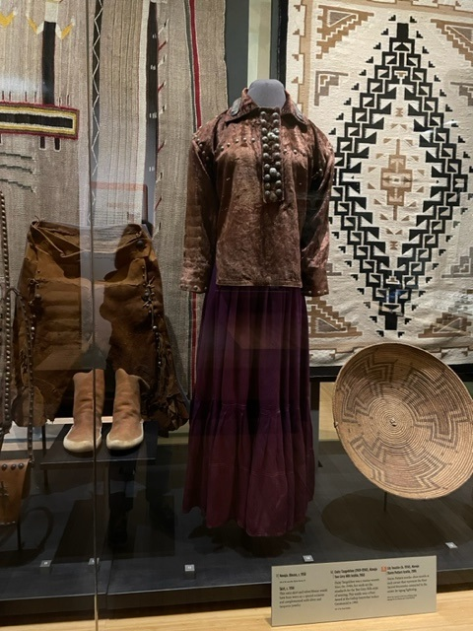
My grandma always wore skirts, pretty velvet blouses and all her jewelry. She’d be herding sheep, and you could see her pins flashing and hear her necklace jingling against her conchos or silver buttons. As a traditional person you’re always supposed to look presentable for the sun to greet you.
Rena Martin, 2003
We also have some men’s clothing with pants of buckskin, made in the late 1800s.
After the Bosque Redondo, women’s dress styles changed to versions of Anglo women’s style. Blouse, c. 1905; Skirt is c. 1954.
The basket was woven c. 1900 with a Spider Woman’s cross design.
Jumping ahead, textiles move into the regional design period of the mid 20th century.
In the background is a Daisy Taugelchee Two Grey Hills textile, 1960. Taugelchee was a master weaver who won first prize with this textile at the Gallup Inter-tribal Ceremonial in 1960.

Slide 16
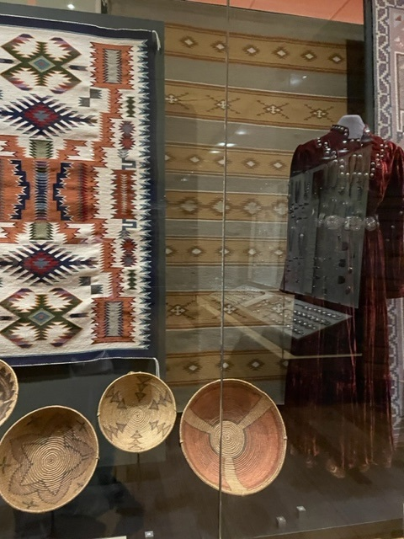
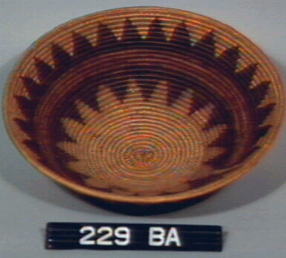
The photo of the case shows a variety of
baskets from 1897-1910 collected by Richard
Wetherill. The design on the basket
featured here is usually called a wedding
basket design, but it could be used in any
ceremony. Its designs are daylight, dark, rainbow
dark clouds, mountains and the break is the
pathway of consciousness.
The textile is a Storm Pattern by Lillie Touchin, c. 1986, and a Wide Ruins
design woven from vegetal-dyed yarns. In front of the Wide
Ruins textile, is a Virginia Ballenger dress that is a modern version
of the earlier velvet blouse and satin skirt.

Slide 17
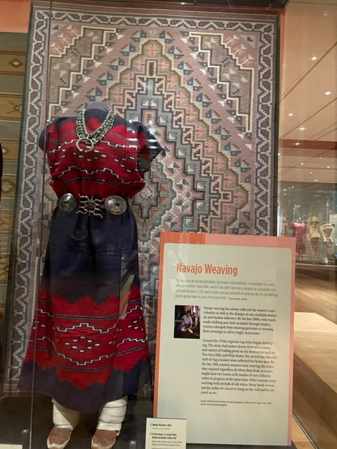
A contemporary version of a woman’s dress by Emma Lee, woven in
the late 1970s.
It is shown in front of Burntwater-style textile, 1992 by
Victoria Keoni. The design is basically a Two Grey Hills design woven in
pastel colored yarn.

Slide 18
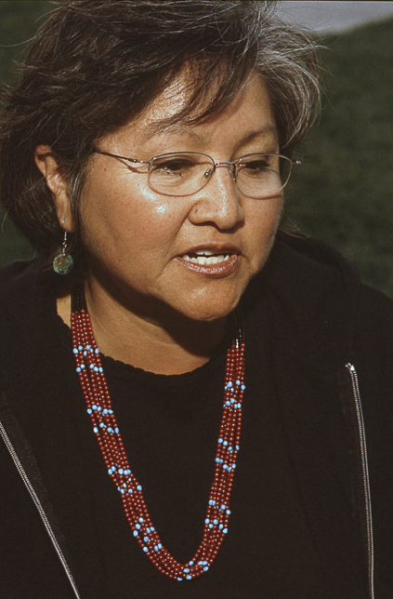
Navajo Jewelry
I started wearing turquoise when I was a toddler, and I can’t see myself without it.
It makes me feel close to whoever gives it to me. I feel like I’m with my mother
when I wear the things she gives me. Rena Martin, 2003
You could draw people’s attention to distinctions between Navajo jewelry and the
lapidary work of Pueblo peoples and the overlay of the Hopi jewelers. In the case
of Navajo jewelers, they are generally master silversmiths, employing a wide variety of
techniques and including stone with an emphasis on turquoise.

Slide 19
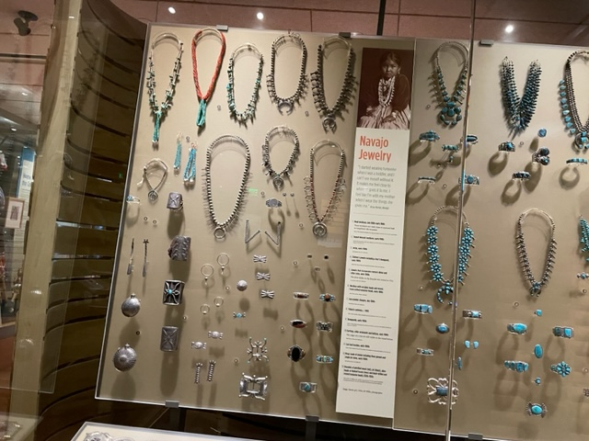
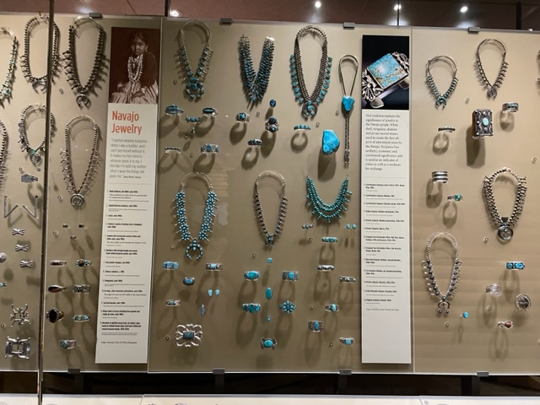
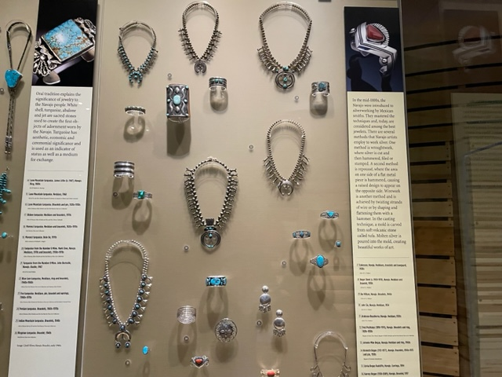
As is shown in the upper left case, the emphasis on silver does not exclude shaping beads of coral, turquoise and shell into
joclahs worn as earrings or pendants.

Slide 20
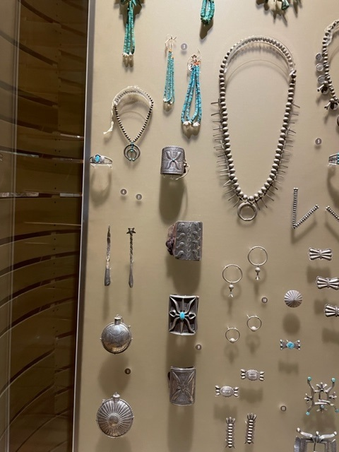
Going back to Rena Martin’s comments about
starting to wear jewelry when she was a toddler,
you could point out the tiny bracelet, necklace, and
bowguard from the early 1900s.

Slide 21
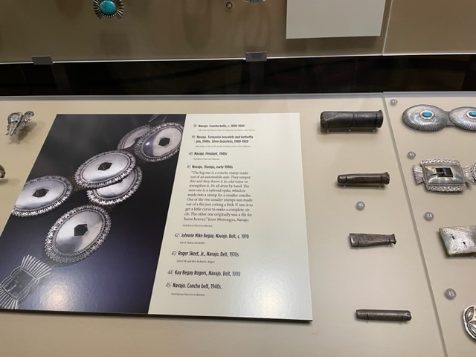
In addition to jewelry, we included some tools
identified by Jesse Monongye. His discussion is
included in the touch screen. The top stamp
is made from a car or truck axle and used to create
the dome of a concho belt. The second stamp is a
railroad spike, and the third and fourth stamps are
made from files, one of which is a file used on
horses’ hooves. They would be used to make
concho belts.

Slide 22
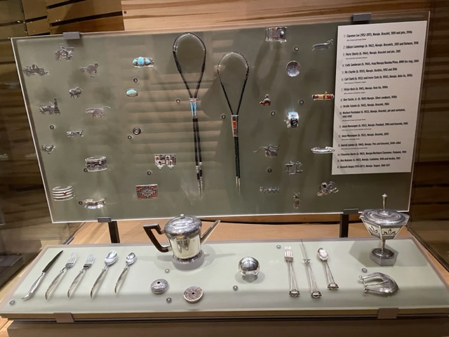
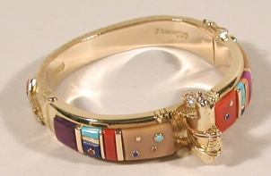
In the final section of Navajo silverwork, you
Have recent pieces that continue to innovate design
and materials.
This bracelet is by Jesse Monongye and his son
Bo. It was made in 2002 of gold, sugilite, coral, turquoise,
fossilized ivory, lapis lazuli, and diamonds. It was
Bo’s first collaborative piece with his father.

Slide 23
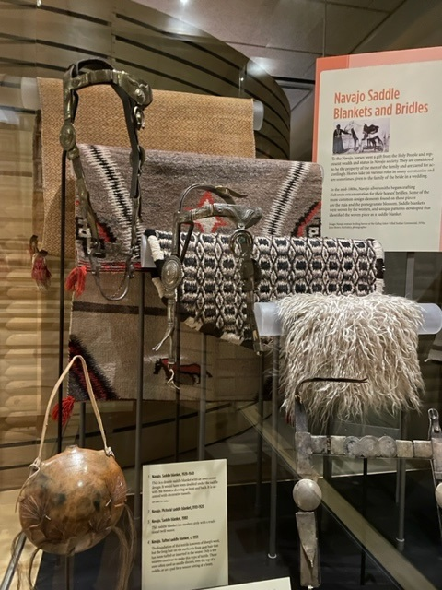
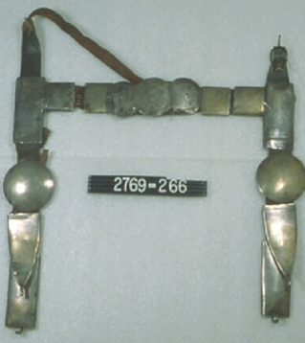
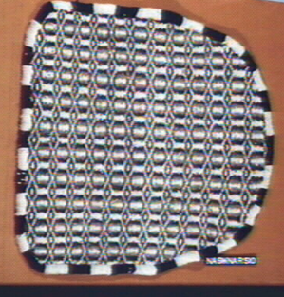
Horse tack from c. 1875 to throughout the 20th century. The canteen
by Christine McHorse is included with its design of a horse.
McHorse was known for her use of micaceous clay. The lower
headstall is attributed to Atsidi Chon, c. 1875, one of the earliest
silversmiths to be known by name. Older bridles were made with
silver coin, first American and later Mexican coins.

Slide 24
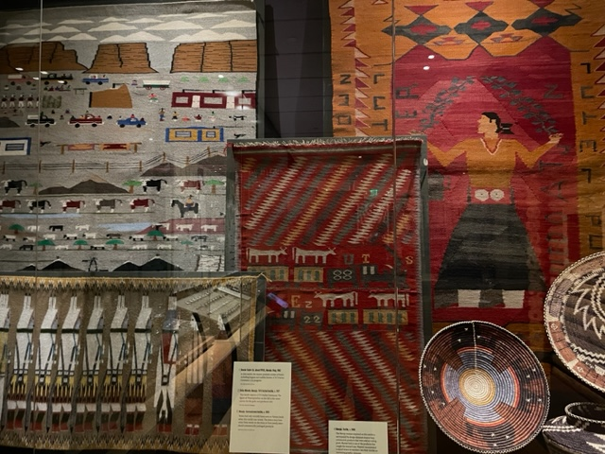
Pictorial Weaving
Some textiles provide snapshots from the
weaver’s world.

Slide 25
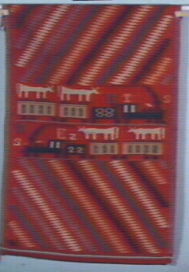
Train pictorial textile, c. 1885, Germantown yarn and cotton twine.
Trains had only recently been seen on Navajo lands when this textile was woven. The weaver positioned the train, a symbol of a new technology, along with ordinary livestock. The letters may have come from words on the train or from newly introduced packaged products. The weaver probably chose them because she found the designs interesting. The cows may have been inside the train cars. You will see a similar basket in the Akimel O’odham section of HOME.

Slide 26
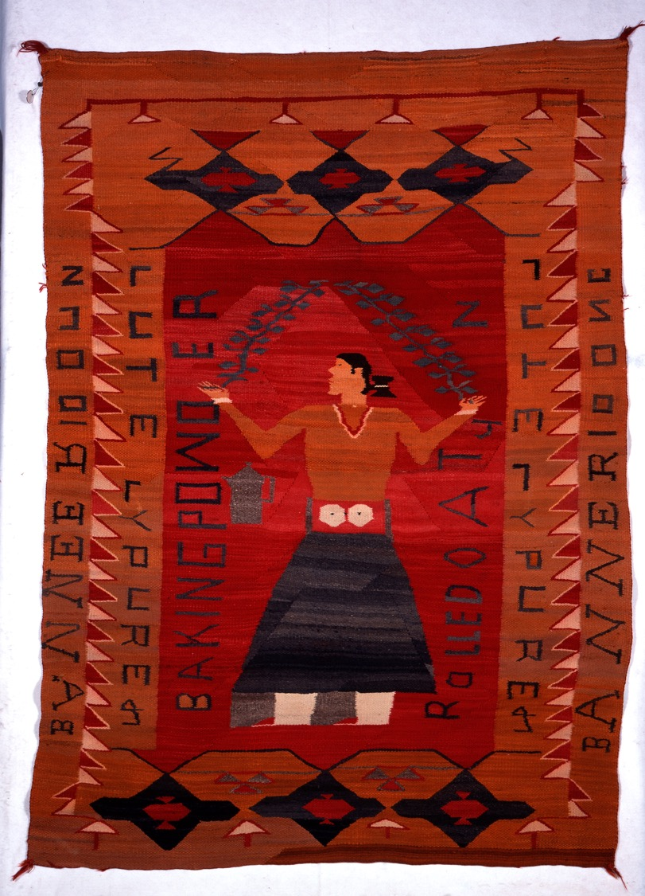
This is a great example of how weavers incorporated
designs from commercial goods found in trading posts into
their textile design. c. 1900.
Based on Banner baking powder, Rolled Oats and something
that is “Lutely Pure,” this weaver chose to treat letters
as graphic symbols. 351Bl

Slide 27
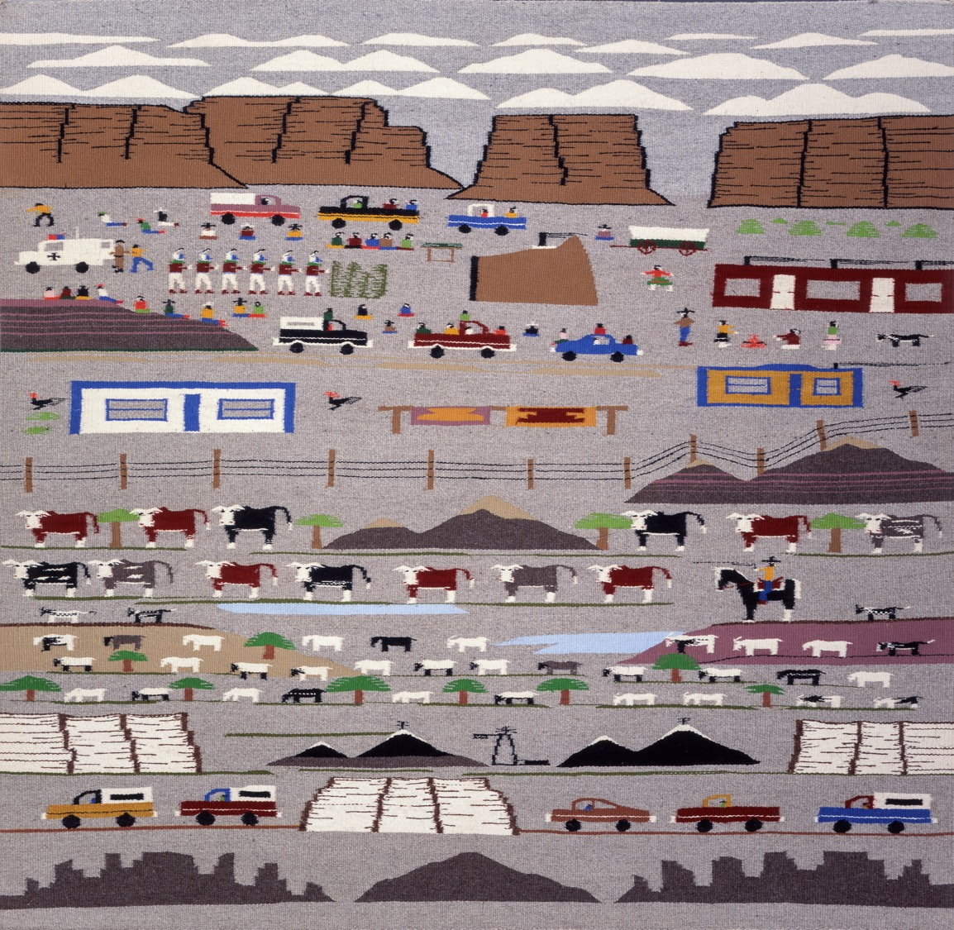
Bessie Taylor included a wonderful variety of
transportation and dwellings in her 1982
textile. The hogan depicted is a male hogan.
You could mention that in view of the fact
that the big hogan is a female hogan.

Slide 28
Myths about textiles
Chief Blankets were not worn by Navajo “chiefs.” They were prized garments and status symbols among Plains tribes. The No Horse ledger book includes a depiction of a procession of Cheyenne women in Chief Blankets.
In Substance of Stars, the subject of deliberate mistakes is raised in connection
with depictions of sandpaintings in textiles. That is the only circumstance in which a deliberate alteration of the design or pictorial subject matter would occur.
When a textile is woven with a border, some weavers choose to include spirit lines or weavers’ pathways as a way to carry forward the good energy and ideas to their next textile. It is not a mark of authenticity in determining if a textile is Navajo in origin.

Slide 29
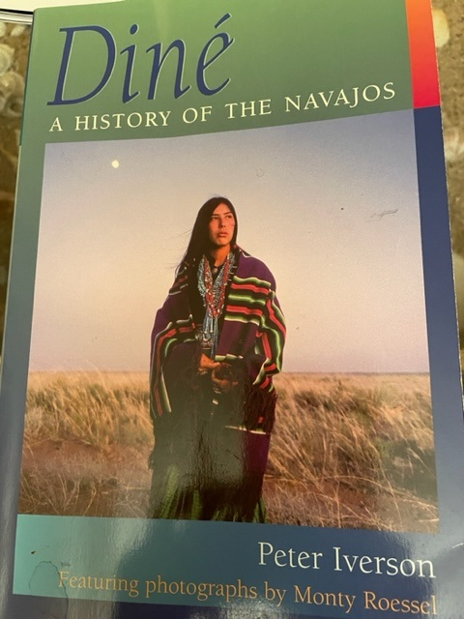
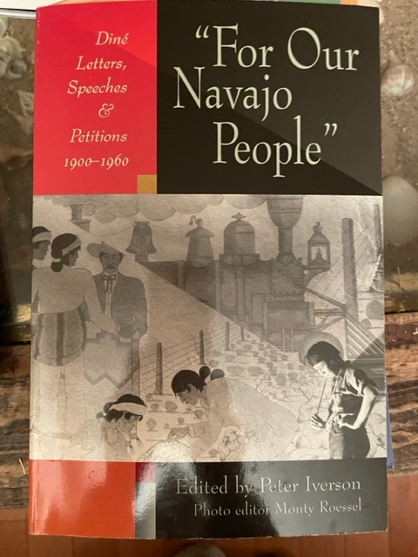

Slide 30
San Juan Southern Paiute
and
Kaibab Band of Paiute Indians

Slide 31
In 1934, the Kaibab Band of Paiute Indians was established under the Indian Reorganization Act with headquarters in
Fredonia. The reservation was established by Executive Order in 1913 and 1917. It is located on the Arizona Strip,
about 50 miles north of the Grand Canyon, on the border with Utah.
Pipe Spring National Monument is located entirely within the tribe’s land base of approximately 121,000 acres.
Tourism, agriculture and livestock are important to the tribe’s economy. The tribe also owns a 1,300-tree fruit orchard.
Paiute weavers excelled at creating many functional baskets suited to their traditional lifeways and seasonal moves.
San Juan Southern Paiute Tribe were federally recognized in 1989 making them the most recently recognized tribe in
U.S. They are currently without a land base, being located entirely on the Navajo Nation. Ancestral lands for the
Southern Paiute are in Utah and Arizona. Sharing of lands with the Navajo people was heightened as the
Navajo moved into the lands of the Paiute to escape the military campaigns of 1864.
Beginning in 1933, land occupied by both Navajo and San Juan Southern Paiute has been added to the Navajo Nation.
In 2000, the San Juan Southern Paiute Tribe and the Navajo Nation signed a treaty that would set aside 5,400 acres
of land for the Southern Paiute pending approval by the U.S. Congress.
Tribal members primarily live in non-contiguous northern and southern areas.
In Utah, those communities are Navajo Mountain, White Mesa and Blanding.
In Arizona, the communities are Hidden Springs, Rough Rock, Willow Springs, Cow Springs and Tuba City.
The tribe’s offices are in Tuba City.

Slide 32
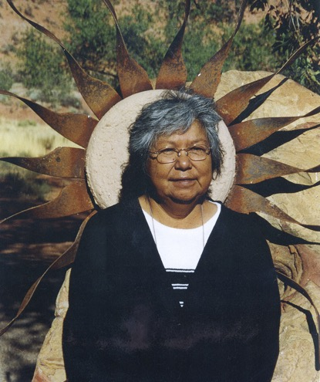
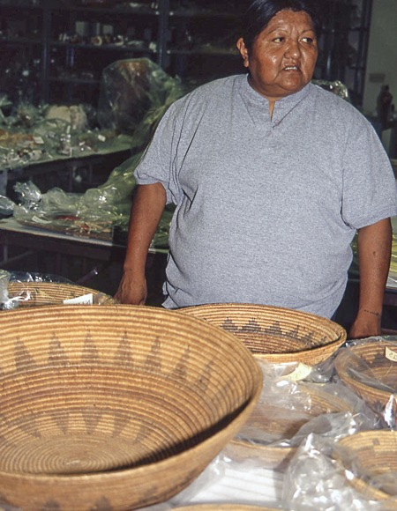
Language plays a major role in our ceremonies; we are orators, and a lot of the orators speak in the Paiute language. In order to understand the whole person, the soul and the spirituality of individuals and of yourself, you need to know that language because, otherwise, you’re just a body that’s walking around out there in the world not having full knowledge of who you are as an individual, as a member of a group, and how you intermingle with that group. Vivienne Caron Jake, Kaibab Paiute
The summer house of cedar and sage smelled like fresh air. Brenda Drye, Kaibab Paiute Cultural Preservation Officer

Slide 33
Important Points
The arid areas of northwest Arizona, Southern Utah and Nevada that are Paiute homelands meant they
had to move in accordance with seasonally available resources. In the Pueblo section, Rachel Agoyo talked about being in
awe of how her ancestors knew every bit of their land. That is the case here.
Important concepts about land use.
Each band lived and moved seasonally within its own use area.
There were communal use areas where bands would seasonally come together for piñon harvesting.
Don’t use the word nomadic. Some may misinterpret that as wandering aimlessly. Also, the phrase “hunters
and gatherers” should be used carefully or not at all for those who have a concept of an evolutionary hierarchy
of social organization.
This “use area” lifeway of peoples’ relation to the land was horribly impacted when settler colonizers moved in
along a major wagon route from New Mexico to California through their territory, fencing off property and waterholes.
Many died of starvation.
You will find this history repeated throughout Pai territory as well.

Slide 34
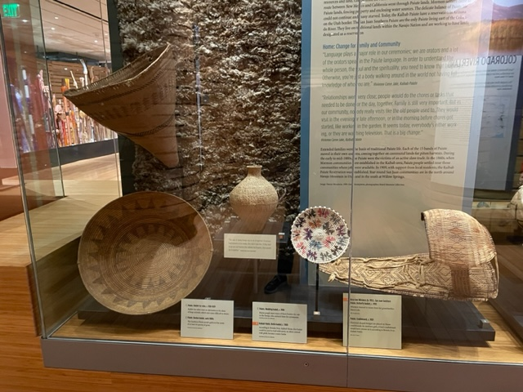
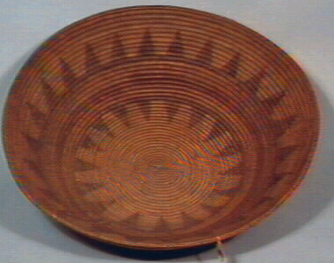
Given the Paiute traditional lifestyle it isn’t surprising that basketry would be a well-developed artform.
Basketry created by San Juan Southern Paiute weavers includes designs appropriate for use in Navajo ceremonies, as well as designs that interest today’s basket collectors.

Slide 35
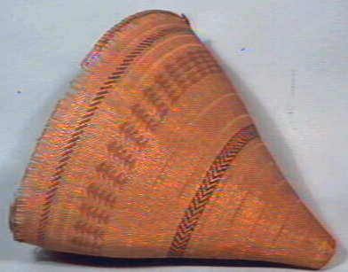
The way of doing things was to do it together. If women had basketry to be made, they did it together. If they had to go out and harvest the willows for baskets, they would do it together. Vivienne Caron Jake, Kaibab Paiute.
This burden basket, woven in the early 1900s, was used for gathering small seeds
of at least 44 species of grass, as well as roots, and berries. Gathering of small
seeds requires a closely woven basket. If you look closely at the basket, you can’t
see light coming through the weave.

Slide 36
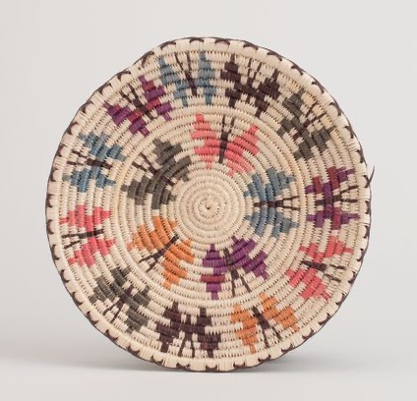
Rose Ann Whiskers, b. 1952
Butterfly basket, c. 1990
This basket is included to illustrate a larger concept that relates to
The shift in basket weaving that took place from utilitarian to
art form for reasons that relate to treasured knowledge shared by
elders and family members and connected to the land, going far
beyond the very real economic factors.
There is a great article from a periodical Leading the Way, Vol. 10.8-12,
(Aug. 2012) In the Native American Artists Resource Collection in
our library and archives that has Whiskers’ discussion about her
profession as a basket weaver. She talks about her practice, how she
learned to weave and growing up as a Paiute person.
This basket makes the very important point about continuing
cultural art traditions.

