Slide 1
Hopi
Hopi began as a gathering of different peoples from different directions of the earth. They call it the gathering of the clans. They brought their own languages. The language we have now is a combination of all these languages.
Albert Sinquah, Sr., Deer Clan, Hopi/Tewa 2003

Slide 2
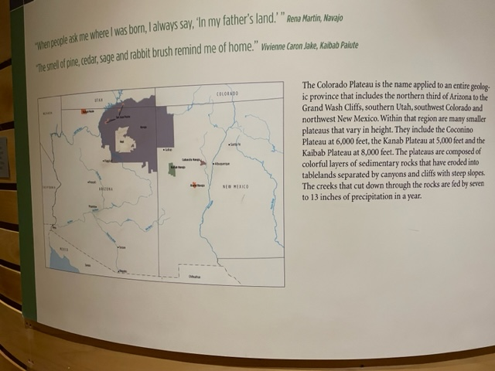
Colorado Plateau Label: Hopi, Navajo and Paiute

Slide 3
There are 12 Hopi villages,10 of which are located on
three mesas.
First Mesa: Walpi, Sitsomóvi, Hano
Second Mesa: Musangnuvi, Supawlavi, Songoopavi
Third Mesa: Orayvi, Kiqötsmovi, Hotevela, and Paaquavi
Two villages are located 35 miles west of Hotevela—Upper
and Lower Mungapi. These two villages were originally summer
villages located near the corn fields.
In many important respects the villages are independent. The passage of the Wheeler-Howard Indian Reorganization Act in 1934 led to the establishment of the Hopi Tribal Council on December 19, 1936.
Gloria and Clifford Lomahaftewa gave family guidance throughout the HOME exhibition and many other Heard
exhibition.

Slide 4
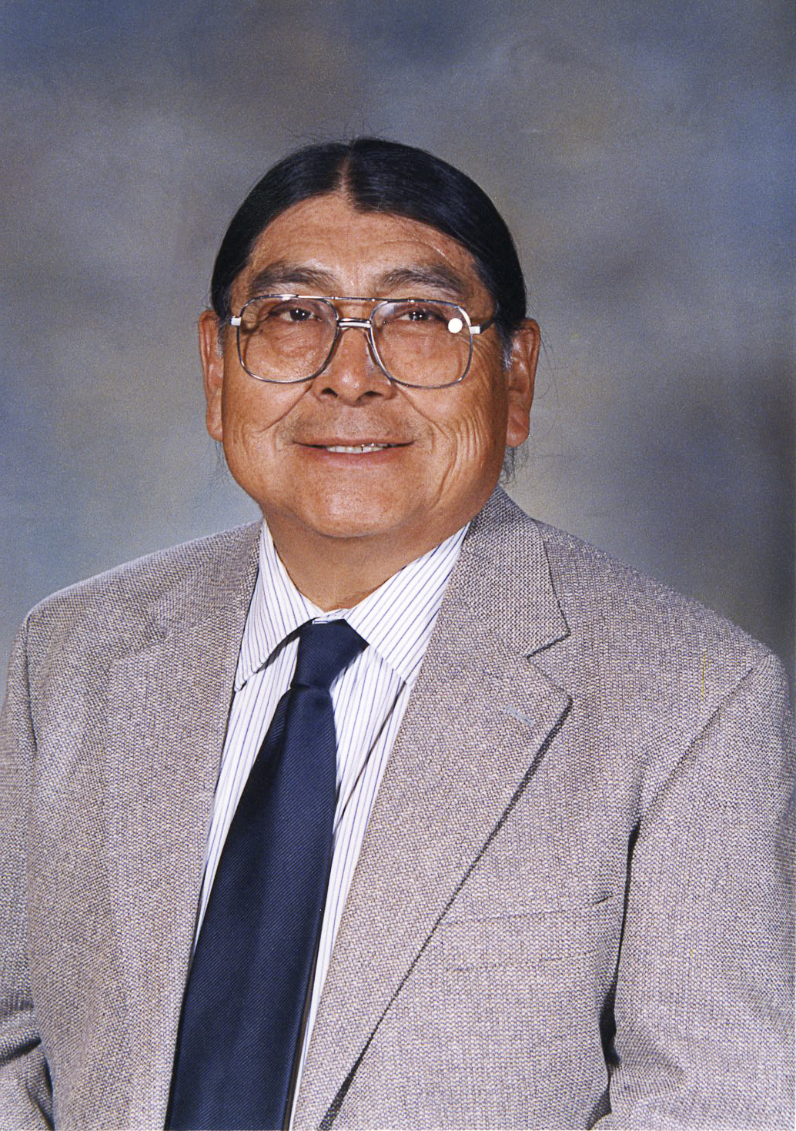
We see ourselves as caretakers of that piece of the earth that we use. We also have respect for the heaven…the stars, the moon and the sun, nature itself, the clouds, rain, snow. What makes us whole is to recognize and respect all these things and their seasons. Our lives are pretty much controlled by the seasons. Our ceremonies are dictated by the seasons. Our daily lives are dictated by Mother Nature because we live on a definite calendar, our planting season, our katsina season, our home dance, are all dictated to us by Mother Nature. Albert Sinquah, Hopi
The villages are on three smaller mesas that reach out from 60-mile wide Black Mesa.
The Hopi arrived at their present mesa top homes by at least 1000 C.E.
Settled at least by 1150 C.E., Orayvi is the oldest continuously inhabited community in the United States.
Migration stories tell of clans gathering from every direction. “Dynamic change” is a phrase used in the book Becoming Hopi: A History. It is used in the context of romanticized outsider presentations of the Hopi presented as frozen in the past. By using the word “becoming” in the title, the authors explain that one is always striving to live by the standards of the Hopi way of life that includes “sustaining the wholeness of all things in great balance,” as Alph Secakuku wrote in The Hopi Katsina Tradition: Following the Sun and Moon.

Slide 5
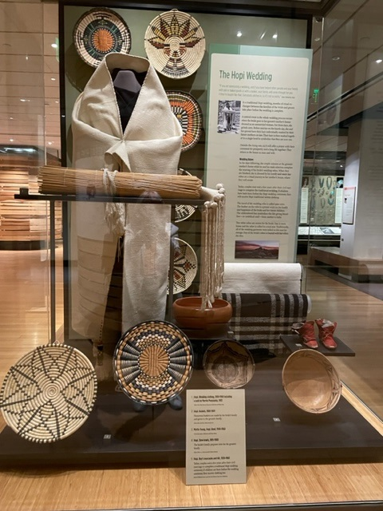
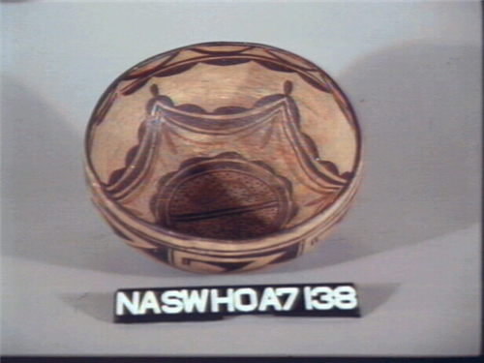
Hopi Wedding
Because of the months of preparation required for a traditional wedding, people may have a civil ceremony and begin raising a family.
For that reason, children’s clothing and moccasins are included as gifts.
The whole case recognizes the scope of the ceremony.
Baskets are gifts to the groom’s family.
Food bowls recognize the food the bride provides to the
groom’s family as they weave.
If you could see the robe up close you, would see that more than one hand wove the robe. It is woven by the groom’s family.
Karen Kahe Charley told us the design represents friendship

Slide 6
“In Hopi religion Katsinas are many things
Katsinas are messengers, carrying the prayers of humans to the spiritual forces that control such phenomena as
rainfall.
Katsinas are spiritual beings that personify all aspects of the Hopi universe—from corn to deer to fertility.
Katsinas are ancestors who have passed on and who return in the clouds with blessings to ensure the continuity of
the living Hopi.
Katsinas are clouds whose flowing hair touches the earth as falling rain.
Katsinas are friends who come and reside in the Hopi villages during the winter and the spring and to conduct prayers,
dance in the ceremonial rooms called kivas and in the outdoor plazas.
Katsinas are depicted in carvings made as gifts to Hopi babies and girls and now for sale to outsiders.
It is in these last two forms—the Katsinas dancing in the plazas and especially the katsina dolls—that katsinas are
experienced by outsiders.”
A statement formulated by Ramson Lomatewama and Gloria Lomahaftewa for a paper written by Peter H. Welsh,
“Repatriation and Cultural Preservation: Potent Objects, Potent Pasts,” in the University of Michigan Journal of
Law Reform, Volume 25, Issues 3 & 4, Spring and Summer 1992. KF8210.A57, W3, 1992.

Slide 7
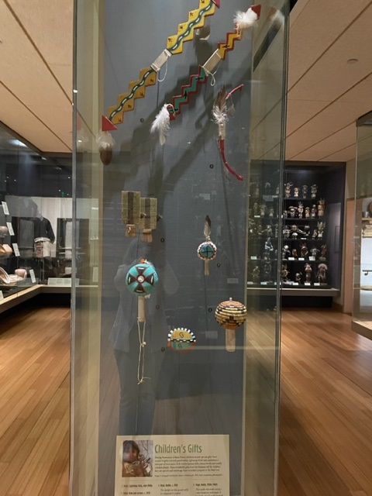
Gifts given by the Katsinam at the February ceremony, Powamuya,
include lightning sticks, bows and arrows and rattles for boys. In
addition to katsina dolls, girls may receive dance wands or a basket
plaque.
The gifts tell children they are special and encourage them to behave
properly in the Hopi way.

Slide 8
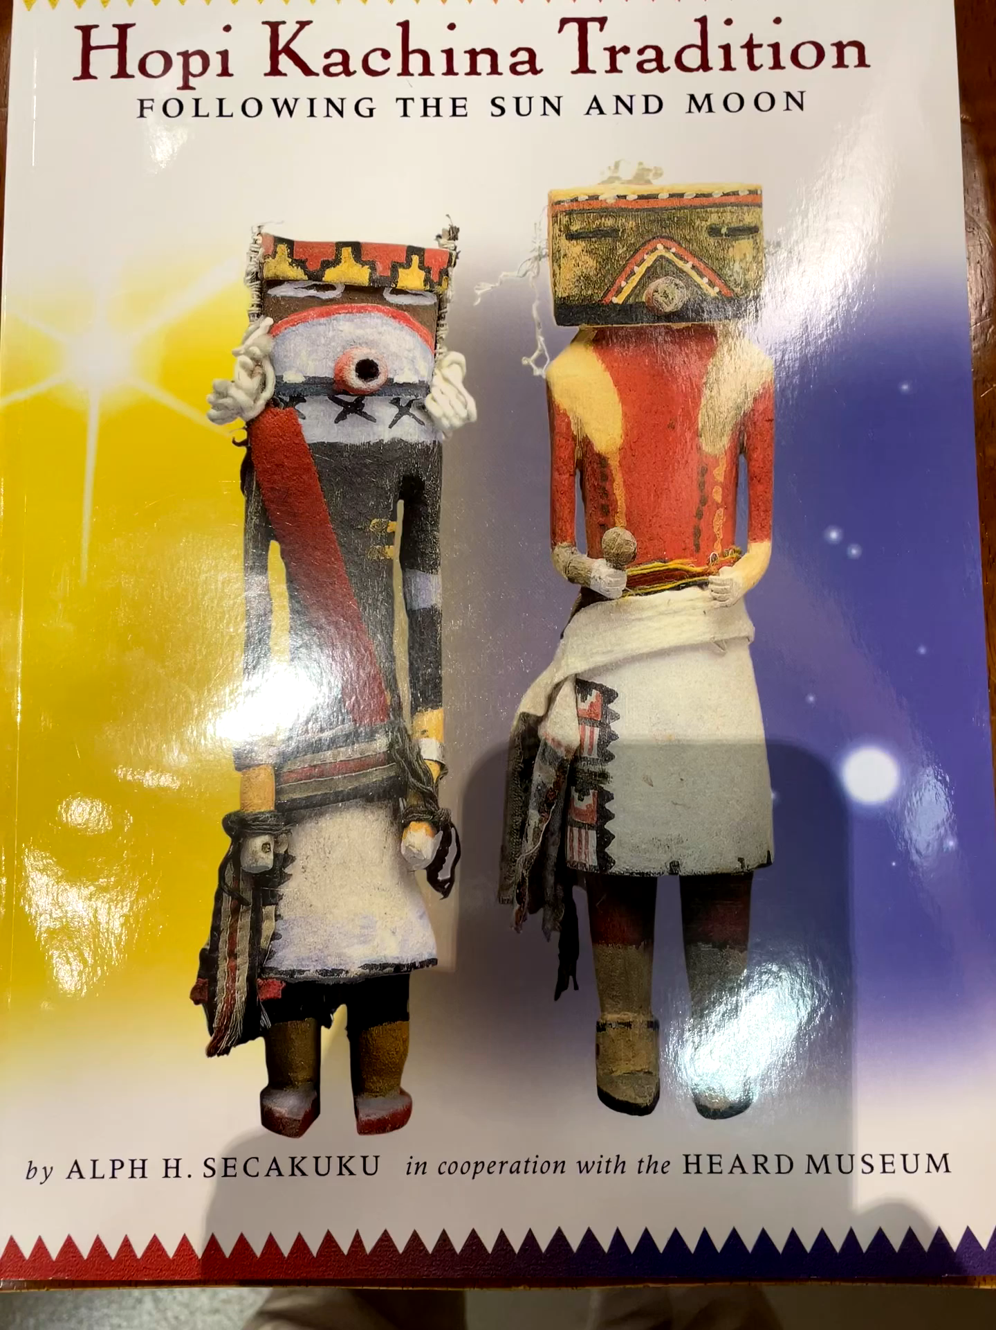
This publication by Alph
Secakuku is a first person
account of the Katsina
Tradition featuring the
Heard’s collection. Note
the subtitle, which was the
original book title.
Make sure to emphasize that the ceremonies, their songs and prayers, are done for blessings of peace, fertility, growth, for the well-being of the earth and are done for all people. You heard that in the Pueblo section, and this is the same.
The Katsinam as they appear in ceremony are the physical
embodiment of the spirits, in the words of Alph Secakuku.
Alph Secakuku refers to katsina carvings as “personifications of the Katsina spirits, originally created by the Katsinam in their physical embodiment.
Do not say dancing Katsinas are masked dancers.
Do not say that dancers are “impersonating” Katsinas.
Uninitiated Hopi children visit the museum in school groups or with their parents.
Keep in mind that anything said should be appropriate for an uninitiated Hopi child to hear. Formal initiation is done around the age of ten.
Our visitors, for the most part, are beginning to learn and your time is limited.

Slide 9
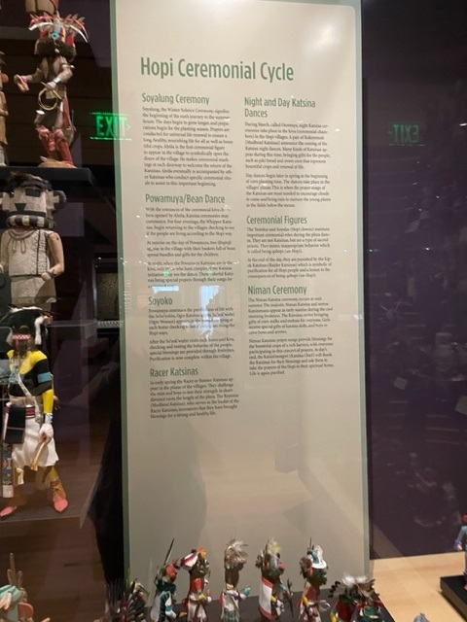
The ends of the shelves have the name of the ceremony in which
the Katsina appears.
Katsina ceremonies extend from the winter solstice, beginning of
the new year to summer solstice and Niman Ceremony.
Specific timing and dates are set by the kikmongwi and village
priesthood society leaders.
Gifts of katsina dolls are given by the Katsinam to babies, girls,
young women during the February Powamuya/Bean Dance Ceremony
and during the July Niman Ceremony/Home Dance before the
Katsinam return to their home in the San Francisco Peaks.
The gifts of carvings are hung in the home and become teaching
tools in discussions with parents.
When you get around to the other side of the center case, you can
see Ray Naha’s depiction of a Niman Ceremony. I would call this out.
You can see children and a new bride receiving the gifts.

Slide 10
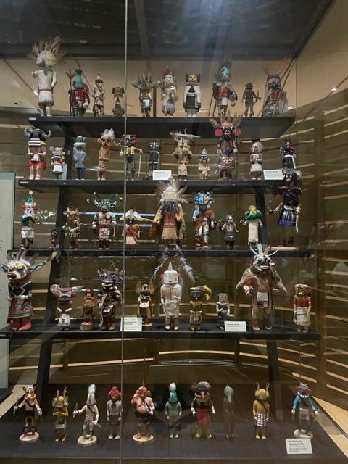
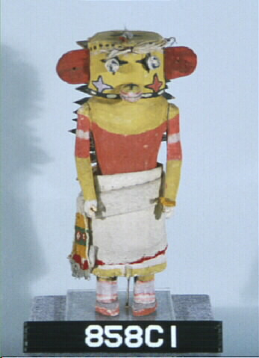
First section of katsina dolls
Note that they are arranged without regard to when they were
carved. Gloria Lomahaftewa selected dolls based on accuracy of
representation.
The carvings on the top shelf are associated with Soyalung, the Winter
Solstice ceremony and Ahöla is the first ceremonial figure to appear in
the village, to symbolically open the village’s doors.
The next three shelves are associated with Powamuya or Bean Dance.
Among many other gifts given by the Katsinam is the gift of bean sprouts.
Si’oho’te, c. 1900
Some of the older carvings have carefully crafted and embroidered clothing.

Slide 11
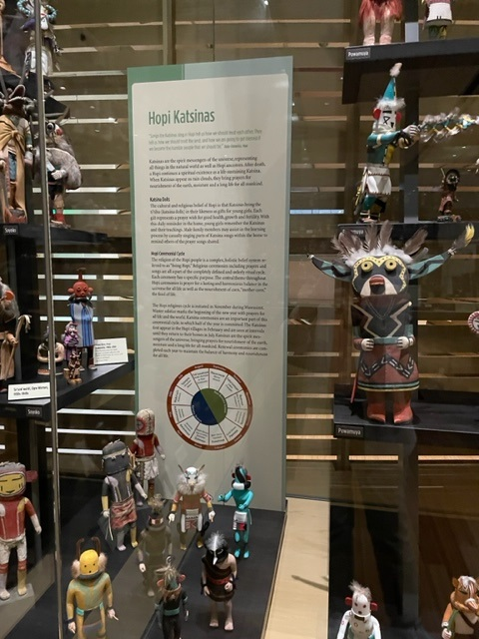
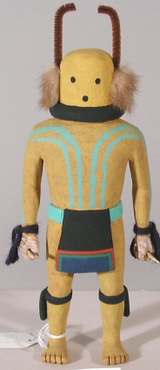
Clifford Lomahaftewa
Scorpion katsina carving, 1997

Slide 12
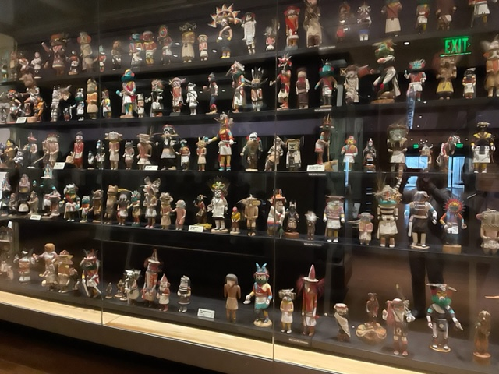
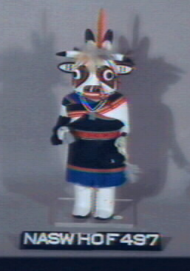
Wakaskatsinmana/Cow Maiden 1970
Arnold Taylor, Sungopovi
Appears in mixed katsina dances.
It personifies animal life and sings songs
For bountiful moisture.

Slide 13
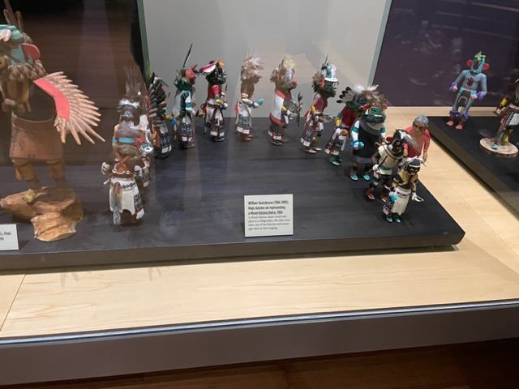
Night and Day Dances
In the colder months ceremonies are conducted in the
Kivas.
Day dances begin in spring at the start of planting time.
They are held in the village plazas at corn planting time
As prayers for the special blessings of rain are needed to
bring life and growth to the young plants.
William Quotskuyva (1909-1999)
Katsina set representing a Mixed Katsina Dance. The elder man takes care of the Katsinam and encourages them in their singing.

Slide 14
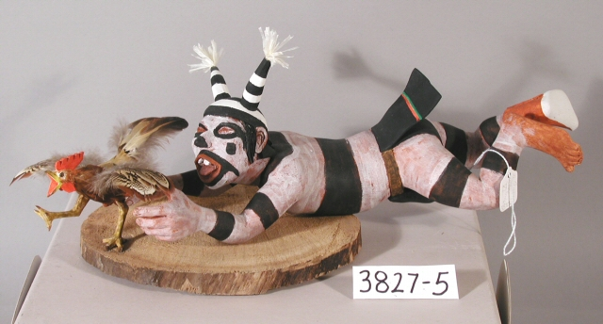
Clowns
There are several types of clowns, one of which if the Koyaala, the Hano clowns of First Mesa. They are not Katsinam.
They are sometimes referred to as
Sacred clowns to differentiate them from the circus clowns that visitors might be thinking of. They teach by showing how not to behave. They make fun of people and are punished by the Whipper Katsinam.
Neil David, Sr. Hopi-Tewa, 1987
3827-5

Slide 15
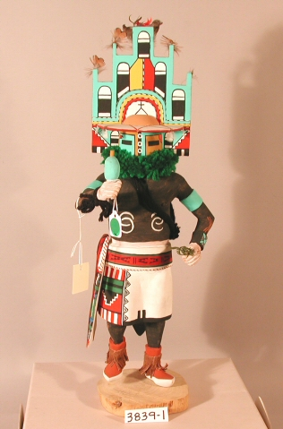
Niman Ceremony/Home Dance in July when the Katsinam who have been in the
Villages in their physical form return to their spiritual home.
Tino Youvella, Hemis Katsina, 1983
These figures are shown in the Naha painting bearing gifts of corn and melons that represent the bounty of the harvest. In addition to the cloud shaped headpiece, the tiny feathers on top also represent clouds.

Slide 16
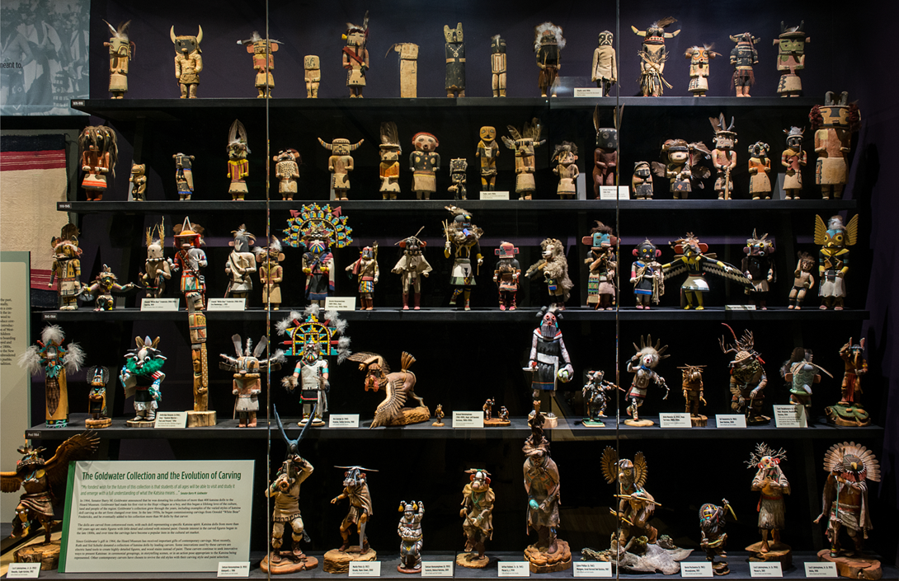
Changes in carving styles
Top three shelves are from the Goldwater Collection,
given in 1964, during his Presidential campaign.
Senator Goldwater was introduced to the Hopi ceremonies as a boy by architect John Rinker Kibbey.
The figures are carved from cottonwood root.
Note the change in carving styles over time, becoming increasingly detailed and animated.
The use of Dremel tools influenced the ability to add detail.
With the passage of time fabric clothing, Douglas fir ruffs, yarn and feathers have given way to amazingly finely carved figures, with many carved from one piece.
Also mineral paint, changed to tempera, acrylic, and eventually to stains.

Slide 17
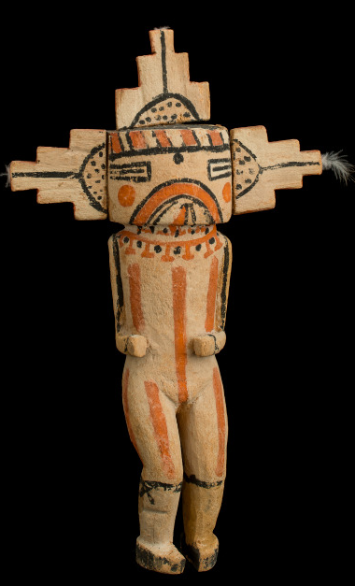
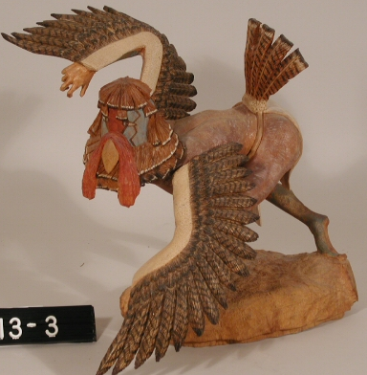
Sa’lakwmana, 1890s
Turkey Katsina. Ros George, 1988. The carving is posed with dramatic
tension shown in every muscle, and hands and feet take on a
human/bird-like quality.

Slide 18
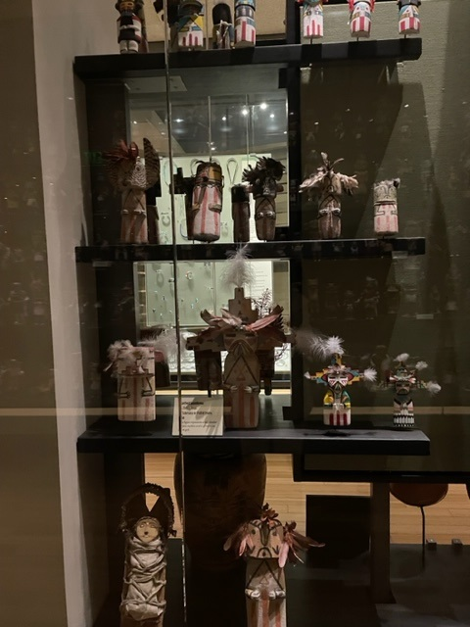
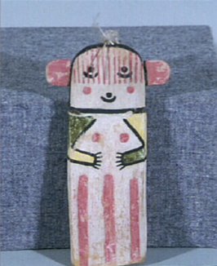
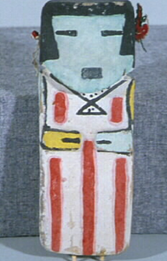
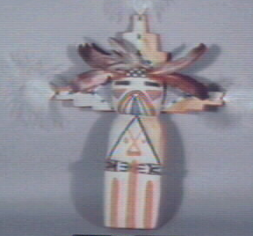
Puch’tihu or cradle katsinas
In viewing these carvings note that some old ones have a gloss to the mineral paint that is the result of honey being mixed into the paint, knowing an infant will try to chew on the carving.
Hahay’iwuuti is the Katsina Mother and the first doll given to an infant girl. She embodies all the qualities of a good mother.
Hanomana is the second doll given. An
Unmarried maiden from the village of Hano on
First Mesa.
Salakmana or Palhikmana is the third doll an
Infant girl receives. This carving is by
Manfred Susunkewa, 1984.

Slide 19
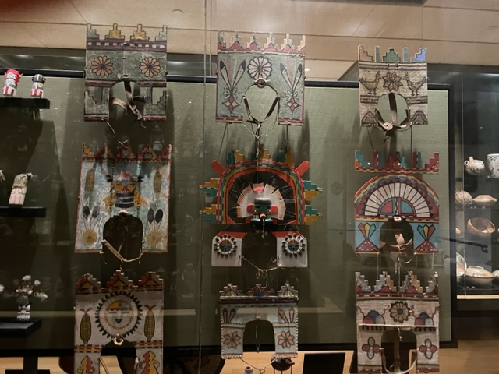
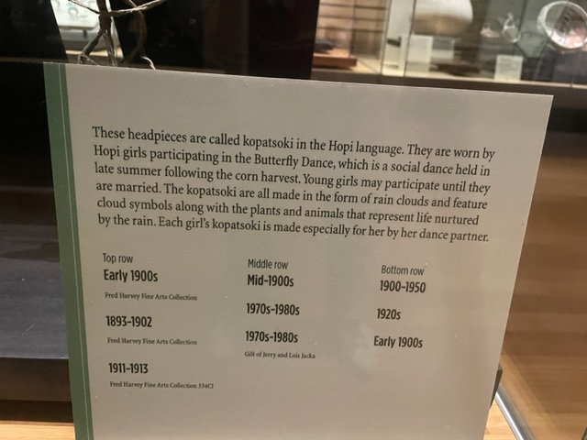
We wanted to give a representation of something from the non-Katsina part of the ceremonial calendar.
Note the abundant references to clouds and rain and the resultant plant growth.

Slide 20
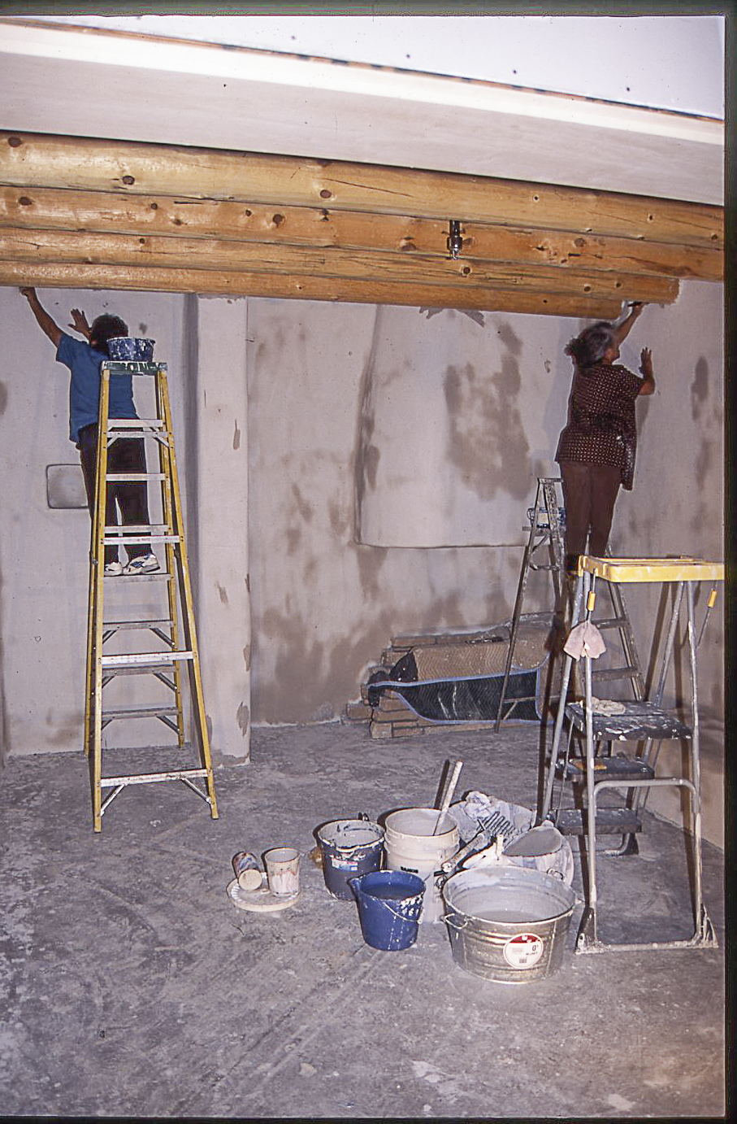
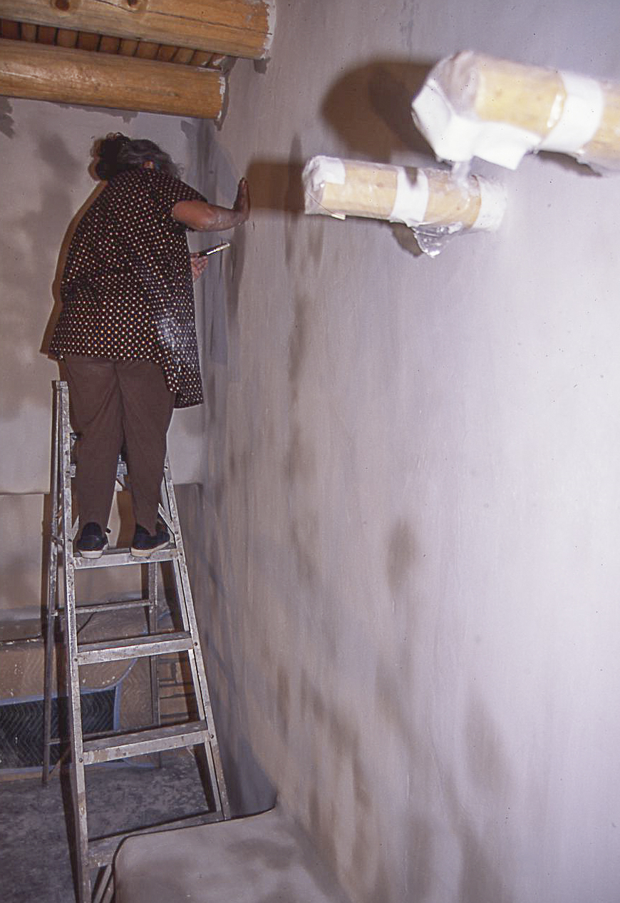
Piki room under construction with Mary Katherine Siow and Eileen Sohongva plastering the walls.
Remember Ofelia’s poem at the
beginning of HOME talking about
how home has “the right sense of
coolness when you touch the walls.”

Slide 21
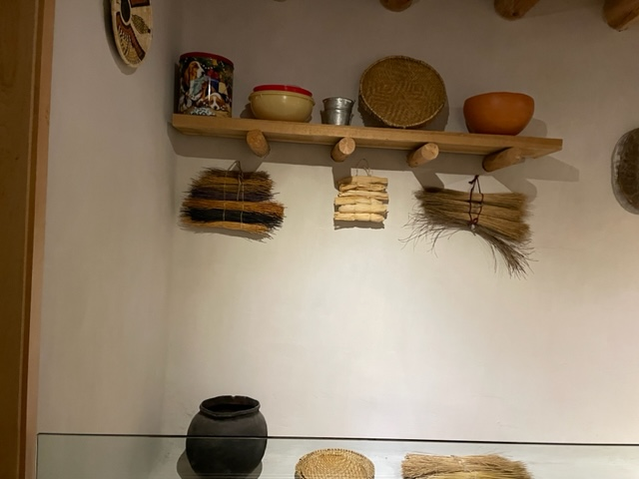
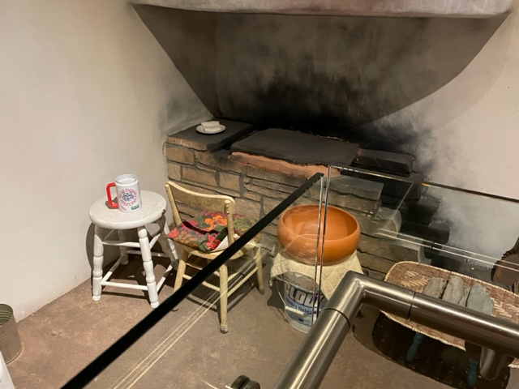
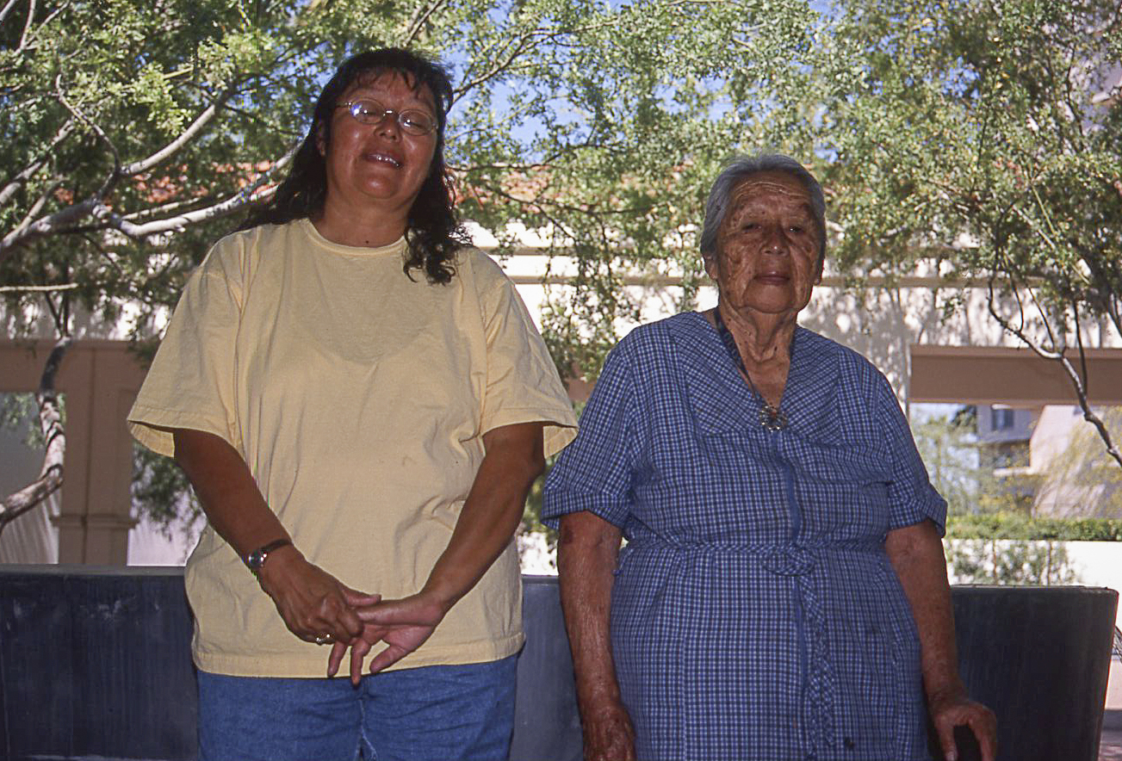
The room is furnished with a mix of old and new.
On the shelf are a few of the touches that Gloria inserted
to be certain modernity was included, reminding people
that this is a part of life today.
Piki stone and furnished work area. Note the U. of A. mug on the
stool. The piki bowl was approved as having the right recurve by
Karen Kahe Charley. The soot blackening is not nearly as extensive
as it would be in an older room.
Karen Kahe Charley and
Marcella Kahe

Slide 22
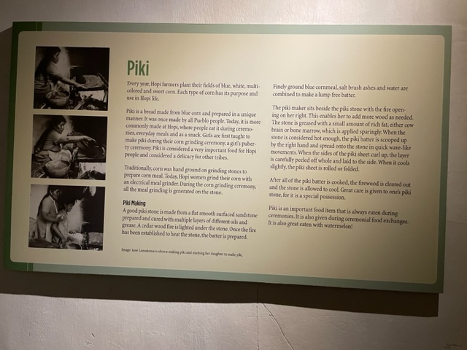
Made from finely-ground blue corn meal, salt brush
ashes and water. In an absence of salt brush ashes,
baking soda is used.
Unless the corn grinding is a part of a girl’s puberty
ceremony corn is ground in an electric grinder—another
modern touch you could mention.
Be sure to tell people that piki is made at the Guild
Indian Fair and Market.

Slide 23
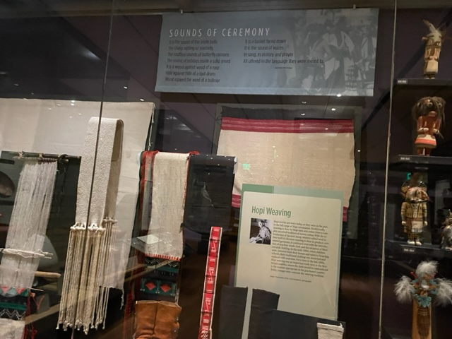
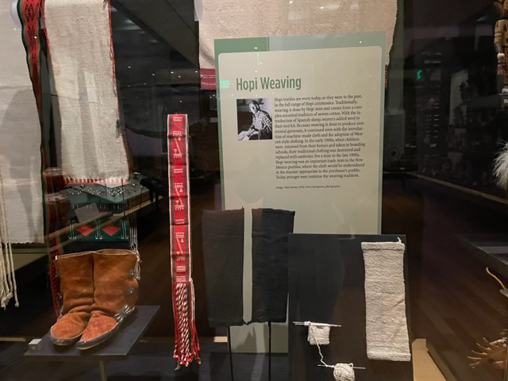
At Hopi, men have traditionally been the weavers. Today more garments are embroidered by women on machine-made cloth.
Most of our display focuses on ceremonial regalia with just a few everyday garments.
You could point out the partially knitted leggings shown were collected at Shungopovi in the early 1900s. The maker was
using large sewing needles. Textile expert Kate Peck Kent said that the Spanish introduced knitting as a technique.

Slide 24
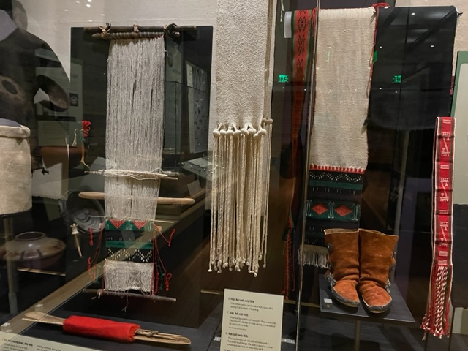
On the loom is a sash with the old technique of
brocaded weaving instead of embroidery.

Slide 25
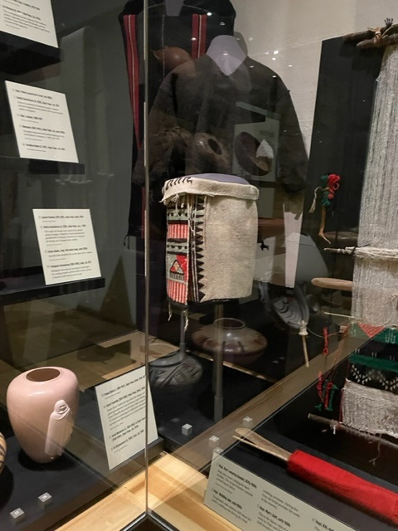
In the corner are men’s garments that were woven before western-style
clothing was available.
You might point out the embroidery on the kilt which features rain
clouds with lightning, and red streaks representing falling rain with the sun
shining through.

Slide 26
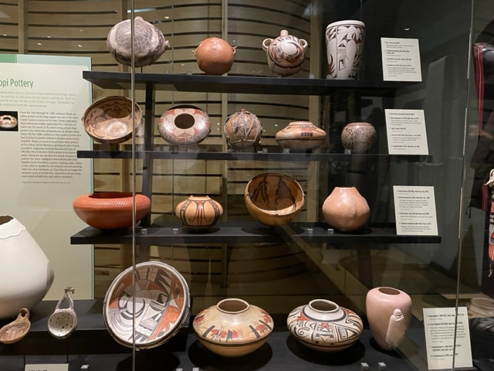
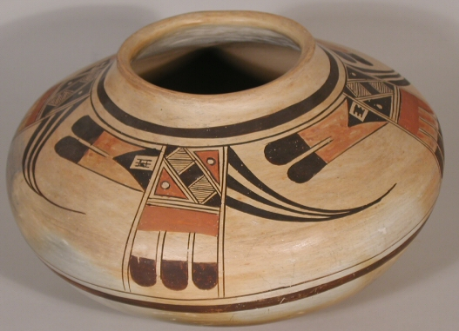
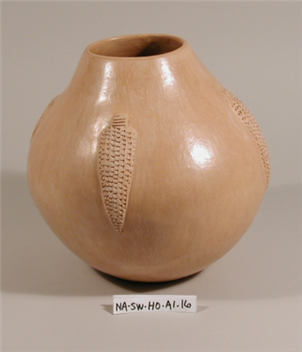
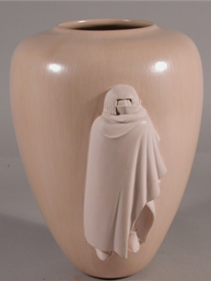
Nampeyo (1862-1942) Jar, early 1900s
Polingaysi Qöyawayma (1892-1990)
Jar, 1973
Al Qöyawayma, b. 1938, Jar, 1980
Recall the Jeddito jar we saw in the Ancestral Pueblo section, an example of a Hopi pottery type widely traded. Following the
Ancestral period, as more metal containers were available by the early 1900s, pottery production declined.
It was revived as an artform by Nampeyo, demonstrating for the Harvey Company at Hopi House. She brought renewed
attention to the art form. She was inspired by designs on pottery found at the ancestral site of Sikyatki.

Slide 27
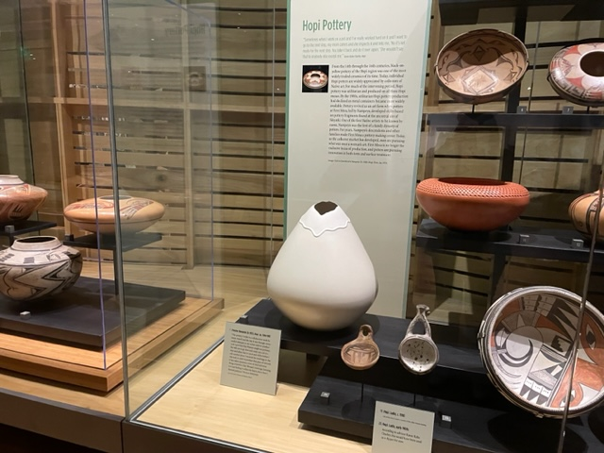
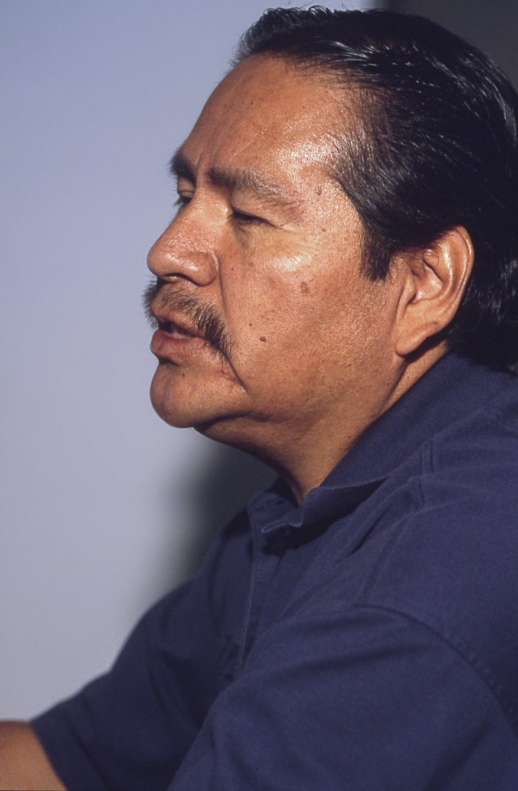
“The pottery I make is a collaborative
work between myself and the clay.
It was through unsuccessful attempts in
my earlier years to produce such a pot that
Clay Woman taught me patience. She
tells me to go slow and create one coil
at a time and allow that to stand and
stiffen before I add another piece.
I received her teachings in that way
and in order to produce that piece of
artwork, it has taken numerous years of
trial and error. Being attuned to Clay
Woman’s teachings, listening to it and
feeling it within the heart, that is how
I learned patience.”
Preston Duwyenie
b. 1951.
Jar, 1984-1987

Slide 28
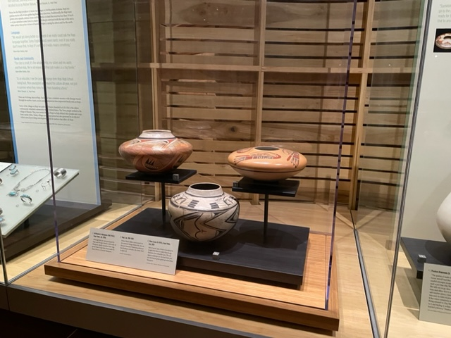
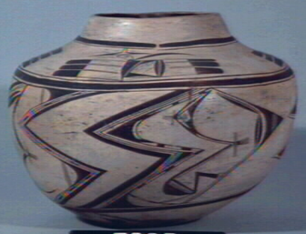
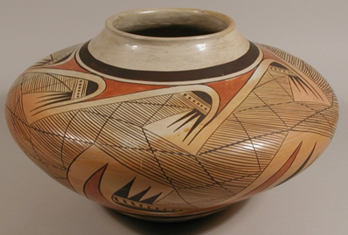
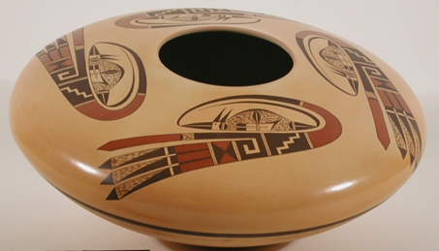
Jar with bird motifs and lightning, 1905-1910, 506P
Jar, 1920s, Probably Daisy Hooee or
Rachel Nampeyo. Original Heard
Collection.
Steve Lucas learned to do the large
diameter low-shoulder jars from his
aunt Dextra Quotskuyva

Slide 29
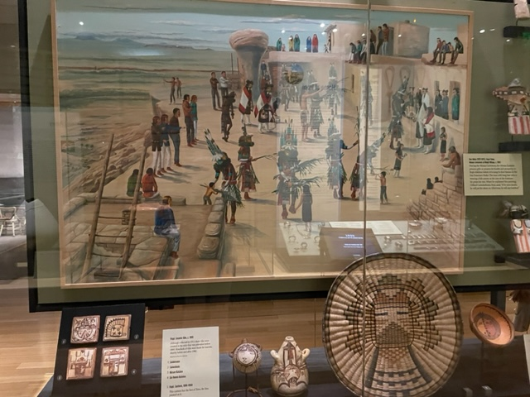
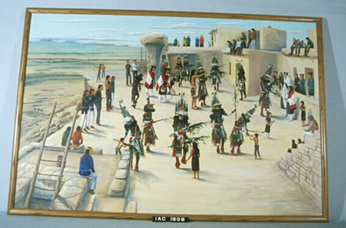
Ray Naha, 1933-1975
Home Dance, c. 1965

Slide 30
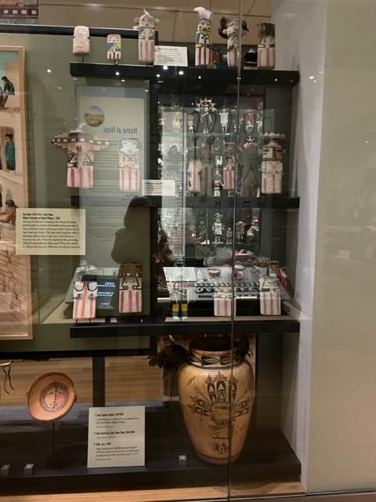
The jar, c. 1900, on the bottom shelf was on a postage stamp with the
side featuring the Pahlikmana, as shown here. The series was Pueblo Art,
Issued April 13, 1977.
It was originally in the William Randolph Hearst collection.

Slide 31
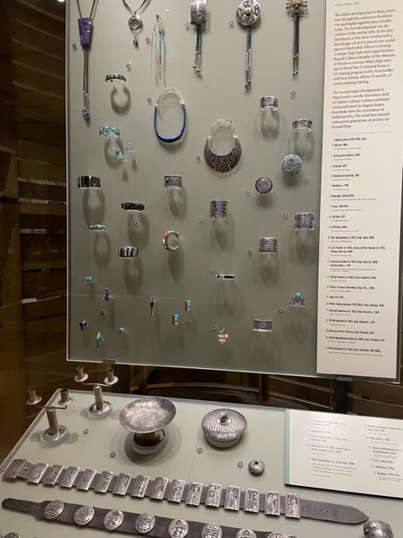
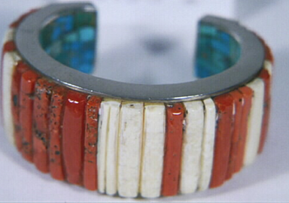
Hopi Jewelry
Refer back to jewelry visitors have seen in the Pueblo section that
focused on lapidary work. The distinctive Hopi style
is overlay where a thin sheet of silver has a design cutout of it and
placed over a solid piece of silver, with the cutout chemically blackened.
Mary-Russell Colton (MNA) was encouraging a distinctive jewelry style
For Hopi and from that overlay was developed. Fred Kabotie and
Paul Saufkie developed classes for G.I.s returning from World War II.
Charles Loloma inaugurated the second big change in Hopi jewelry, using
dramatic design and materials that included precious and semi-precious
stones and ironwood set in both gold and silver. Used stones that no one
but the wearer could see.
“We are all about beauty.”

Slide 32


Slide 33


